Slide 1
A model for large non-standard interactions of neutrinos leading to the LMA-dark solution
Yasaman Farzan
IPM, Tehran

Slide 2
Effects of NSI on neutrinos
Neutral current Non-Standard Interaction (NSI): propagation of neutrinos in matter
Charged current Non-Standard Interaction (NSI): production and detection

Slide 3
Effects of NSI on neutrinos
Neutral current Non-Standard Interaction (NSI): propagation of neutrinos in matter
Charged current Non-Standard Interaction (NSI): production and detection
Focus of this talk

Slide 4
Non-standard neutral current interaction
Projection
matrix
Matter field
Neutrino propagation:

Slide 6
LMA-Dark solution
Miranda, Tortola and Valle, JHEP 2006; Escrihuela et al., PRD 2009

Slide 7
Maltoni and Gonzalez-Garcia, JHEP 2013

Slide 8
LMA-Dark solution
LMA-Dark solution provides even a better fit. (suppression of low energy upturn)

Slide 9
Total flux measurement at SNO
Neutral current
Deuteron dissociation
Gamow-Teller transition
Sensitive only to axial-vector interaction
No effect from

Slide 10
Scattering experiments
NuTeV and CHARM rule out a large part (but not all) of parameter space of LMA-Dark solution.
Davidson, Pena-Garay, Rius, SantaMaria, JHEP 2003

Slide 11
Davidson, Pena-Garay, Rius, SantaMaria, JHEP 2003
NuTeV: Muon neutrino energy~75 GeV

Slide 12
Davidson, Pena-Garay, Rius, SantaMaria, JHEP 2003

Slide 13
Scattering experiments
NuTeV and CHARM rule out a large part (but not all of) parameter space of LMA-Dark solution.
Davidson, Pena-Garay, Rius, SantaMaria, JHEP 2003
But not in the model that we shall present

Slide 14
Determining
Shedding light on LMA-Dark solar neutrino solution by medium baseline reactor experiments: JUNO and RENO-50
YF and Bakhti, JHEP 2014

Slide 15


Medium Baseline reactor experiments
DAYA BAY in CHINA JUNO
RENO in South Korea RENO-50
Ready for data taking in 2020.
Baseline ~ 50 km
Main goal determination of

Slide 16
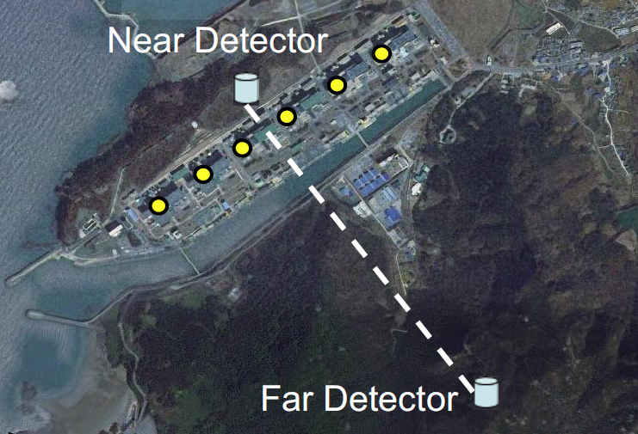
RENO-50 in South Korea

Slide 17
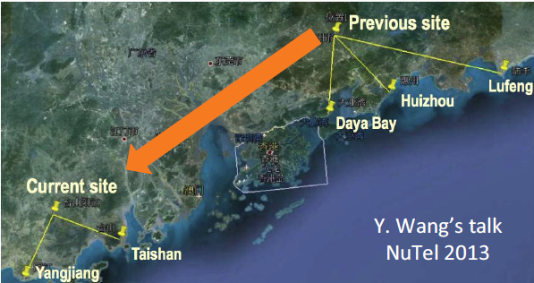
Daya Bay and Juno

Slide 19
Underlying theory for LMA-Dark?

Slide 20
Underlying theory for LMA-Dark?
Various model with heavy intermediate particle
For a review see:

Slide 21
Too small NSI

Slide 22
Suggestion
What if
YF, A model for large non-standard interactions leading to LMA-Dark solution,
Phys. Lett. B748 (2015) 311-315

Slide 23
Suggestion
What if
Bounds can be avoided not because mass of the intermediate state is high
But because coupling is small!

Slide 25
NO coupling to the electron

Slide 27
Why not to couple to electron

Slide 28
LMA-Dark solution

Slide 29
Big Bang Nucleosynthesis
Kamada and Yu, arXiv:1505.00711

Slide 30
Neutrino scattering experiments
Suppression factor

Slide 31
Neutrino scattering experiments
Relaxing bounds from scattering experiments, NuTeV and CHARM

Slide 32
Gauging

Slide 33
Gauging

Slide 36
Yukawa coupling of neutrinos

Slide 37
Yukawa coupling of neutrinos
Basis change:
Mix:
No mixing:

Slide 38
Majorana masses
If there is no Majorana mass for right-handed neutrinos:
1)
2) Smallness of neutrino mass

Slide 39
Majorana masses

Slide 40
Quark mixing
Mixing between first and second generations
No mixing between third generation and the rest

Slide 41
Flavor violation

Slide 42
Small VEV

Slide 43
Small VEV

Slide 44
Small VEV

Slide 45
Mass of new gauge boson

Slide 46
Observational consequences

Slide 47
Emission in Supernova
Similar to
Reduced mean free path for
Kamada and Yu, arXiv:1504.00711

Slide 48
High energy cosmic neutrino
Kamada and Yu, arXiv:1504.00711
Background neutrino at rest

Slide 49
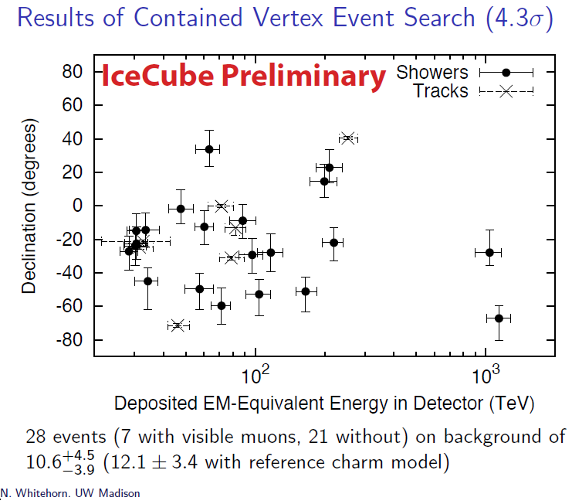
Dip or gap in ICECUBE spectrum

Slide 50
Theoretical prediction of dip in 400 TeV to PeV is robust!
Testing model

Slide 51
Proposal
Gninenko, Krasnikov and Matveev PRD 91 (2015)

Slide 52
Gninenko, Krasnikov
And Matveev, PRD 91 (2015)

Slide 53
Meson decay
Lessa and Peres, PRD 75 (2007)

Slide 54
Meson decay
Lessa and Peres, PRD 75 (2007)

Slide 55
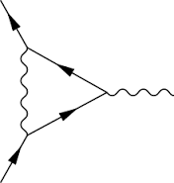
Muon magnetic dipole moment

Slide 56
Neutrino trident scattering
CCFR collaboration:
CHARM II collaboration
PRL66 (1991)
PLB 245 (1990)

Slide 57
Neutrino trident scattering
Altmannshofer et al., PRL113 (2014)

Slide 58
Summary
A via model for NSI required for LMA-Dark solution
Rich phenomenology: Prospect of testing via
SN neutrino
Dip below PeV in the spectrum of cosmic neutrinos
150 GeV muon beam from SPS CERN

Slide 59
Backup slides

Slide 60
Maltoni and Gonzalez-Garcia, JHEP 2013

Slide 61
Gauging

Slide 62
Flavor physics in quark sector
Diagonal in flavor basis
Non universal
Universal coupling of first and second generations
Avoiding large contribution to
Mixing in mass basis

Slide 63
Quark mixing
Mixing between first and second generations
No mixing between third generation and the rest

Slide 64
Flavor physics in quark sector
Diagonal in flavor basis
Non universal
Universal coupling of first and second generations
Avoiding large contribution to
Mixing in mass basis

Slide 65
Crivellini, D’Amrosio and Heeck, PRD 91 (2015) 075006
Global fit

Slide 66
Kamada and Yu, 1504.00711

