Slide 1
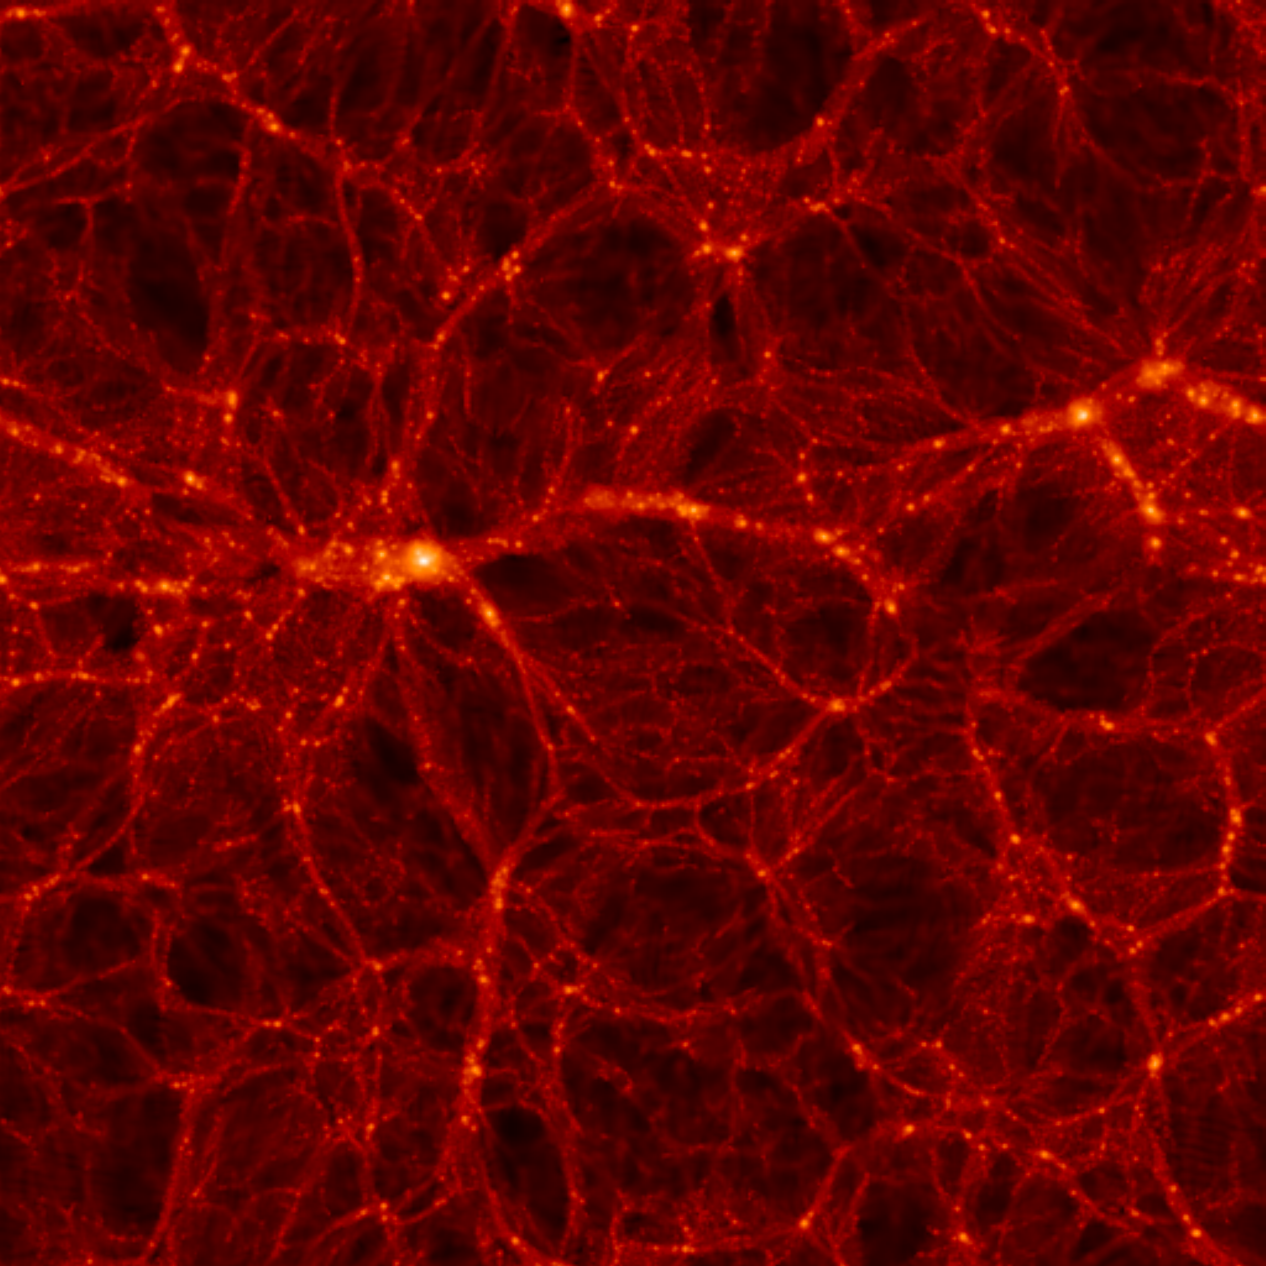
NEUTRINOS IN THE ERA OF
PRECISION COSMOLOGY
$$ν_{e}$$
$$ν_{μ}$$
$$ν_{S}$$
$$ν_{τ}$$
STEEN HANNESTAD, AARHUS UNIVERSITY
MAINZ, 21 JULY 2015

Slide 2
What do we know about neutrinos?
They are light (but not massless) fermions - $m_{ν}≤eV$
The carry no electric or strong charge
They do carry weak charge
3 known charged current eigenstates: $ν_{e}, ν_{μ}, ν_{τ}$
Must correspond to three eigenstates of energy and
momentum: $ν_{1},ν_{2},ν_{3}$
Charged current eigenstates and energy/momentum
eigenstates are NOT identical
Provided that $m\left(ν_{1}\right), m\left(ν_{2}\right), m\left(ν_{3}\right)$are not identical this
leads to neutrino oscillations

Slide 3
NEUTRINO MIXING IN THE STANDARD PICTURE
FLAVOUR STATES
PROPAGATION STATES
$\left(\begin{matrix}ν_{e} \\ ν_{μ} \\ ν_{τ}\end{matrix}\right)=U$ $\left(\begin{matrix}ν_{1} \\ ν_{2} \\ ν_{3}\end{matrix}\right)$
U$=\left(\begin{matrix}1 & 0 & 0 \\ 0 & c_{23} & s_{23} \\ 0 & −s_{23} & c_{23}\end{matrix}\right)\left(\begin{matrix}c_{13} & 0 & {e^{−iδ}s}_{13} \\ 0 & 1 & 0 \\ {{−e}^{iδ}s}_{13} & 0 & c_{13}\end{matrix}\right)\left(\begin{matrix}c_{12} & s_{12} & 0 \\ −s_{12} & c_{12} & 0 \\ 0 & 0 & 1\end{matrix}\right)\left(\begin{matrix}1 & 0 & 0 \\ 0 & e^{i\frac{α_{1}}{2}} & 0 \\ 0 & 0 & e^{i\frac{α_{2}}{2}}\end{matrix}\right)$
Atmospheric
Long Baseline
Solar
Reactor
Only relevant
for 0ν2β decay
Reactor
$c_{23}=cos θ_{23}$ etc., $θ_{12},θ_{13},θ_{23}$ are the Euler angles of 3D rotation
$δ$ is the Dirac CP phase
$α_{1},α_{2}$ are Majorana phases (relevant only if neutrinos are Majorana particles)

Slide 4
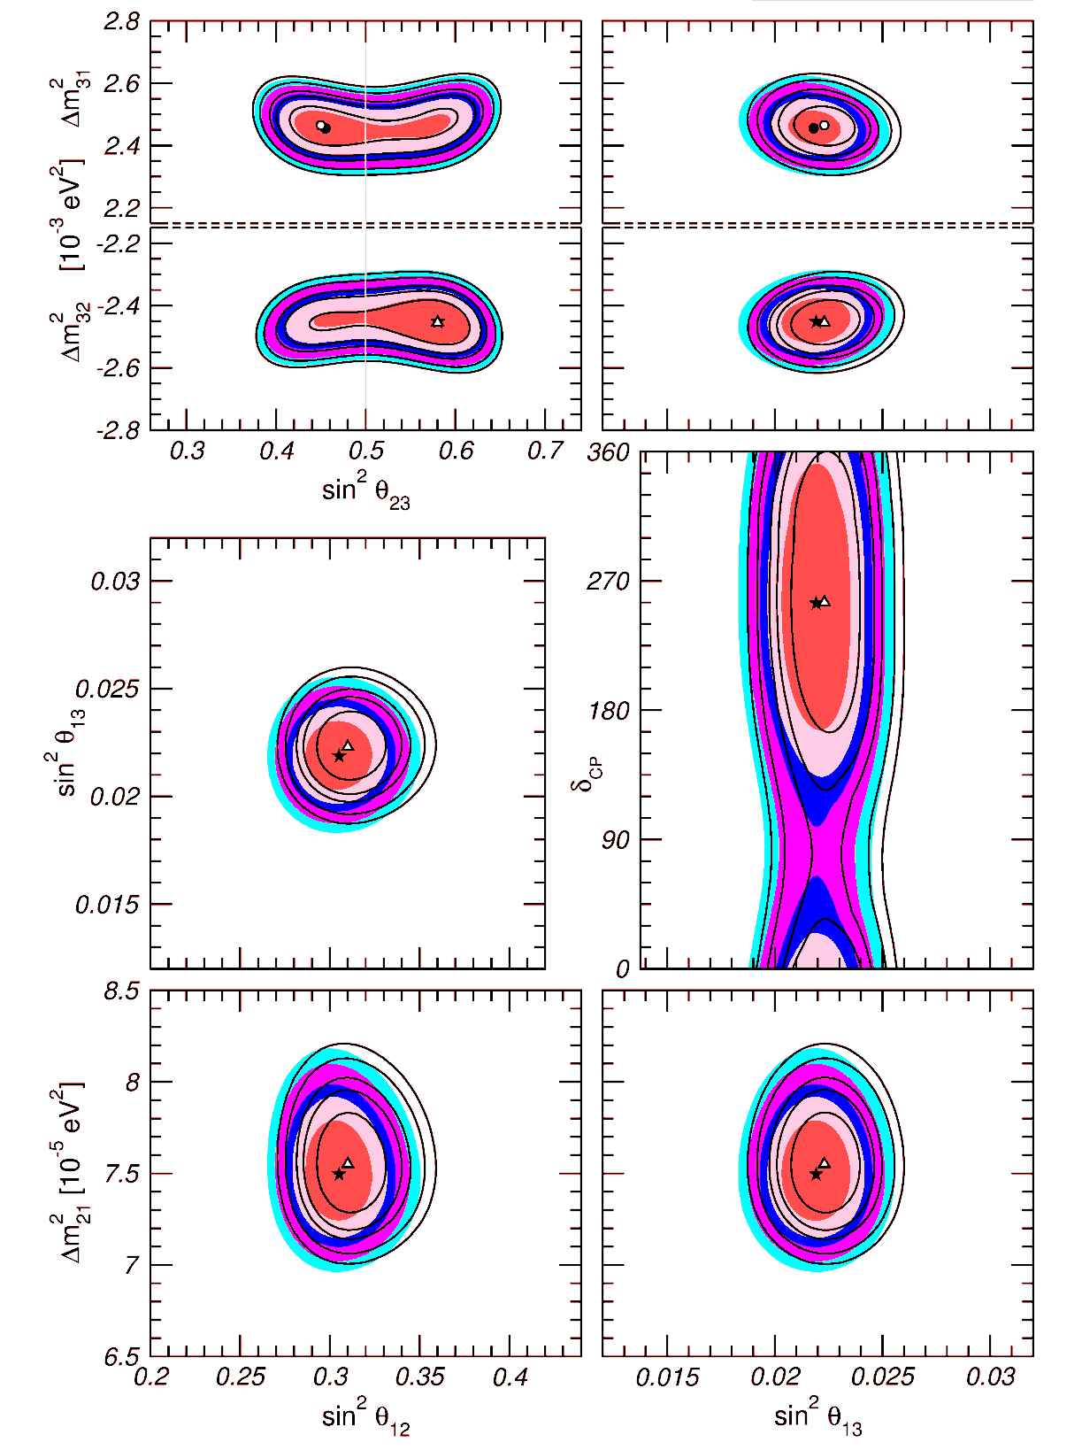
Status of 3-neutrino oscillations
Gonzalez-Garcia, Maltoni, Schwetz
1409.5439

Slide 5
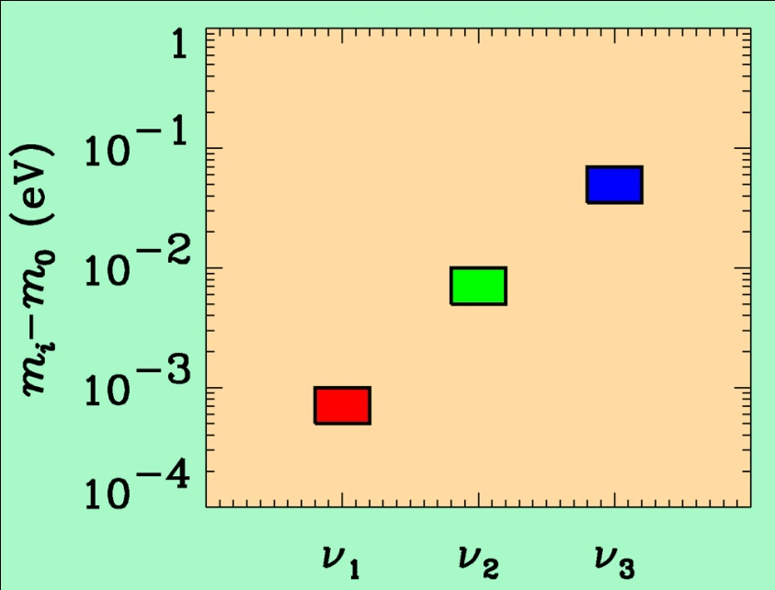
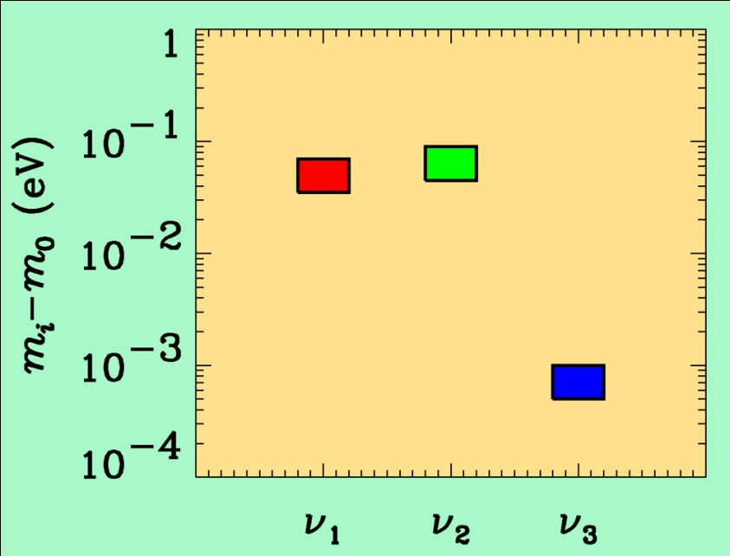
If neutrino masses are hierarchical then oscillation experiments
do not give information on the absolute value of neutrino masses
ATMO. ν
K2K
LBL
SOLAR ν
KAMLAND
Normal hierarchy
Inverted hierarchy
However, if neutrino masses are degenerate
no information can be gained from such experiments.
Experiments which rely on either the kinematics of neutrino mass
or the spin-flip in neutrinoless double beta decay are the most
efficient for measuring m₀

Slide 6
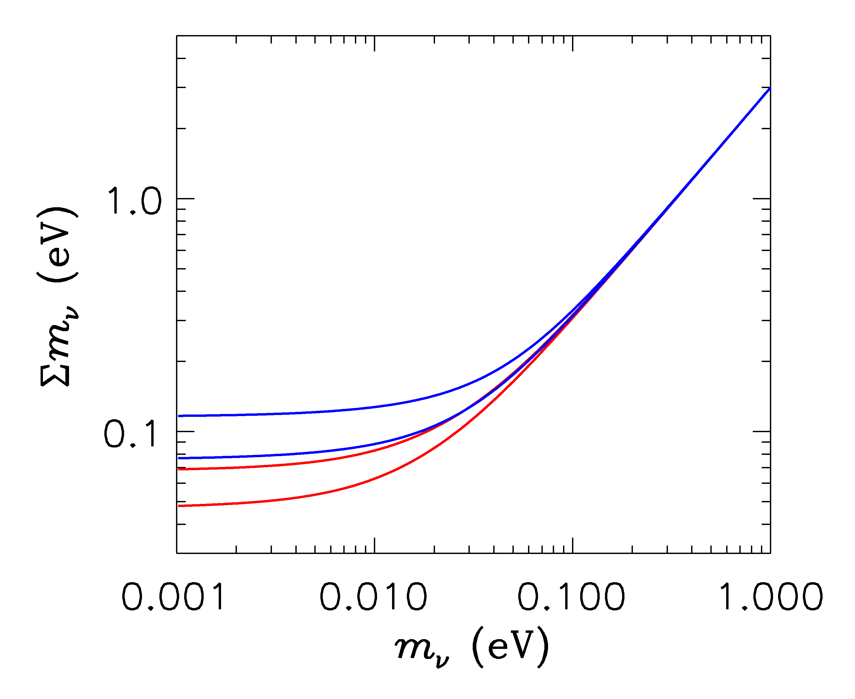
HIERARCHICAL
DEGENERATE
INVERTED
NORMAL
LIGHTEST

Slide 7
ß-decay and neutrino mass
Model independent neutrino mass from ß-decay kinematics
Only assumption: relativistic energy-momentum relation
experimental observable is m_{ν}²
T₂:
E₀ = 18.6 keV
T_{1/2} = 12.3 y

Slide 8
Tritium decay endpoint measurements have provided limits
on the electron neutrino mass
Mainz experiment, final analysis (Kraus et al.)
This translates into a limit on the sum of the three mass
eigenstates

Slide 9
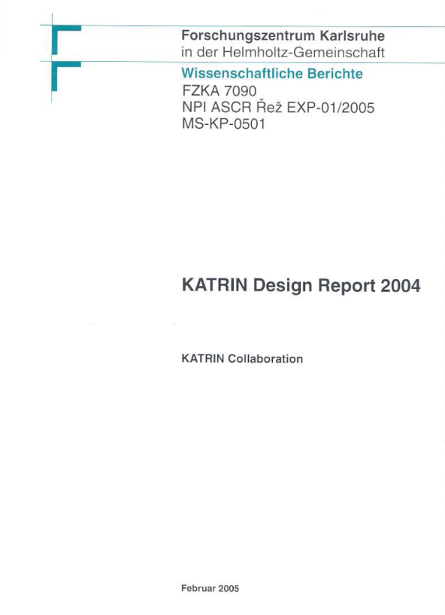
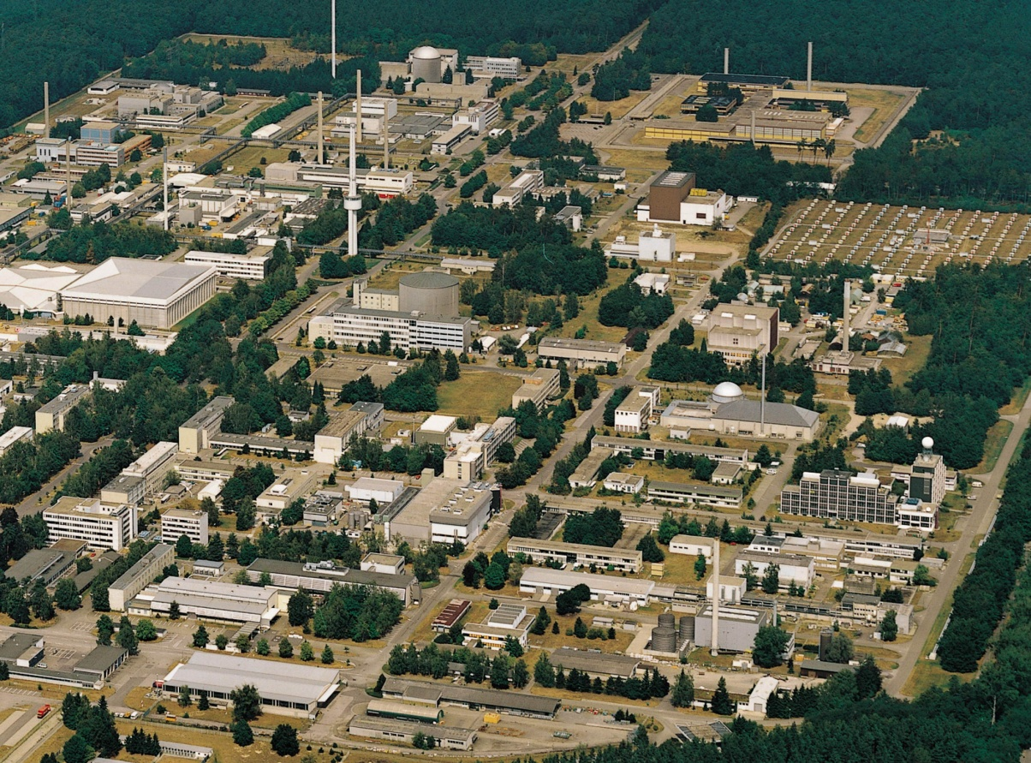
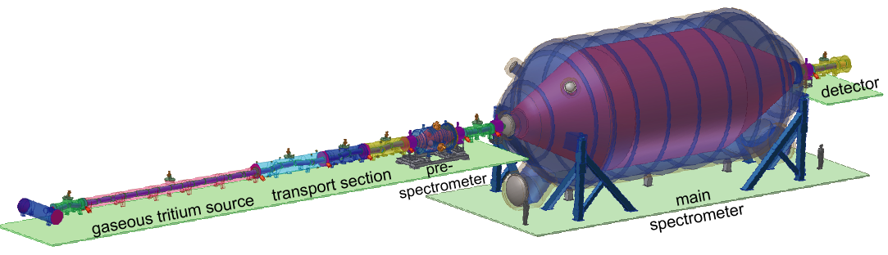
KATRIN experiment
Karlsruhe Tritium Neutrino
Experiment
TLK
25 m

Slide 10
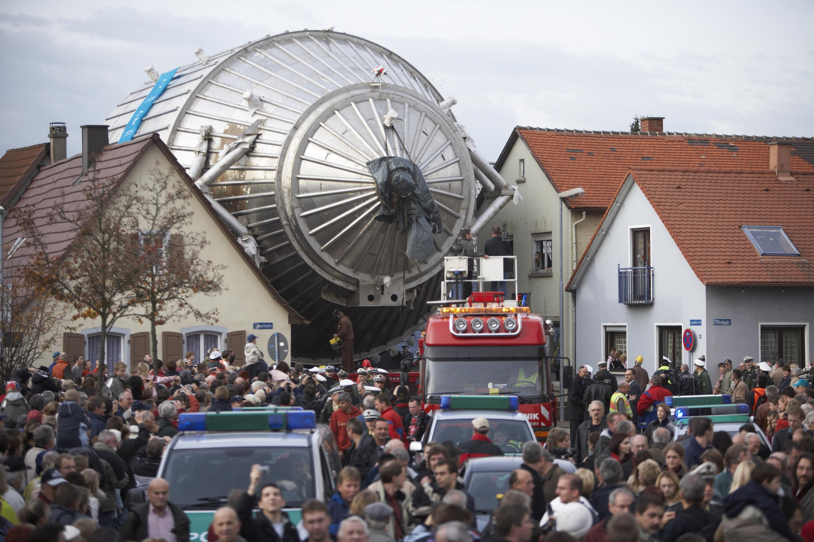

Slide 11
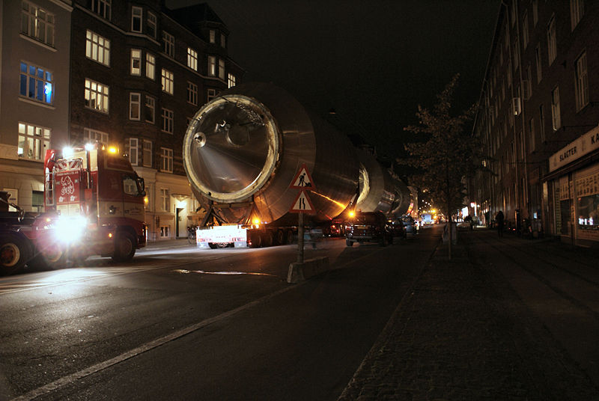
A DANISH VERSION OF KATRIN???
THE CARLSBERG NEUTRINO MASS EXPERIMENT

Slide 12
NEUTRINO MASS AND ENERGY DENSITY
FROM COSMOLOGY
NEUTRINOS AFFECT STRUCTURE FORMATION
BECAUSE THEY ARE A SOURCE OF DARK MATTER
(n ~ 100 cm⁻³)
FROM
HOWEVER, eV NEUTRINOS ARE DIFFERENT FROM CDM
BECAUSE THEY FREE STREAM
SCALES SMALLER THAN d_{FS} DAMPED AWAY, LEADS TO
SUPPRESSION OF POWER ON SMALL SCALES

Slide 13
N-BODY SIMULATIONS OF ΛCDM WITH AND WITHOUT
NEUTRINO MASS (768 Mpc³) – GADGET 2
256
Mpc
T Haugboelle, Aarhus University

Slide 14
AVAILABLE COSMOLOGICAL DATA

Slide 15
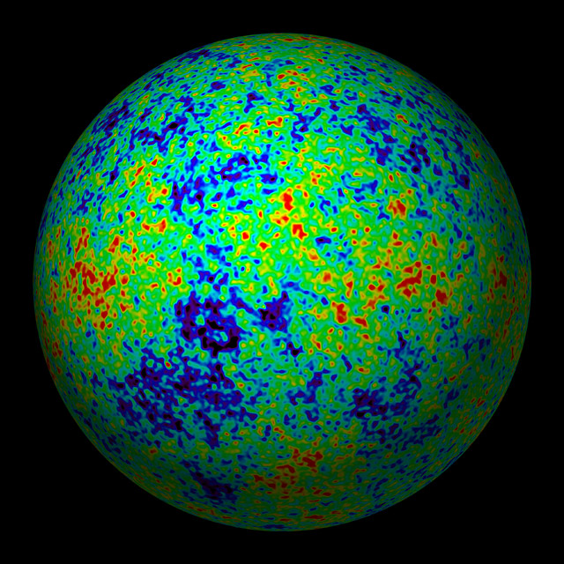
THE COSMIC MICROWAVE BACKGROUND
CMB TEMPERATURE AND POLARISATION

Slide 16
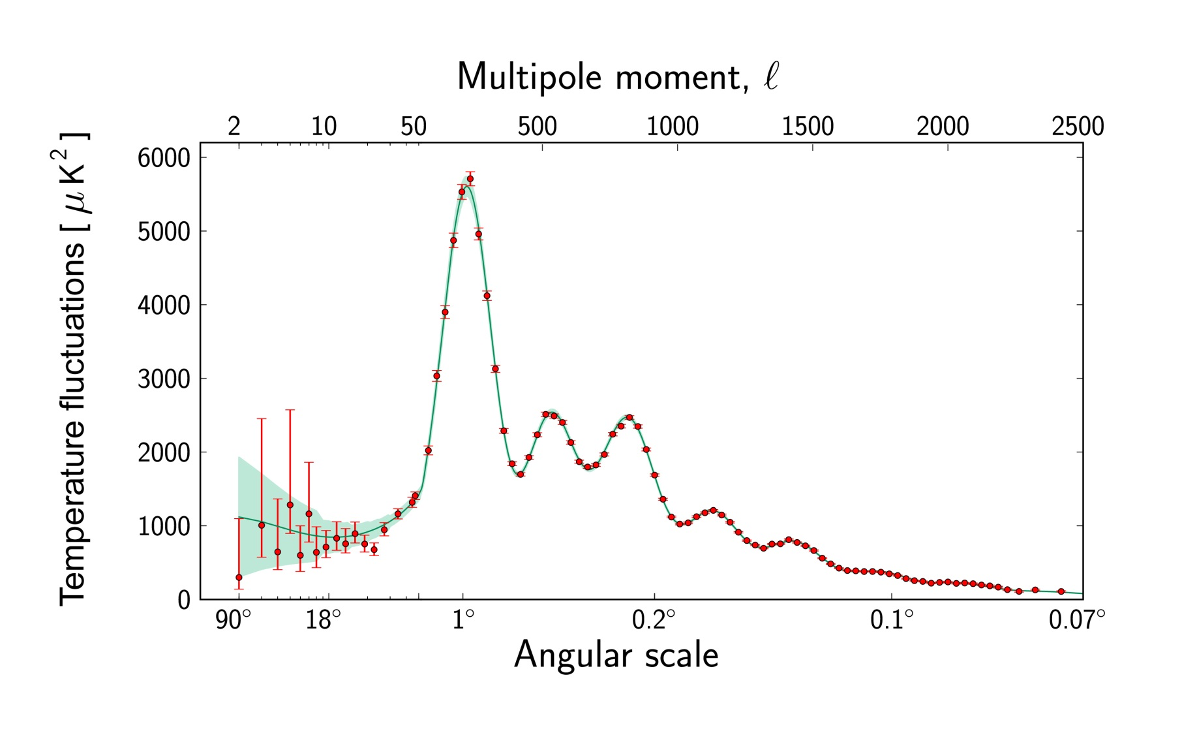
Ade et al. 2015 (Planck)

Slide 17
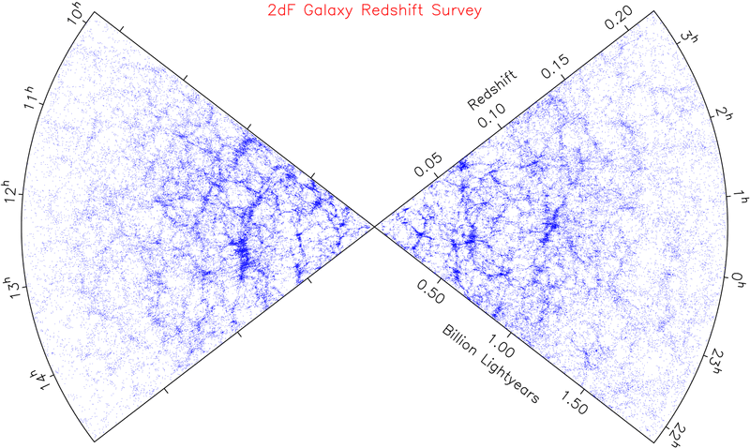
LARGE SCALE STRUCTURE SURVEYS

Slide 18
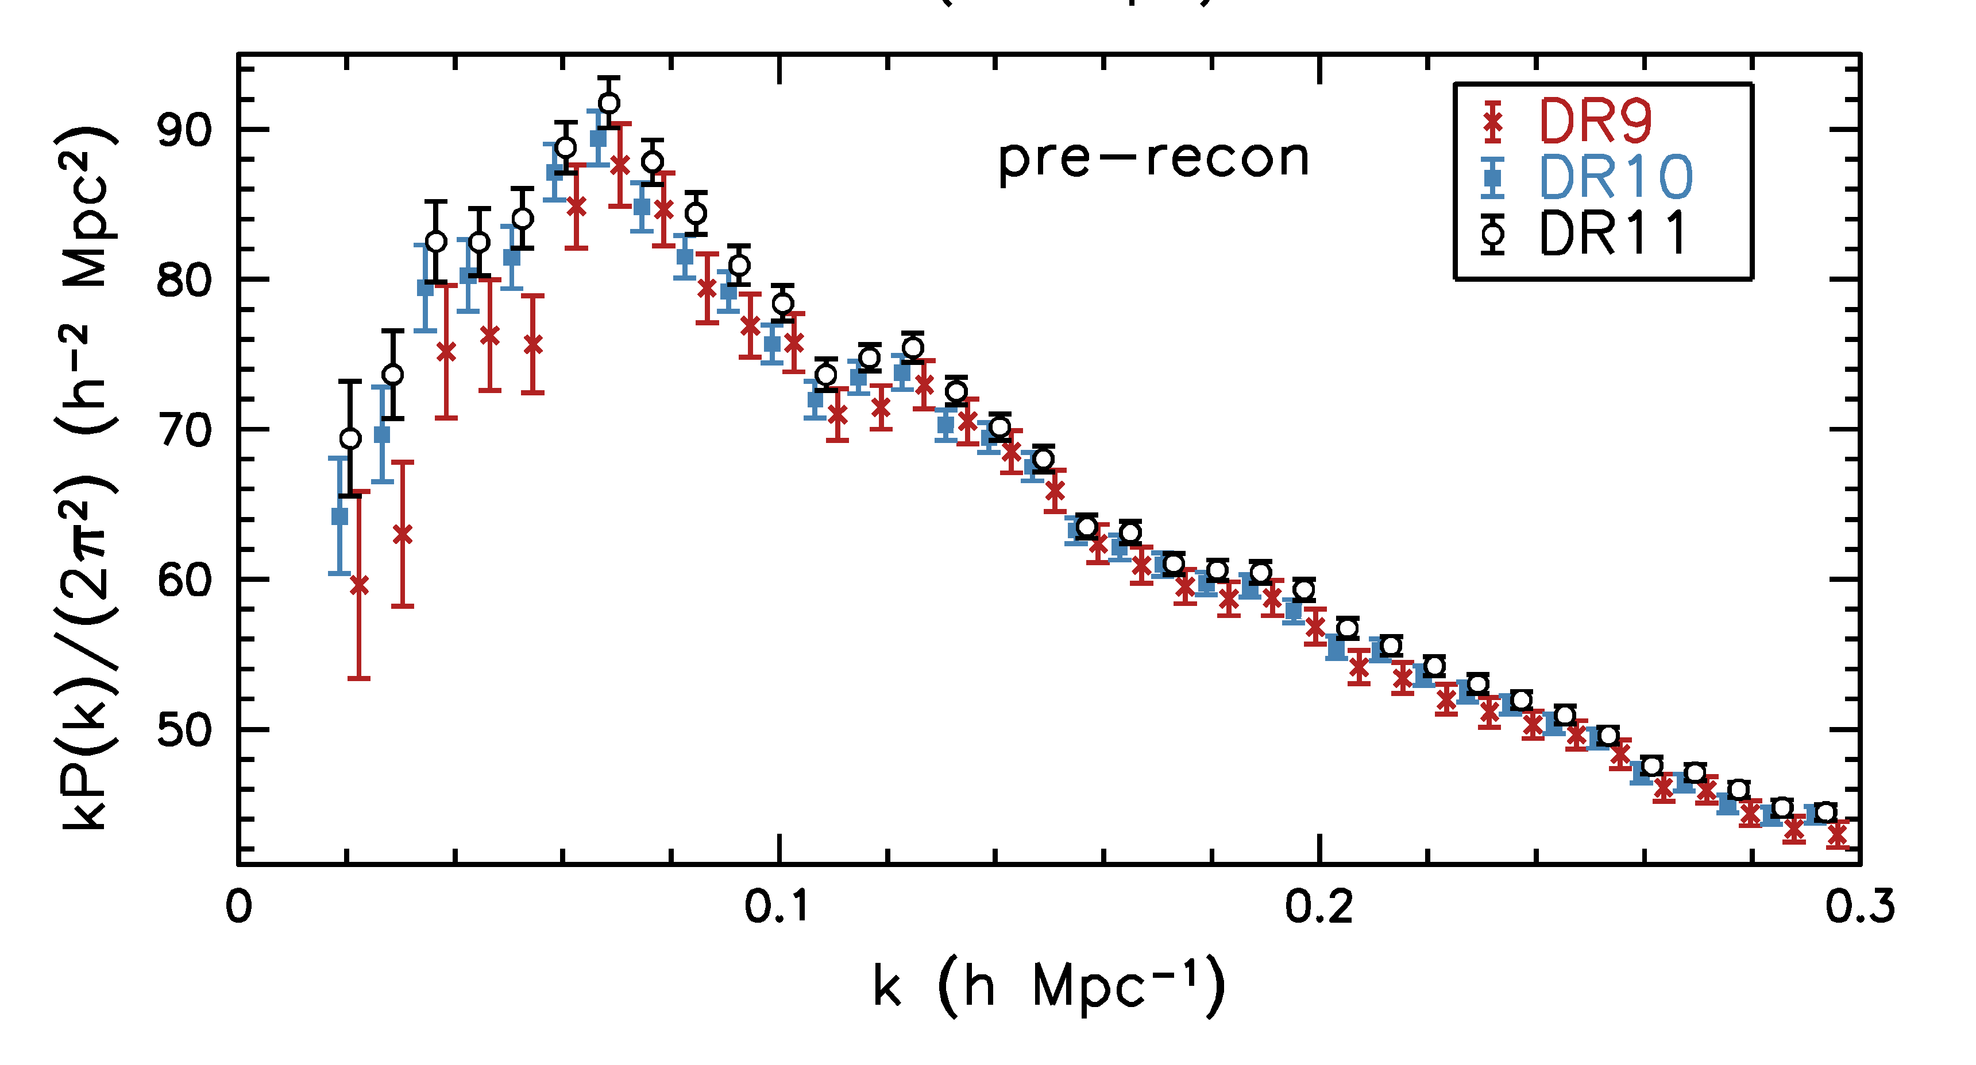
Anderson et al. 1312.4877 (SDSS)

Slide 19
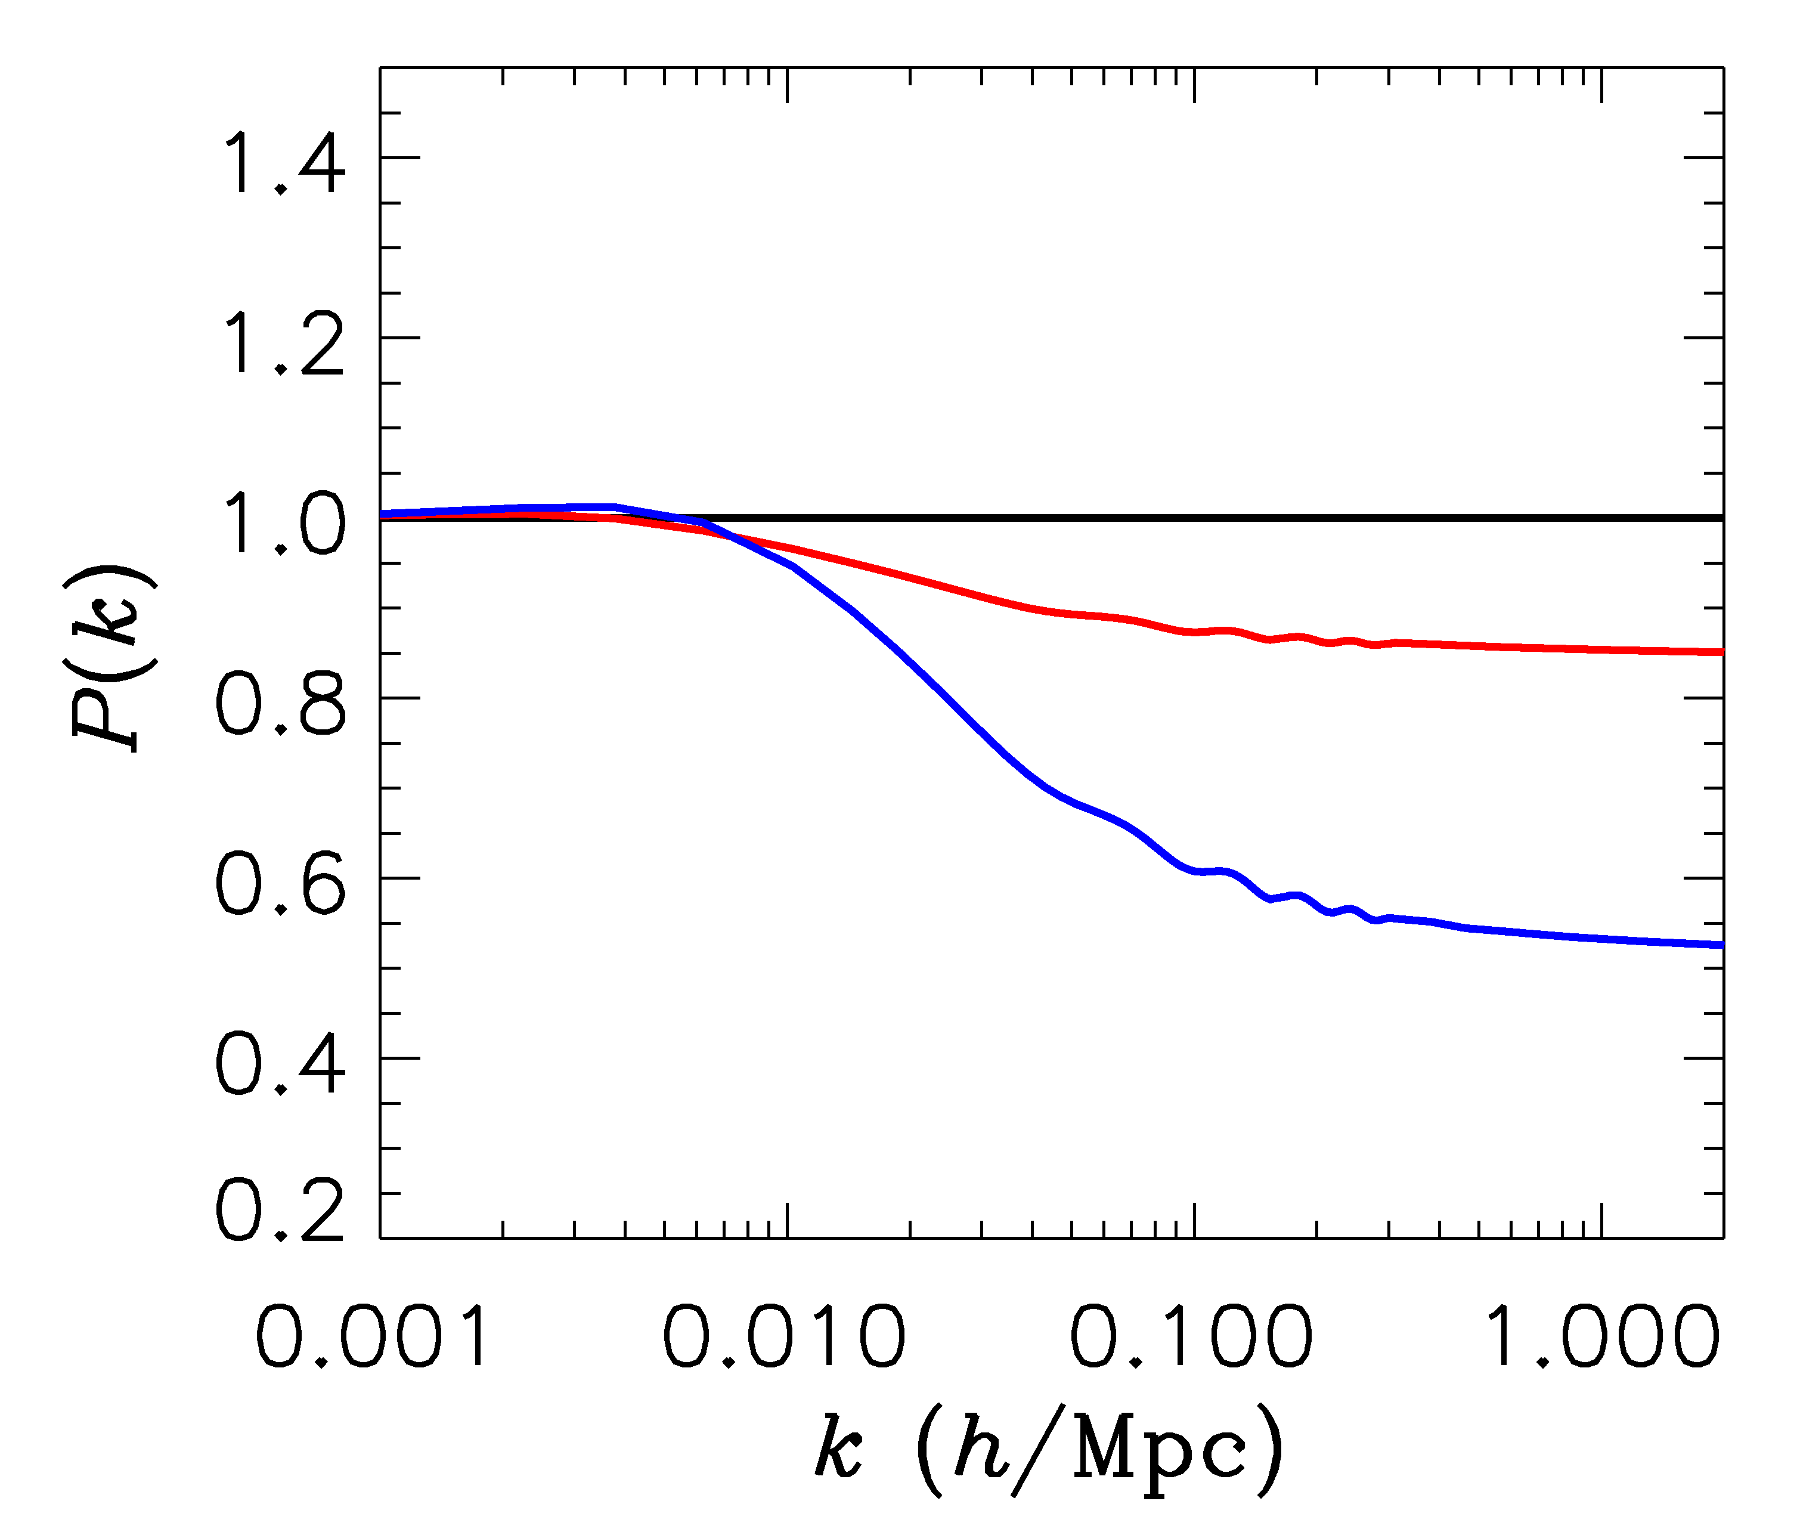
FINITE NEUTRINO MASSES SUPPRESS THE MATTER POWER
SPECTRUM ON SCALES SMALLER THAN THE FREE-STREAMING
LENGTH
Sm = 0 eV
P(k)/P(k,m_{ν}=0)
Sm = 0.3 eV
Sm = 1 eV

Slide 20
NOW, WHAT ABOUT NEUTRINO
PHYSICS?

Slide 21
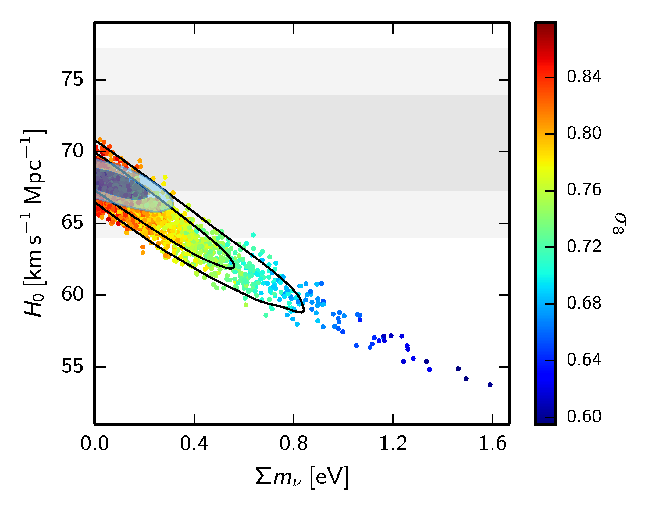
WHAT IS THE PRESENT BOUND ON THE NEUTRINO MASS?
DEPENDS ON DATA SETS USED AND ALLOWED PARAMETERS
THERE ARE MANY ANALYSES IN THE LITERATURE
ADE ET AL.
ARXIV:1502.01589

Slide 22
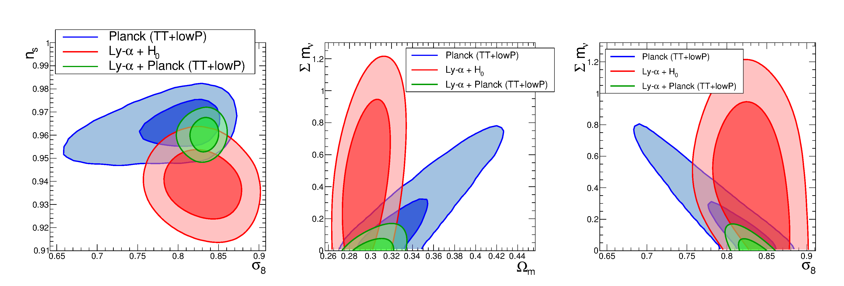
THE STRONGEST BOUND IS CURRENTLY $∑m_{ν}<0.12$ eV BUT
THIS IS DERIVED FROM THE COMBINATION OF CMB AND
LYMAN-$α$ DATA AND PERHAPS NOT VERY ROBUST
Palanque-Delabrouille et al. 1506.05976

Slide 23
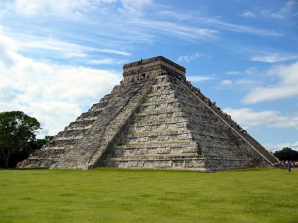
THE NEUTRINO MASS FROM COSMOLOGY PLOT
More data
+Ly-alpha
~ 0.1 eV
0.2-0.3 eV
0.2-0.3 eV
+ SNI-a
+WL
~ 0.15 eV
~0.5 eV
0.5-0.6 eV
+ SDSS
~0.15 eV
~ 0.5 eV
~0.5 eV
CMB only
0.7 eV
~ 1 eV
1.? eV
??? eV
Minimal
ΛCDM
+N_{ν}
+w+……
Larger model
space

Slide 24
HOW CAN THE BOUND BE AVOIDED?
CHANGE THE PRIMORDIAL SPECTRUM?
NOT MUCH
TOPOLOGICAL DEFECTS?
NOT MUCH
MAKE THE NEUTRINOS STRONGLY INTERACTING
PERHAPS (MORE TO COME)
MODIFIED GRAVITY / DARK ENERGY
YES
……

Slide 25
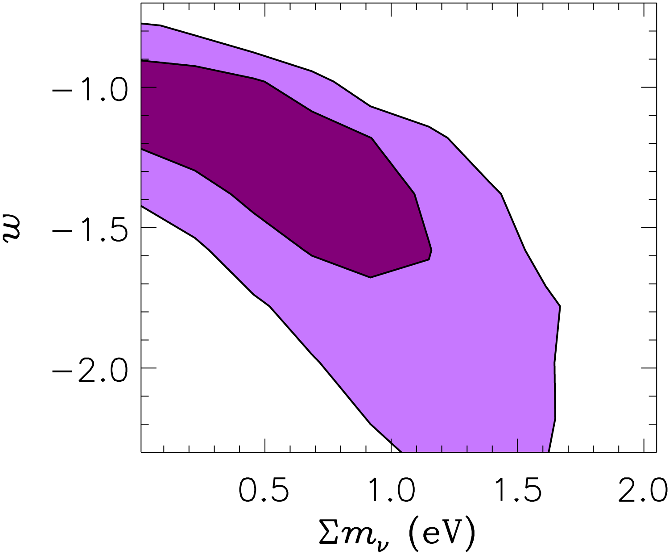
EXAMPLE:
THERE IS A VERY STRONG DEGENERACY BETWEEN NEUTRINO
MASS AND THE DARK ENERGY EQUATION OF STATE
THIS SIGNIFICANTLY RELAXES THE COSMOLOGICAL BOUND ON
NEUTRINO MASS
STH 05

Slide 26
GOING BEYOND THE MASS
$$Ω=\frac{ρ}{ρ_{c}}=∑m_{ν,i}n_{ν,i}$$
$$n_{ν}=\frac{3}{4}{\left(\frac{T_{ν}}{T_{γ}}\right)}^{3}n_{γ}$$
Normally $T_{ν}={\left(\frac{4}{11}\right)}^{1/3} T_{γ}$ , but could be different. Normally the relativistic
energy density in neutrinos is quantified through the relation
$$ρ_{ν0}=\frac{7}{8}{\left(\frac{T_{ν}}{T_{γ}}\right)}^{4}ρ_{γ}$$
$$N_{eff}=\frac{ρ_{ν,rel}}{ρ_{ν0}}$$
$N_{eff}$ is a measure of any type of ”dark radiation”

Slide 27
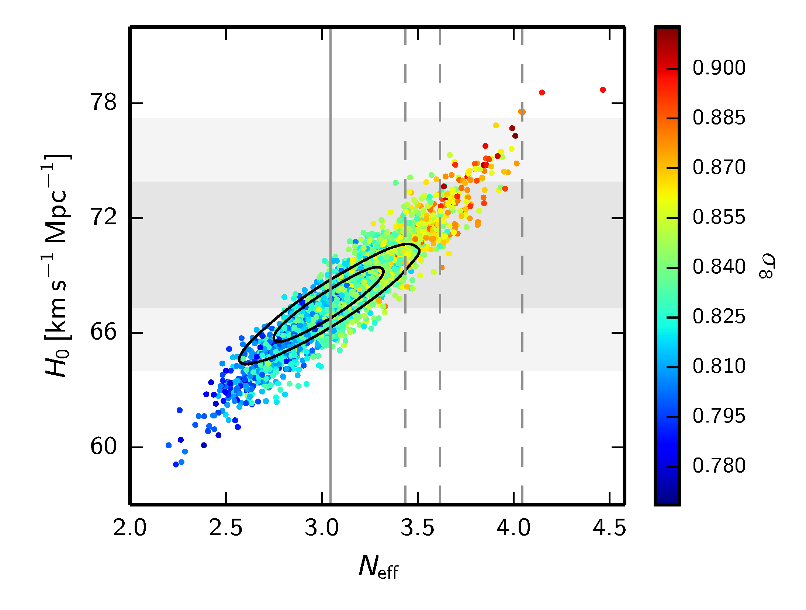
THE CONCLUSION SEEMS TO BE THAT THERE IS NO EVIDENCE
FOR ANY PHYSICS BEYOND THE STANDARD MODEL
BUT BE AWARE THAT IN EXTENDED MODELS THIS CAN BE
VERY DIFFERENT!

Slide 28
Cosmology shows no evidence for non-standard physics in the neutrino sector. However, cosmology might have to accomodate it after all.
A variety of different terrestrial experiments show hints of the presence of a 4th neutrino mass state (possibly even a 5th), most likely with a mass around 1 eV

Slide 29
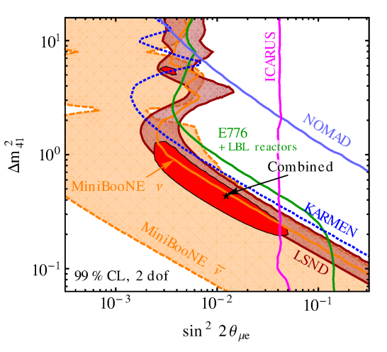
$ν_{e}$ APPEARANCE
Kopp, Machado, Maltoni & Schwetz, 1303.3011
(see also e.g. Gariazzo, Giunti & Laveder, 1309.3192)

Slide 30
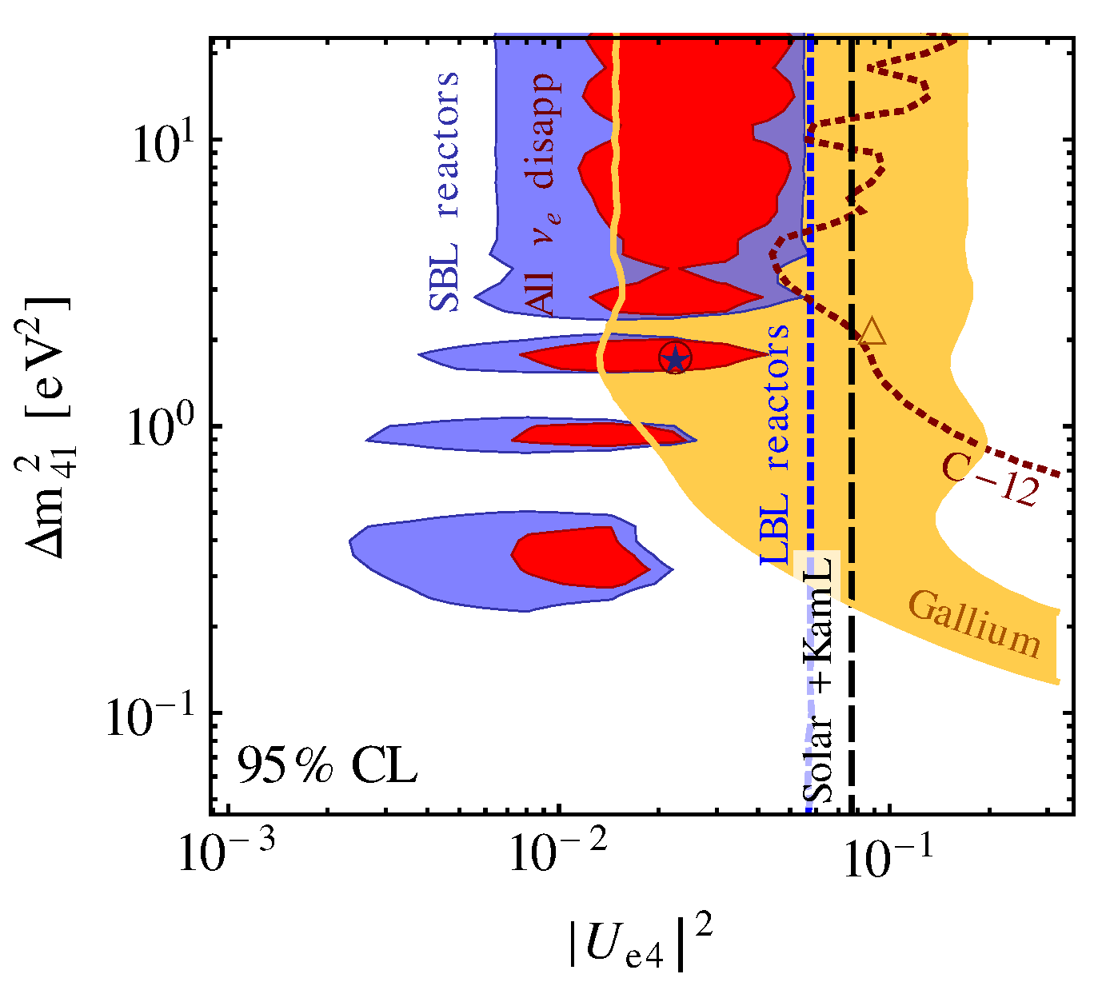
$ν_{e}$ DISAPPEARANCE
Kopp, Machado, Maltoni & Schwetz, 1303.3011

Slide 31
An additional neutrino with such a mass and mixing should be fully thermalised in the early Universe and act completely like a standard model neutrino of equal mass.
This, however, is excluded by data roughly at 5.5σ

Slide 32
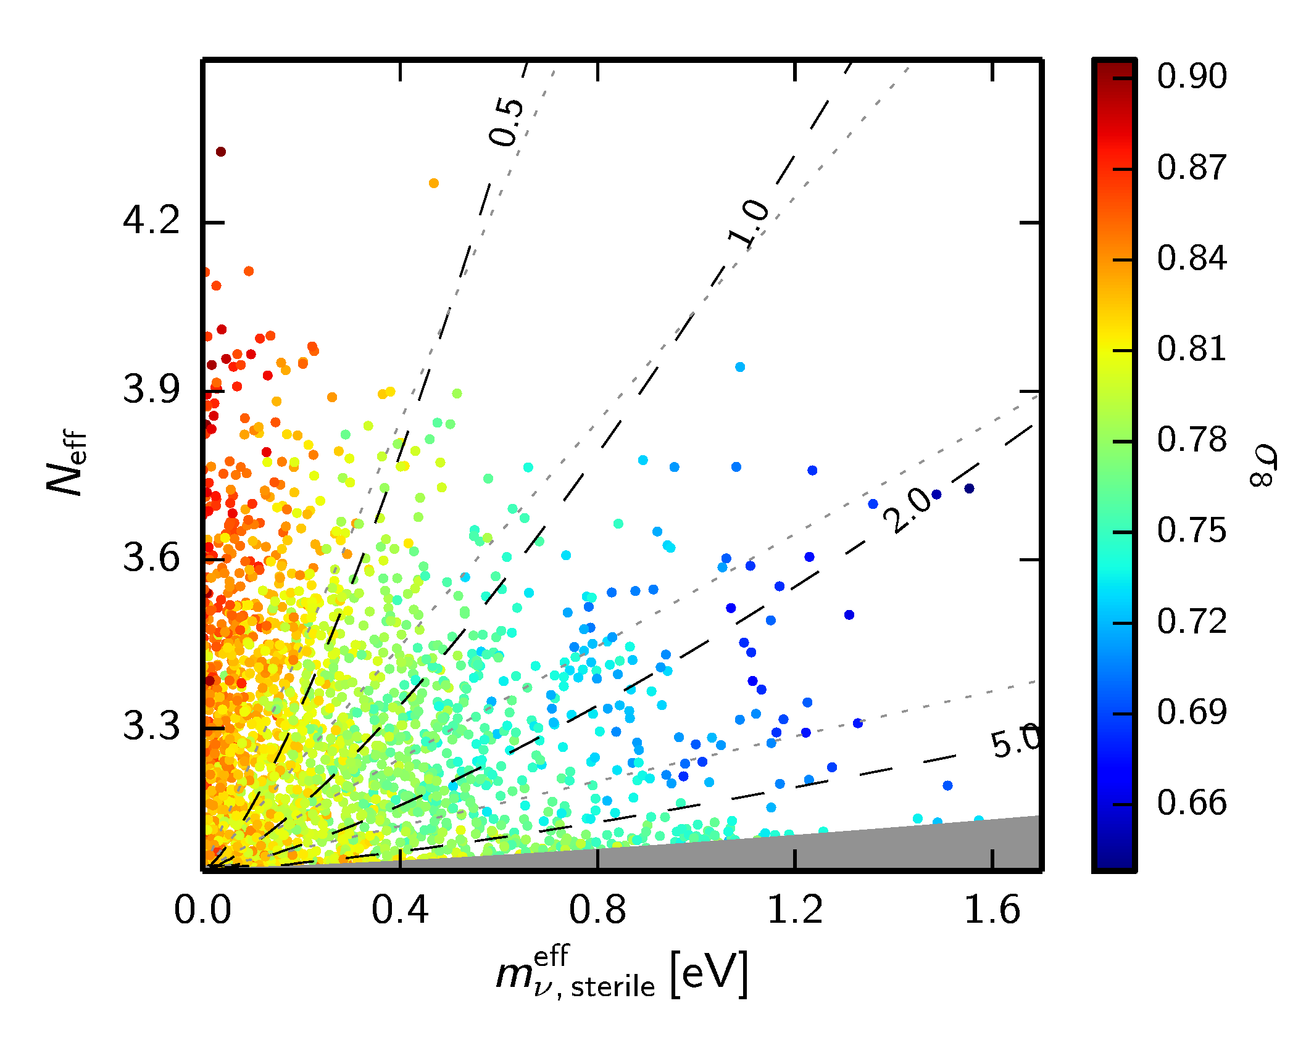
$$N_{eff}= \frac{ρ_{s}+ρ_{a}}{ρ_{ν,0}}$$
ADE ET AL. 2015 (Planck)

Slide 33
Bottom line: Sterile neutrinos in the
mass range preferred by SBL data
can be accomodated by cosmology,
but ONLY if they are not fully
thermalised

Slide 34
Sterile neutrinos are thermalised via a combination of oscillation and scattering
(Barbieri & Dolgov 91; Enqvist, Kainulainen & Maalampi 91, Raffelt & Sigl 93, McKellar & Thomson 94)
The neutrino matter potential is important and a very large potential could in principle prevent thermalisation
How can this be achieved?
A large neutrino lepton asymmetry
(see e.g. STH, Tamborra, Tram 1204.5861, Saviano et al. arXiv:1302.1200)
New, non-standard interactions in the sterile sector
(e.g. STH, Hansen, Tram, 1310.5926, Dasgupta & Kopp 1310.6337, Bringmann, Hasenkamp & Kersten 1312.4947, Archidiacono, STH, Hansen, Tram 1404.5915
Chu, Dasgupta & Kopp 1505.02795)

Slide 35
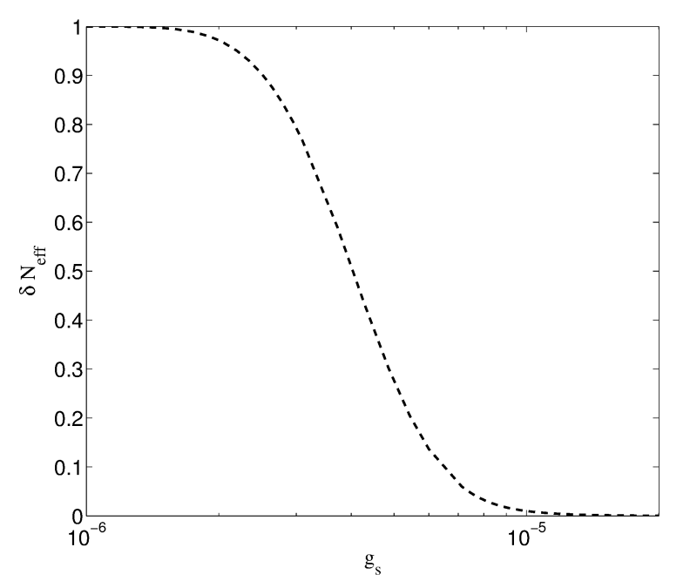
Sterile neutrinos can couple to a light or massless pseudoscalar.
In that case a background potential appears even in a CP-symmetric medium and suppressing oscillations requires only a very weak coupling.
Archidiacono,
STH, Hansen, Tram
(arXiv:1404.5915)

Slide 36
This model provides a solution to the mass problem
If the mediator is massless the sterile couples strongly at low temperatures
As soon as it goes non-relativistic it annihilates and leads to what is known
as the ”neutrinoless universe”
(Beacom, Bell & Dodelson 2004)
Very different low energy phenomenology: The combined sterile/pseudoscalar fluid is strongly self-interacting and has no anisotropic stress (STH 2004)
The model with a strongly interacting, new mass state in the eV range actually provides a better fit to all cosmological data than $Λ$CDM and favours a Hubble parameter compatible with local measurements
(Archidiacono, STH, Hansen, Tram, arXiv:1404.5915)
This conclusion is unchanged with Planck2015 data (Archidiacono, STH, Hansen, Tram – to appear later this week)

Slide 37
TIMELINE WITH A MASSLESS MEDIATOR
$T≫1$TeV: Neutrinos and phi equilibrated (not necessary)
Entropy production $T_{ν}≫T_{s},T_{ϕ}$
$T∼1−10$ MeV: Sterile production from via oscillations plus scatterings
$T<1$ MeV: Equilibration of steriles with actives via oscillations
$T>1{ eV: ν}_{s}$ and $φ$ come into chemical equilbrium and behave as a single
fluid
$T∼1{ eV: ν}_{s}$ annihilates into $φ$

Slide 38
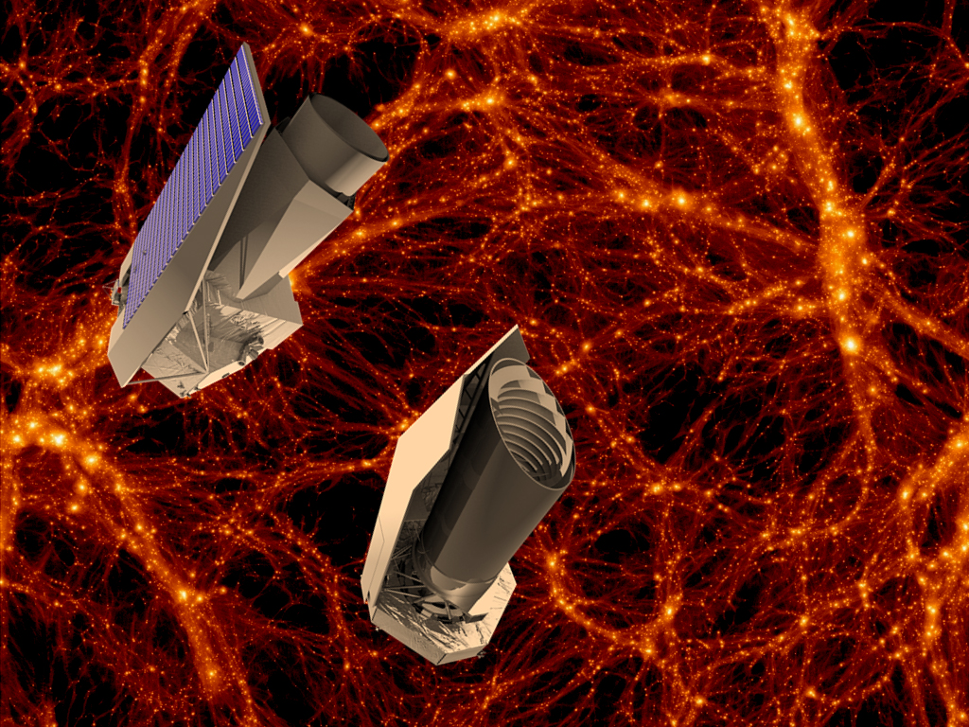
The future: Disentangling
neutrinos and dark energy

Slide 39
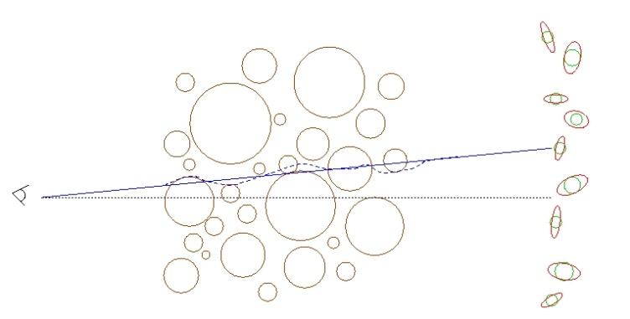
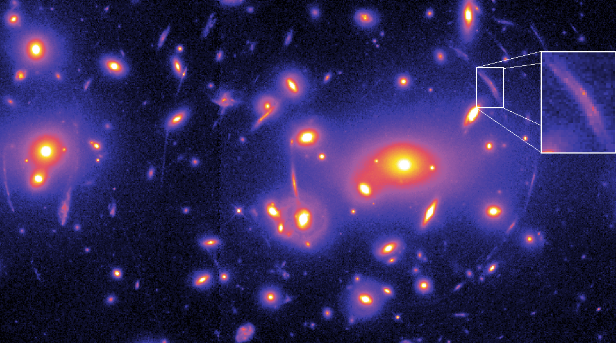
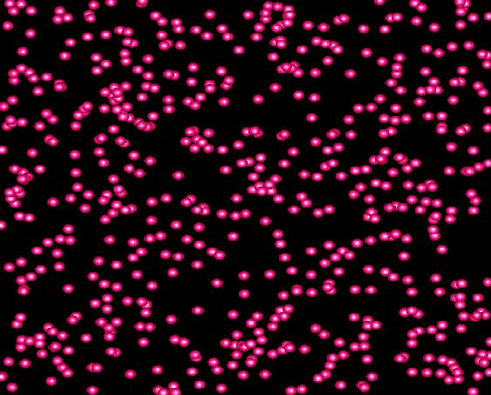
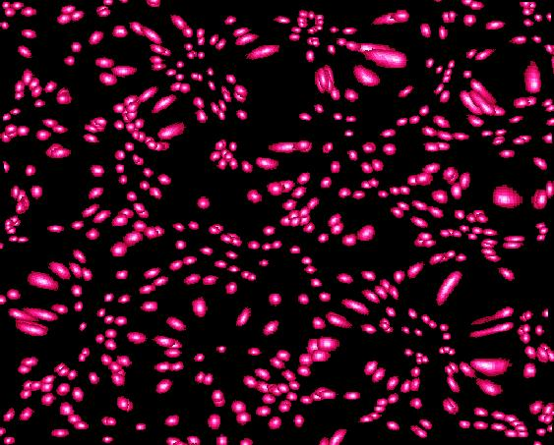
WEAK LENSING – A POWERFUL PROBE FOR THE FUTURE
Distortion of background images by foreground matter
Unlensed Lensed

Slide 40
FROM A WEAK LENSING SURVEY THE ANGULAR POWER SPECTRUM
CAN BE CONSTRUCTED, JUST LIKE IN THE CASE OF CMB
MATTER POWER SPECTRUM (NON-LINEAR)
WEIGHT FUNCTION
DESCRIBING LENSING
PROBABILITY
(SEE FOR INSTANCE JAIN & SELJAK ’96, ABAZAJIAN & DODELSON ’03,
SIMPSON & BRIDLE ’04)

Slide 41
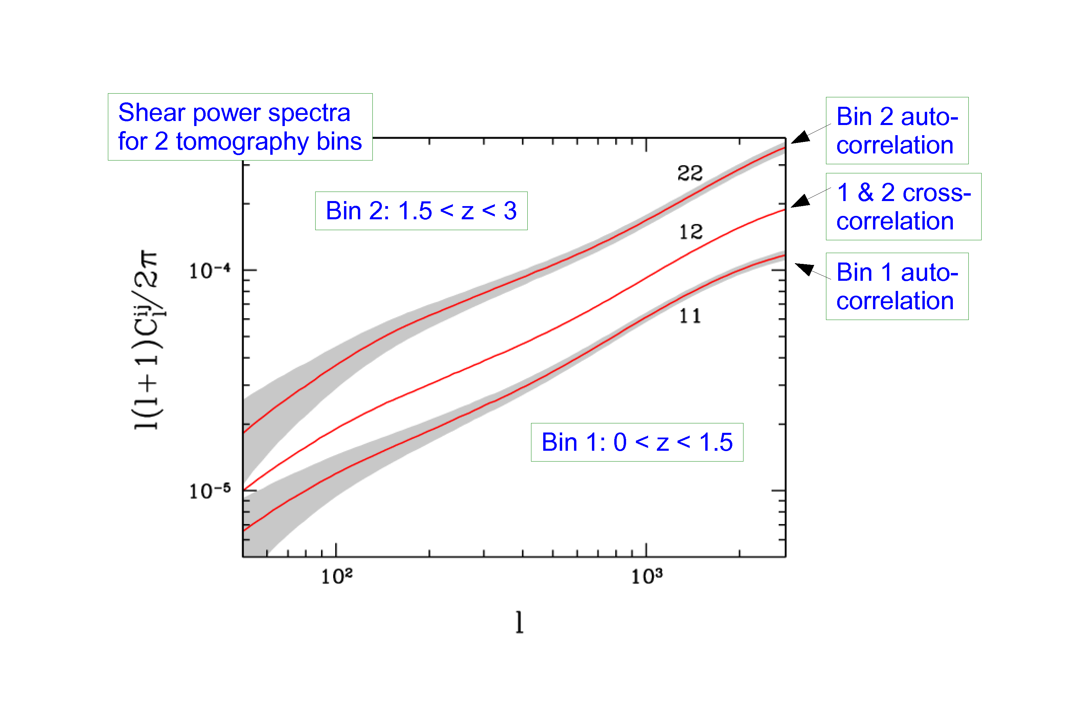
STH, TU, WONG 2006

Slide 42
EUCLID
ESA M-CLASS MISSION
Q1 2020
SELECTED OCTOBER 2011

Slide 43
EUCLID WILL FEATURE:
A WEAK LENSING MEASUREMENT OUT TO z ~ 2, COVERING
APPROXIMATELY 20,000 deg²
(THIS WILL BE MAINLY PHOTOMETRIC)
A GALAXY SURVEY OF ABOUT 10⁷ GALAXIES (10 x SDSS)
A WEAK LENSING BASED CLUSTER SURVEY

Slide 44
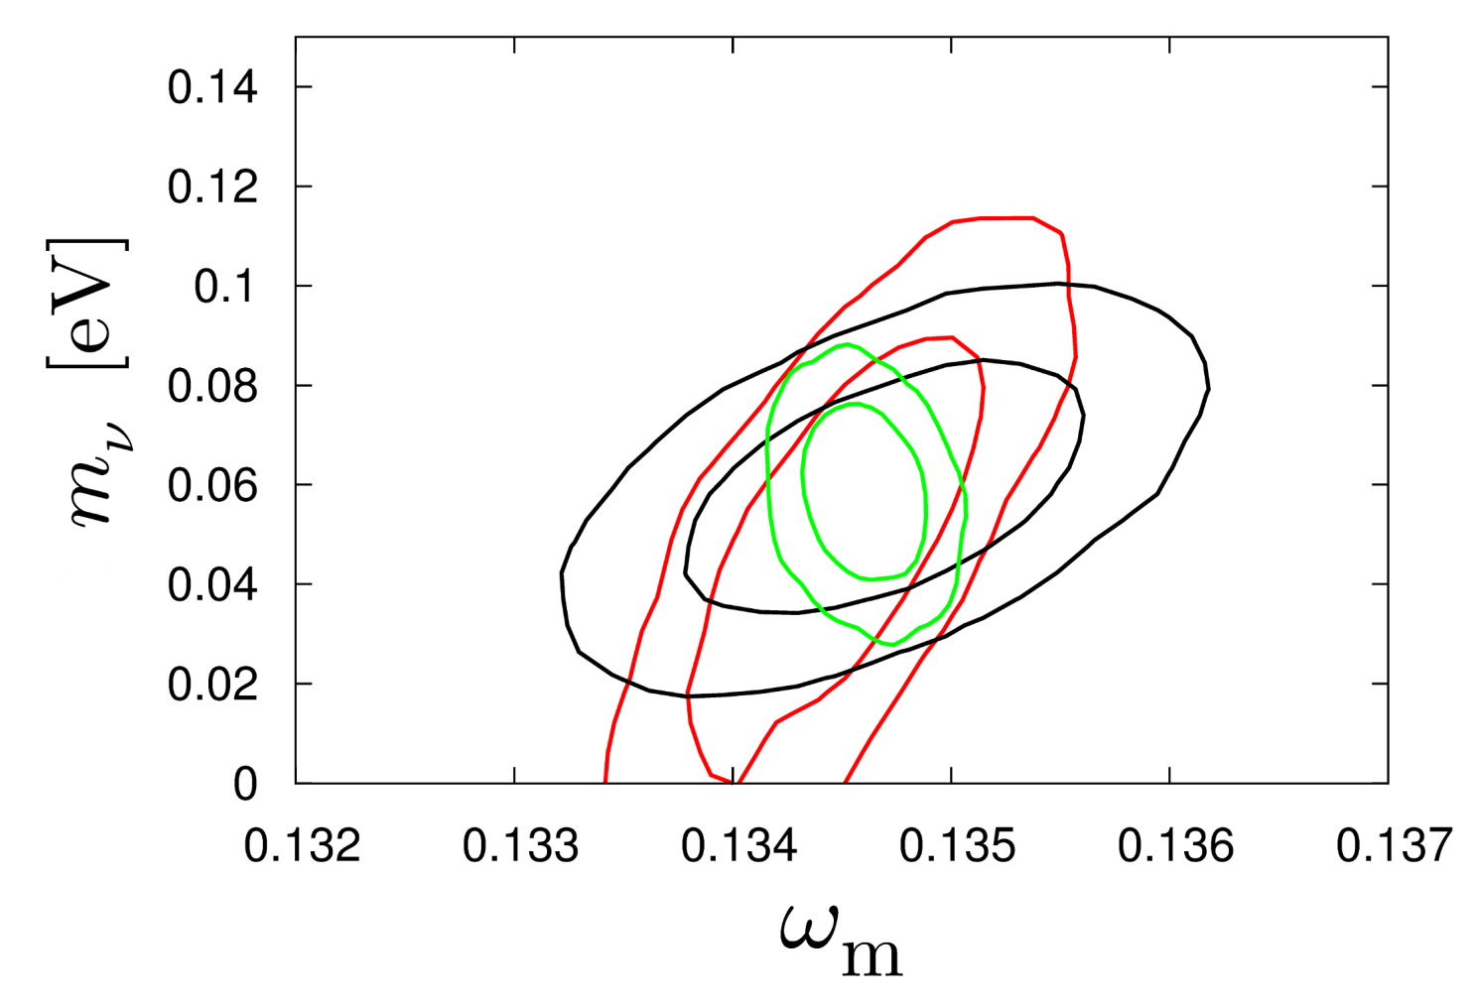
HAMANN, STH, WONG 2012: COMBINING THE EUCLID WL AND GALAXY
SURVEYS WILL ALLOW FOR AT A 2.5-5σ DETECTION OF THE NORMAL
HIERARCHY (DEPENDING ON ASSUMPTIONS ABOUT BIAS)
CMB+WL
CMB+WL+GAL
CMB+GAL
arXiv:1209.1043 (JCAP)

Slide 45
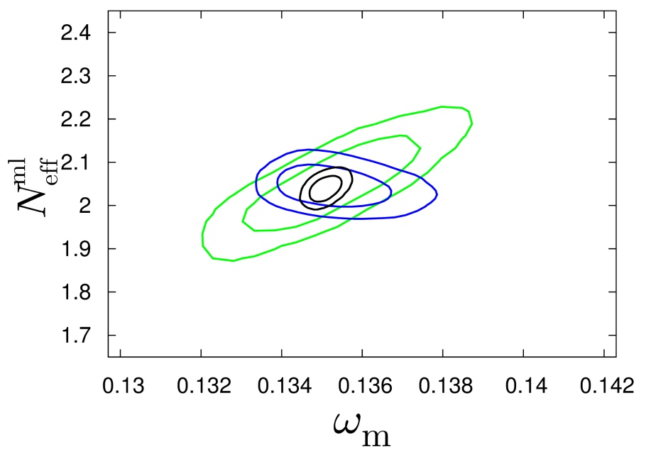
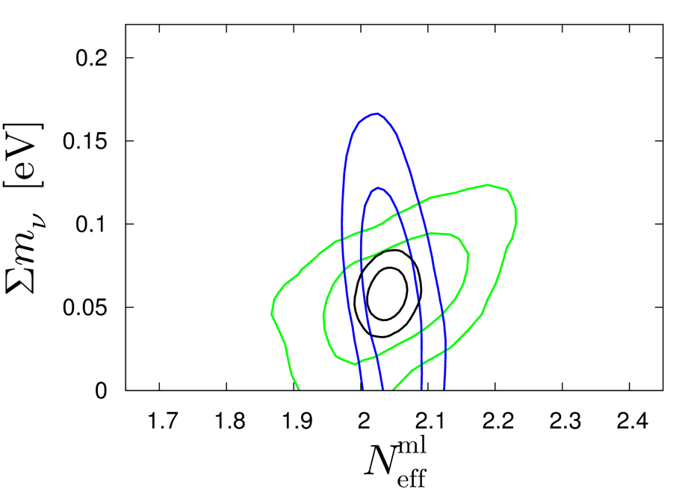
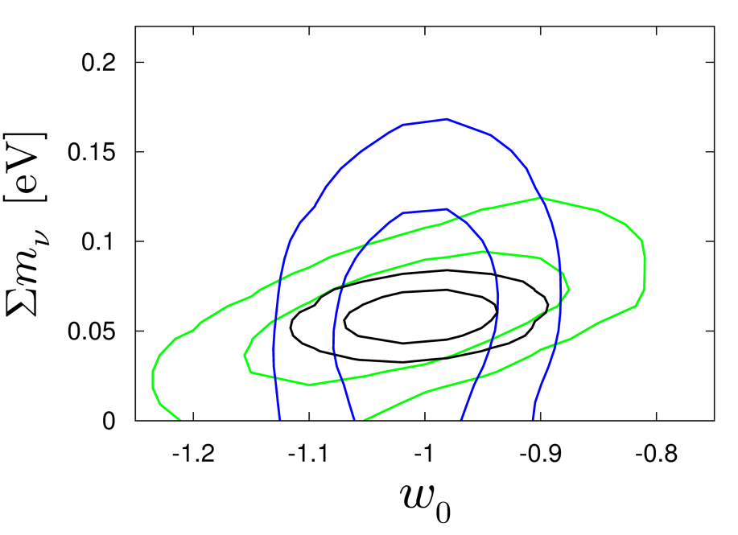
Basse, Bjælde, Hamann, STH, Wong 2013: Adding information on the
cluster mass function will allow for a 5σ detection of non-zero neutrino
mass, even in very complex cosmological models with time-varying
dark energy
arXiv:1304.2321
(JCAP)
CMB+CL
CMB+GAL+WL
ALL

Slide 46
THIS SOUNDS GREAT, BUT UNFORTUNATELY THE THEORETICIANS
CANNOT JUST LEAN BACK AND WAIT FOR FANTASTIC NEW DATA
TO ARRIVE…..

Slide 47
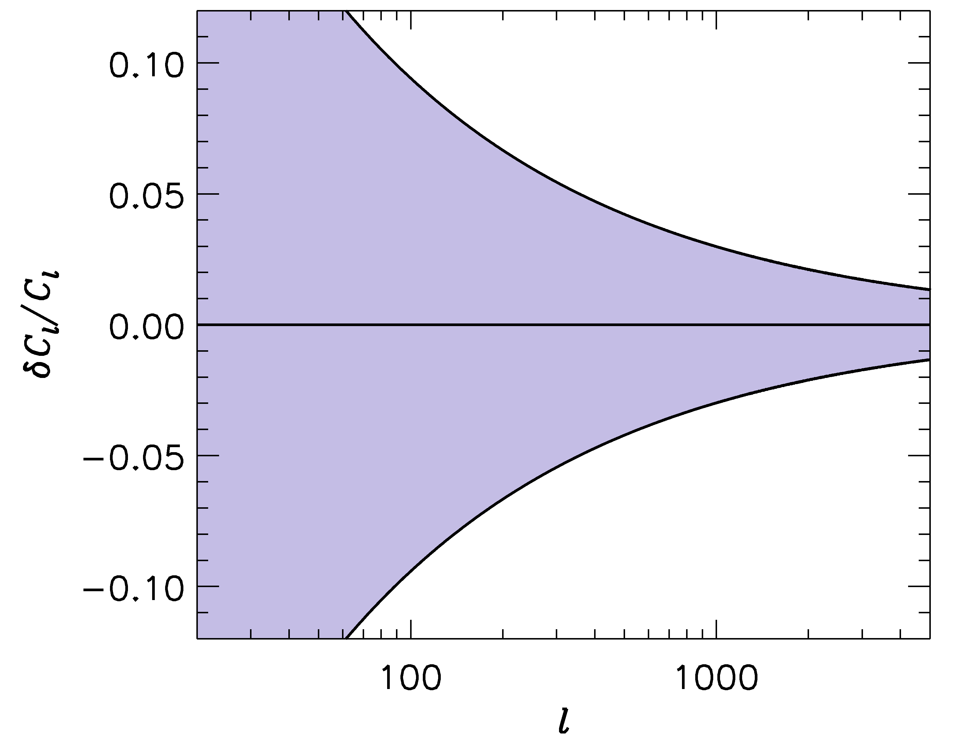
FUTURE SURVEYS LIKE LSST WILL PROBE THE POWER SPECTRUM
TO ~ 1-2 PERCENT PRECISION
-1
”LSST” ERROR BARS
WE SHOULD BE ABLE TO CALCULATE THE POWER SPECTRUM
TO AT LEAST THE SAME PRECISION!

Slide 48
IN ORDER TO CALCULATE THE POWER SPECTRUM TO 1%
ON THESE SCALES, A LARGE NUMBER OF EFFECTS MUST
BE TAKEN INTO ACCOUNT
BARYONIC PHYSICS – STAR FORMATION, SN FEEDBACK,…..
NEUTRINOS, EVEN WITH NORMAL HIERARCHY
NON-LINEAR GRAVITY
……………………..

Slide 49
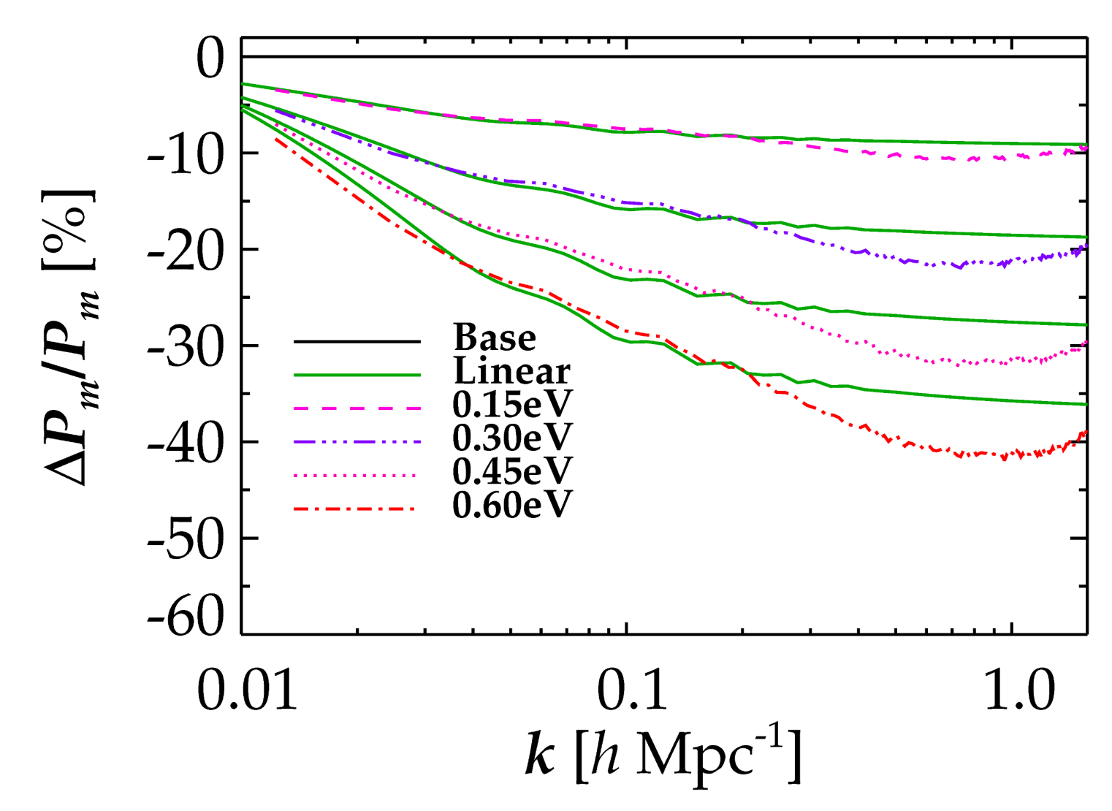
NON-LINEAR EVOLUTION PROVIDES AN ADDITIONAL AND VERY
CHARACTERISTIC SUPPRESSION OF FLUCTUATION POWER DUE TO
NEUTRINOS (COULD BE USED AS A SMOKING GUN SIGNATURE)
LINEAR THEORY
FULL NON-LINEAR
Brandbyge, STH, Haugbølle, Thomsen, arXiv:0802.3700 (JCAP)
Brandbyge & STH ’09, ’10 (JCAP), Viel, Haehnelt, Springel ’10

Slide 50
ANOTHER IMPORTANT ASPECT OF STRUCTURE FORMATION
WITH NEUTRINOS:
THE NUMBER OF BOUND OBJECTS (HALOS) AS WELL AS THEIR
PROPERTIES ARE CHANGED WHEN NEUTRINOS ARE INCLUDED

Slide 51
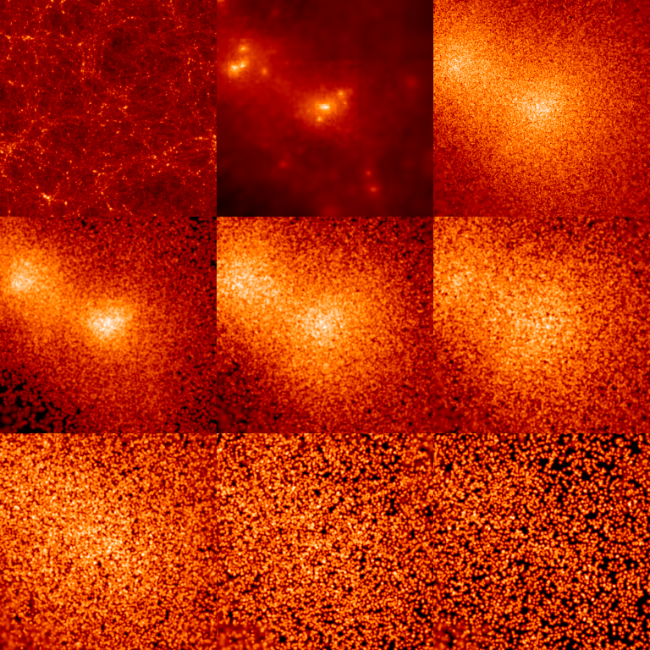
INDIVIDUAL HALO PROPERTIES
CDM
ν
512 h⁻¹ Mpc
0 < p/T < 1
1 < p/T < 2
2 < p/T < 3
3 < p/T < 4
4 < p/T < 5
5 < p/T < 6

Slide 52
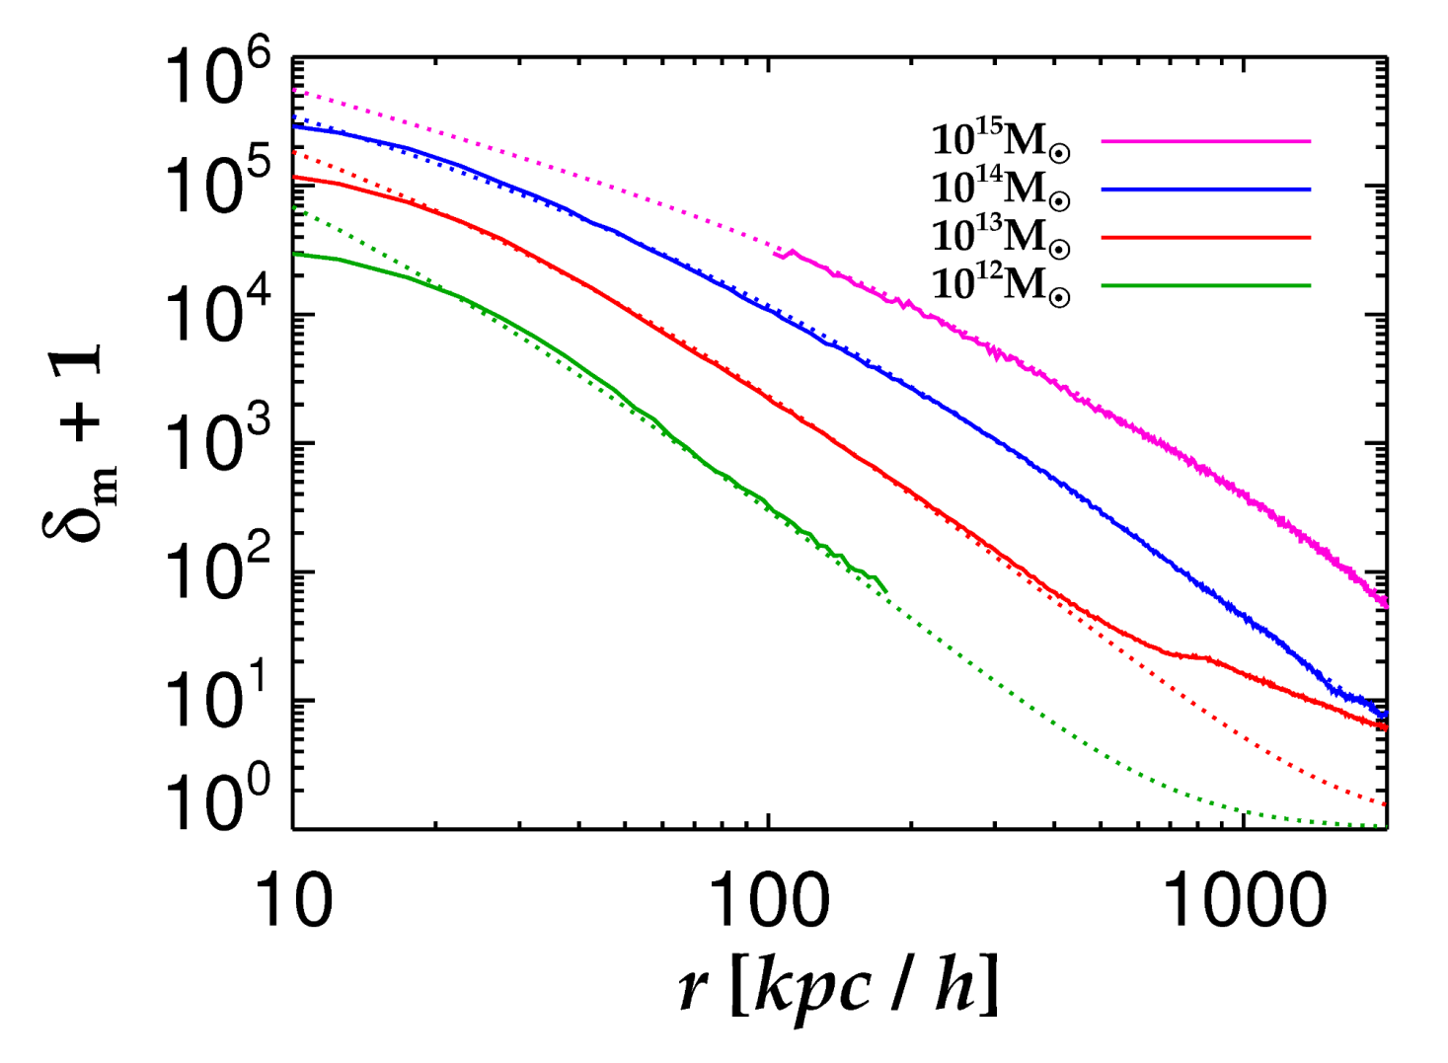
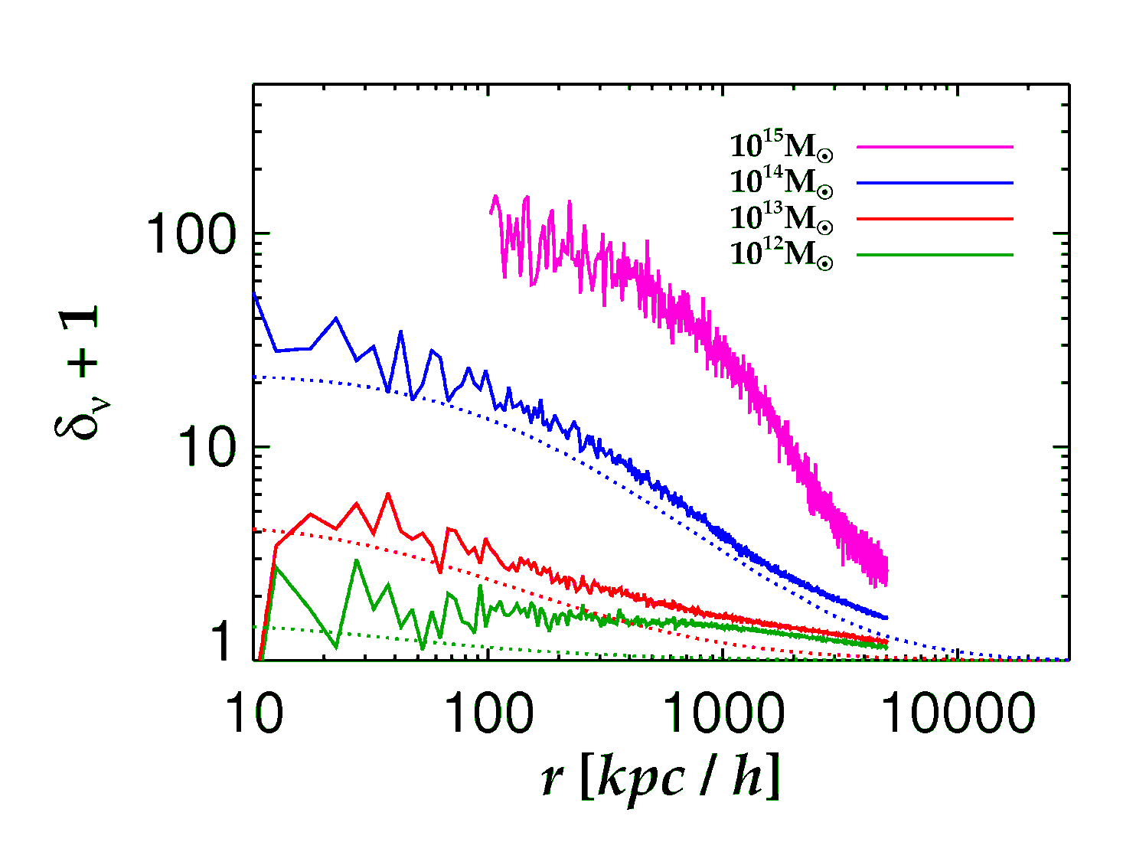
Brandbyge, STH, Haugboelle, Wong, arxiv:1004.4105
Neutrinos
Cold Dark Matter
See also Ringwald & Wong 2004

Slide 53
CONCLUSIONS
NEUTRINO PHYSICS IS PERHAPS THE PRIME EXAMPLE OF HOW
TO USE COSMOLOGY TO DO PARTICLE PHYSICS
THE BOUND ON NEUTRINO MASSES IS SIGNIFICANTLY
STRONGER THAN WHAT CAN BE OBTAINED FROM DIRECT
EXPERIMENTS, ALBEIT MUCH MORE MODEL DEPENDENT
COSMOLOGICAL DATA SHOWS NO EVIDENCE FOR NEW
PHYSICS. HOWEVER, IF eV STERILE NEUTRINOS EXIST THERE
MUST BE NEW PHYSICS IN ORDER TO RECONCILE THEM WITH
COSMOLOGY
NEW DATA FROM PLANCK AND EUCLID MAY PROVIDE A
POSITIVE DETECTION OF A NON-ZERO NEUTRINO MASS

