Slide 1
IceCube’s neutrinos: What we have learned
E. Waxman
Weizmann Institute

Slide 2
The main driver of HE ν astronomy:
The origin of CRs
log [dJ/dE]
Where is the G/XG transition?
E^{-2.7}
Galactic
Protons
UHE
X-Galactic
Source: Supernovae(?)
E⁻³
Heavy Nuclei
Source?
Light Nuclei?
Lighter
Source?
1
10⁶
10¹⁰
Cosmic-ray E [GeV]

Slide 3
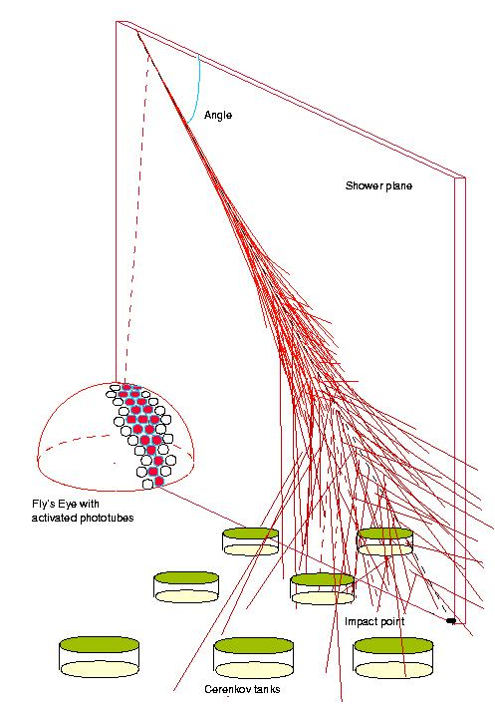
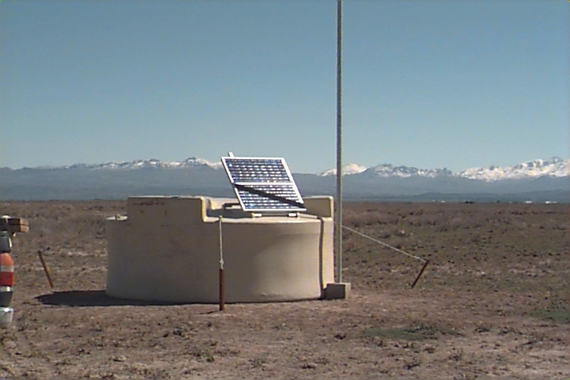
UHE, >10¹⁰GeV, CRs
J(>10¹¹GeV)~1 / 100 km² year 2π sr
Auger:
3000 km²
3,000 km²
Fluorescence
detector
Ground array

Slide 4
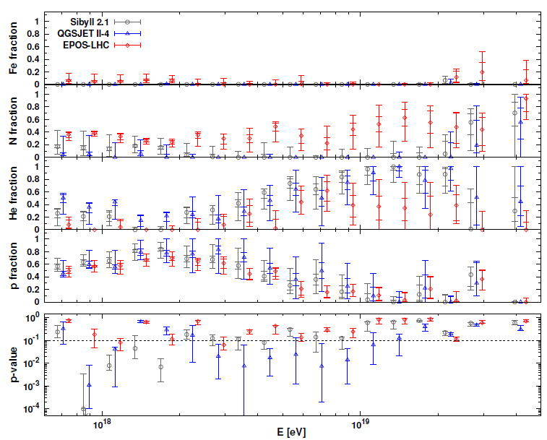
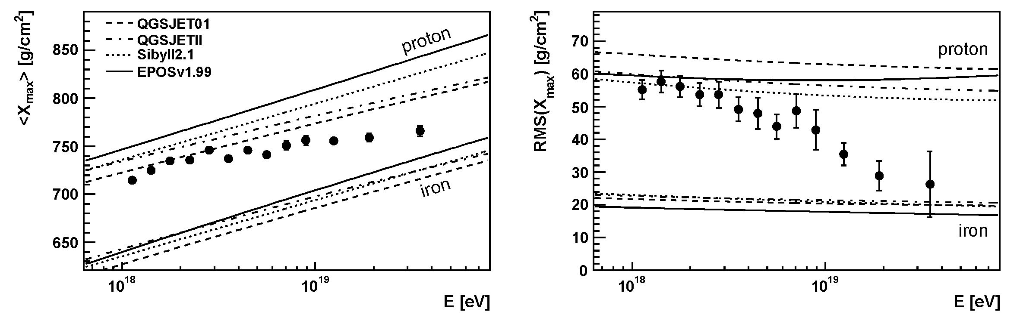
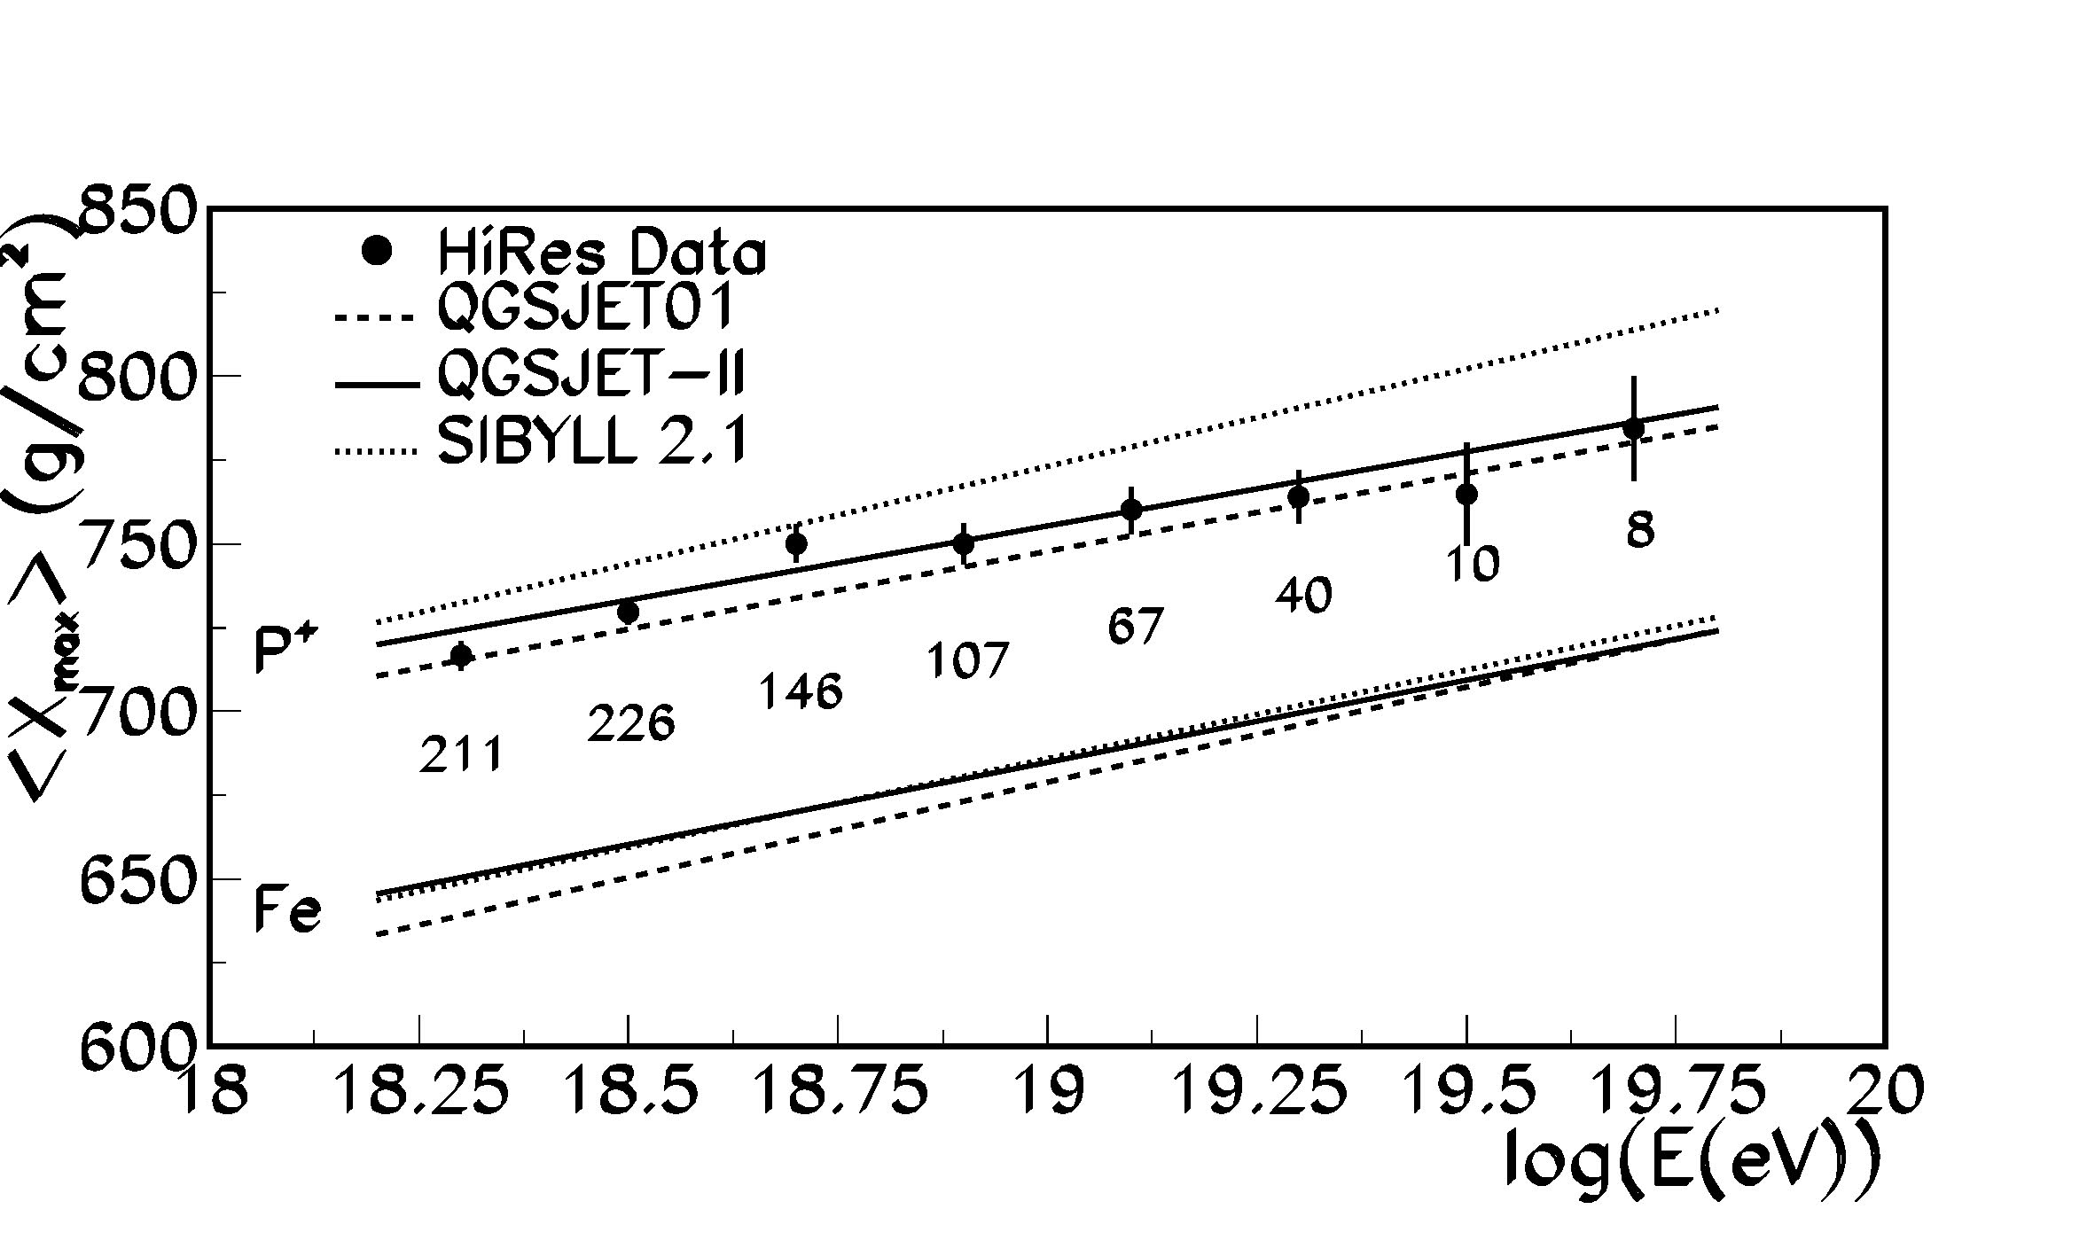
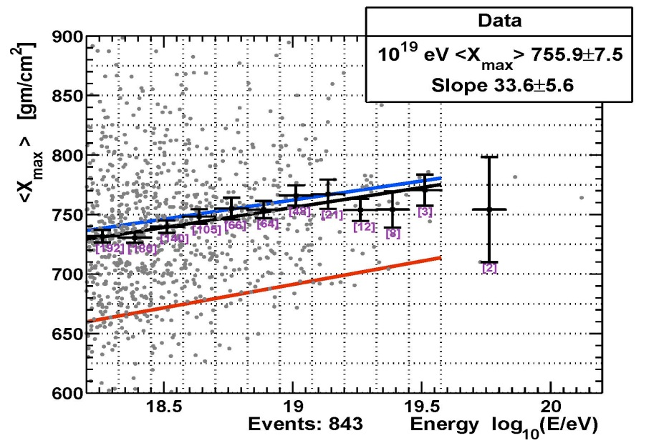
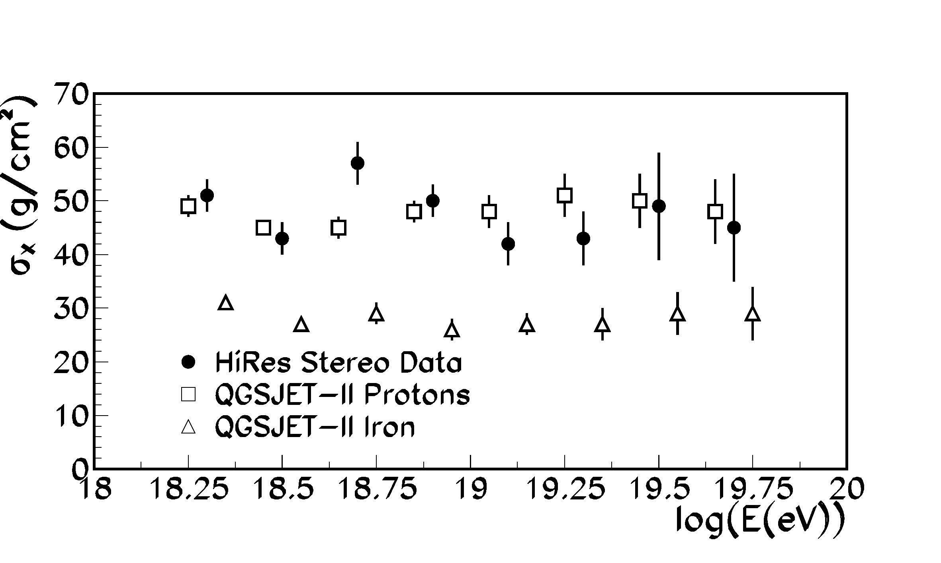
UHE: Composition
Auger 2010: Fe
, 2015: He(??)
N
He
p
HiRes Stereo 2010
& TA Hybrid 2015
HiRes 2005

Slide 5
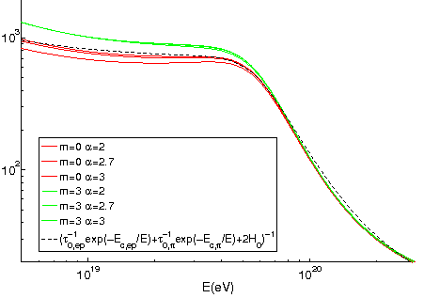
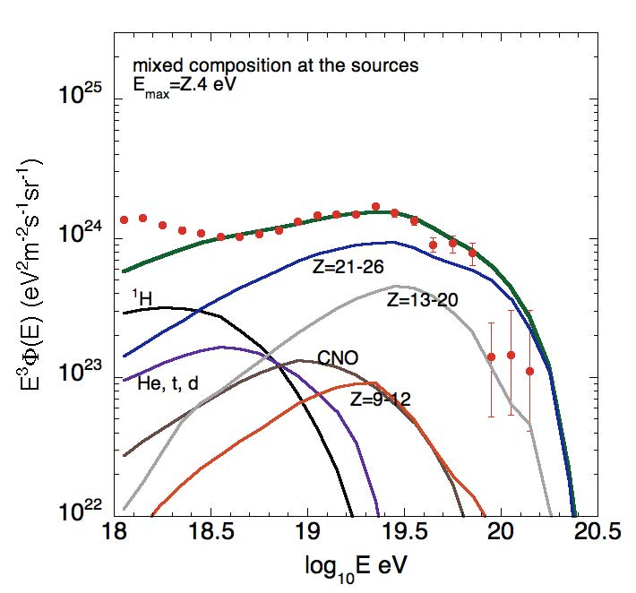
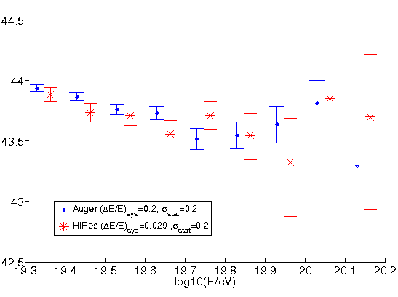
UHE: Energy production rate & spectrum
Protons
4 π j= c Q t
dQ/d log E =Const.:
- Observed in a wide range of systems,
- Obtained in collision-less shock acceleration (the only predictive model of particle acceleration).
ct_{eff} [Mpc]
GZK
Mixed composition
log(dQ/d log ε) [erg/Mpc³ yr]
[Allard 12]
[Katz & EW 09]

Slide 6
Intermediate energy: Neutrinos
p + γ → N + π
π⁰ → 2γ ; π⁺ → e⁺ + ν_{e} + ν_{μ} + ν_{μ} ; ε_{ν}/ε_{p}~0.05
→ Identify UHECR sources,
Study BH accretion/acceleration physics.
For all known sources, τ_{γp}<=1:
If X-G p’s:
→ Identify primaries, determine f(z)
[EW & Bahcall 99;
Bahcall & EW 01]
[Berezinsky & Zatsepin 69]

Slide 7
π production: p/A—p/γ
π decay → ν_{e}:ν_{μ}:ν_{τ} = 1:2:0 (propagation)→ ν_{e}:ν_{μ}:ν_{τ} = 1:1:1
p(A)-p: ε_{ν}/ε_{p}~1/(2x3x4)~0.04 (ε_{p}→ε_{A}/A);
- IR photo dissociation of A does not modify Γ;
- Comparable particle/anti-particle content.
p(A)-γ: ε_{ν}/ε_{p}~ (0.1—0.5)x(1/4)~0.05;
- Requires intense radiation at ε_{γ}>A keV;
- Comparable particle/anti-particle content,
ν_{e} excess if dominated by Δ resonance (dlog n_{γ}/dlog ε_{γ}<-1).

Slide 8
WB bound: p and ν production
dQ/d log E
p
UHE
1/20
3/8 (Δ; o.w. 1/2)
ν
Log E

Slide 9
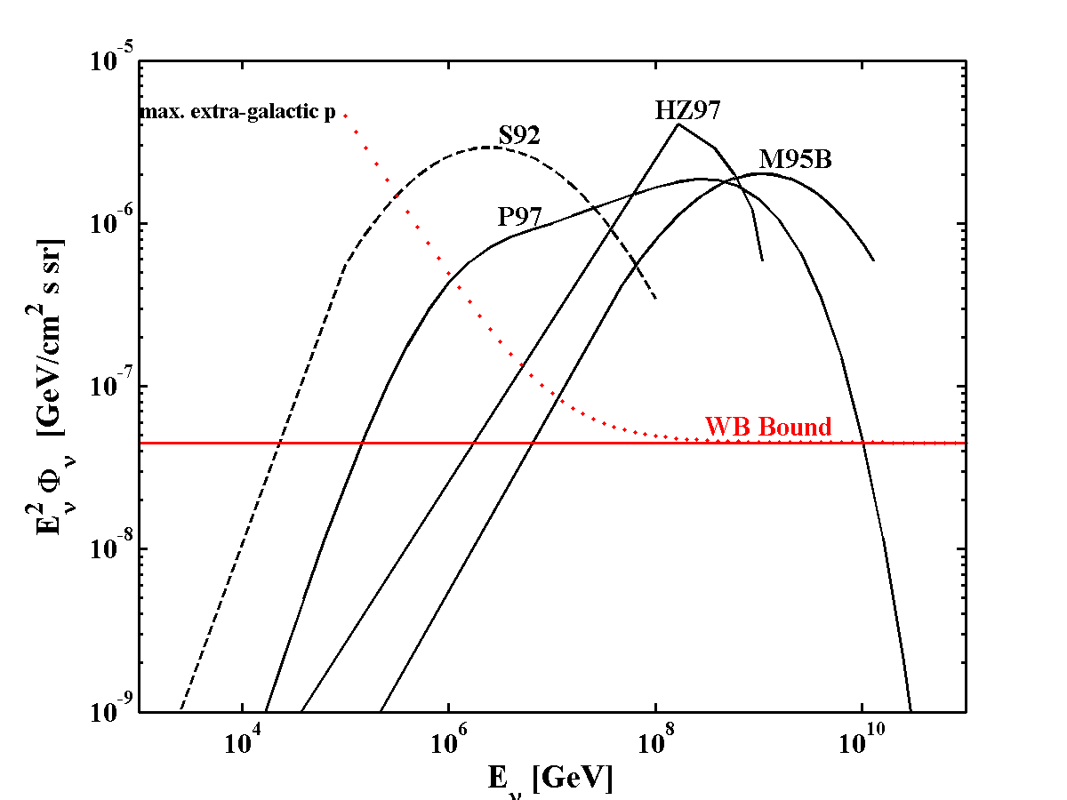
“Hidden” (ν only)
sources
Violating UHECR
bound
[M95: Mannheim 1995
P97: Protheroe 1997
HZ97: Halzen & Zas 1997]

Slide 10
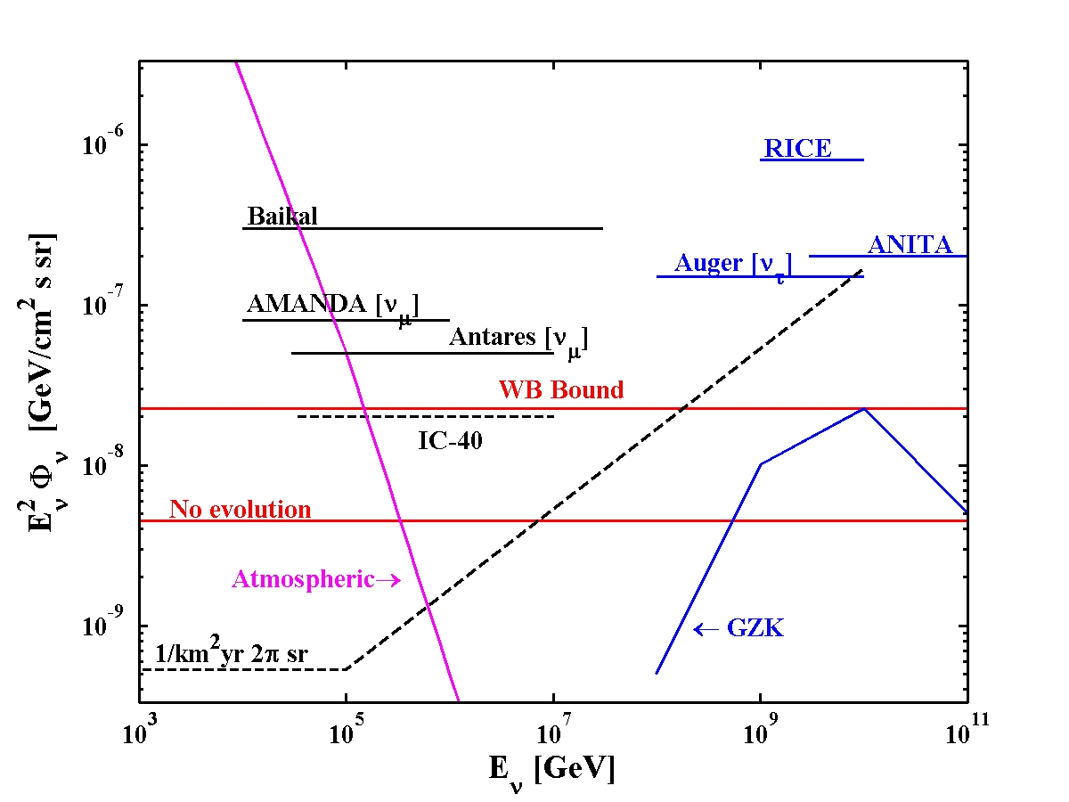
Bound implications: >1Gton detector
(natural, transparent)
Fermi
2 flavors,
1/Gt yr
Rate ~ (EΦ)N_{n}σ(E), σ~E → Rate ~ (E²Φ)Μ

Slide 11
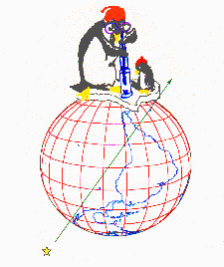
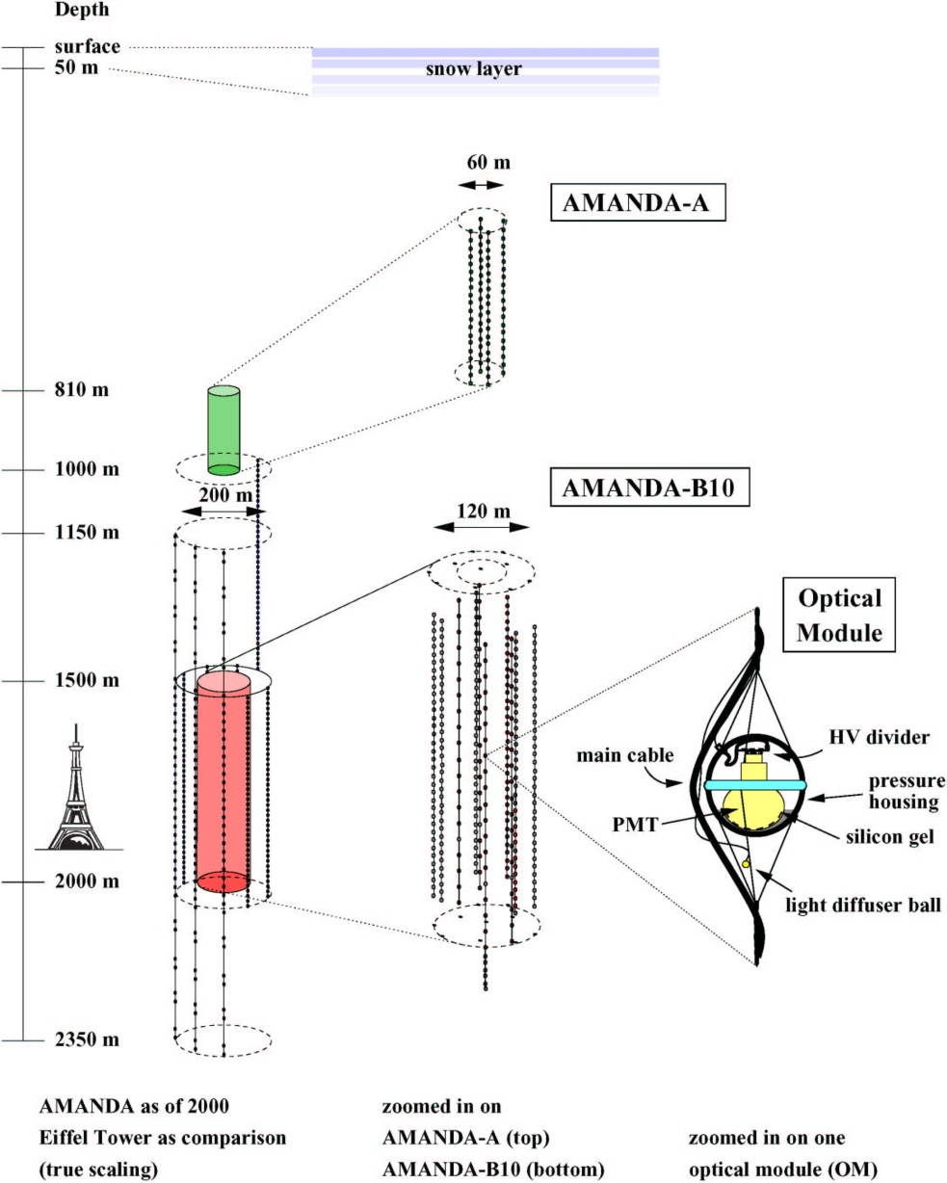
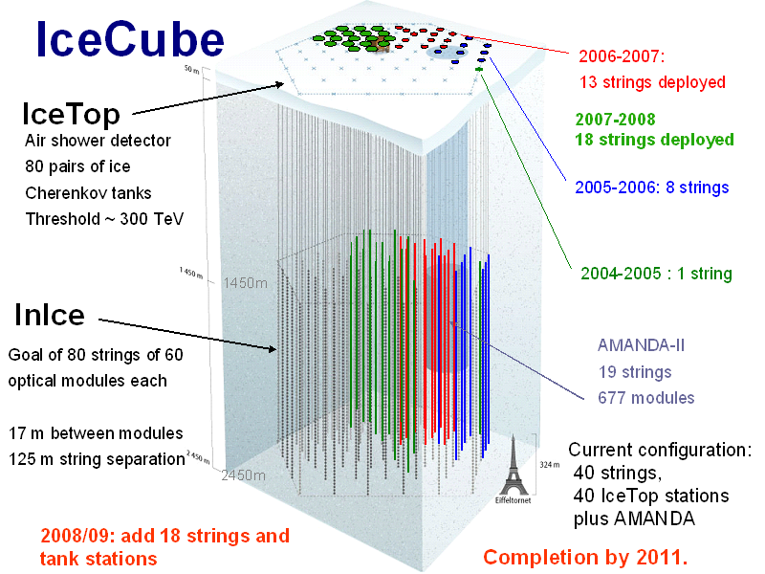
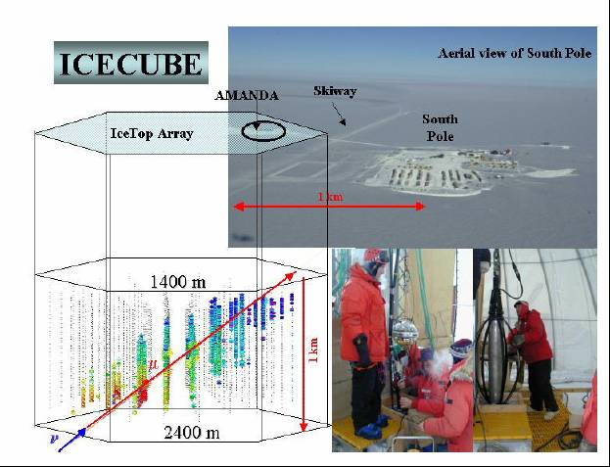
AMANDA
& IceCube
Completed Dec 2010

Slide 12
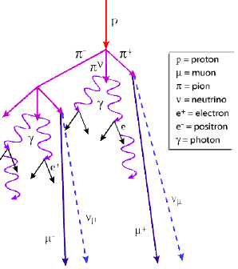
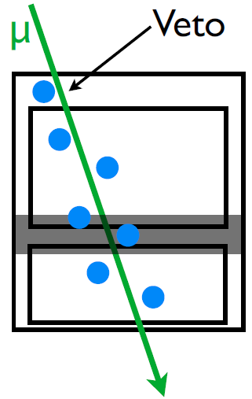
Looking up: Vetoing atmospheric neutrinos
[Schoenert, Gaisser et. al 2009]
Look for: Events starting within the detector,,
not accompanied by shower muons.
Sensitive to all flavors
(for 1:1:1 ν_{μ} induced μ~20%).
Observe 4π.
Rule out atmospheric charmed meson decay
excess:
Anisotropy due to downward events removal
(vs isotropic astrophysical intensity).
[Cartoon: N. Whitehorn]

Slide 13
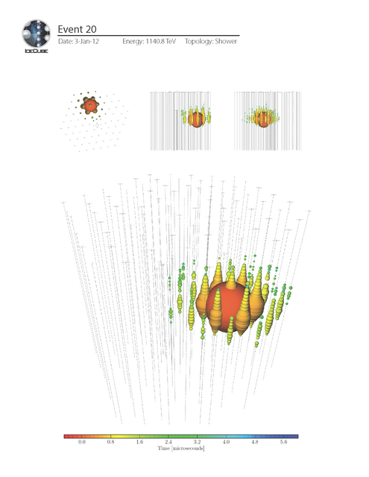
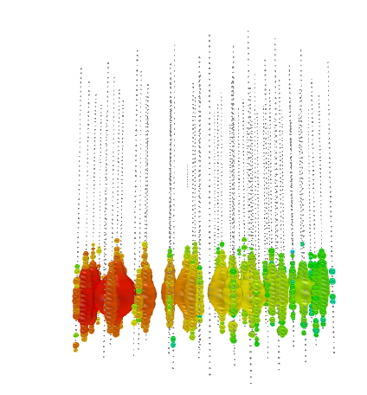
r
400TeV
1100TeV

Slide 14
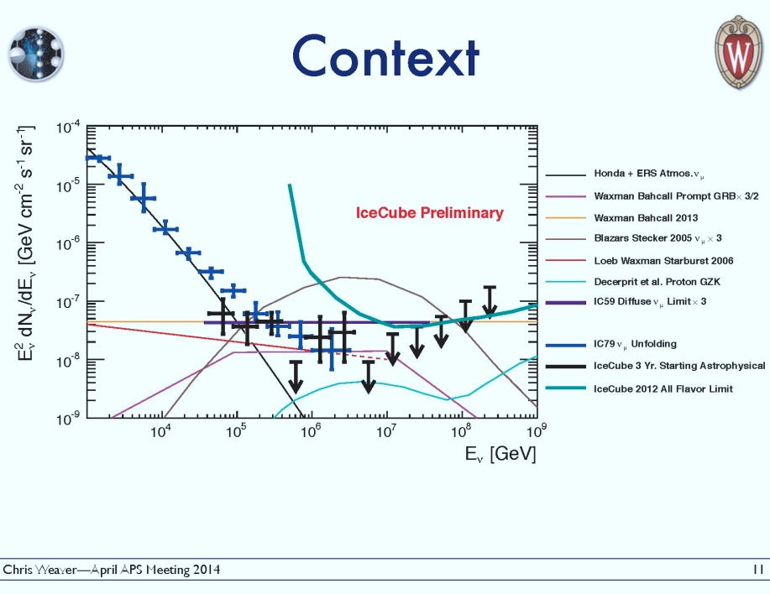
IceCube: 37 events at 50Tev-2PeV
~6σ above atmo. bgnd. [02Sep14 PRL]
A new era in ν astronomy
ε²Φ_{ν} =(2.85+-0.9)x10⁻⁸GeV/cm²sr s =ε²Φ_{WB}= 3.4x10⁻⁸GeV/cm²sr s (2PeV cutoff?) Consistent with Isotropy and
with ν_{e}:ν_{μ}:ν_{τ}=1:1:1 (π deacy + cosmological prop.).

Slide 15
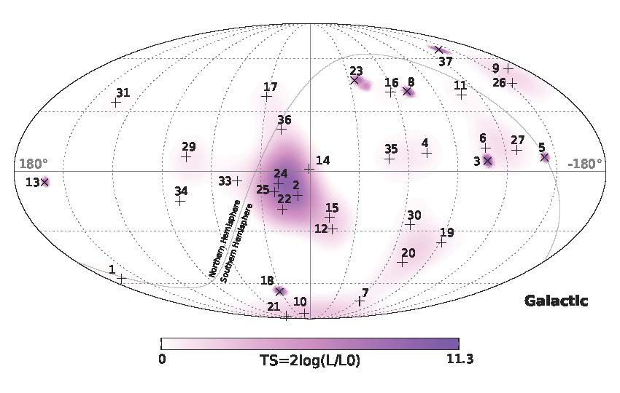
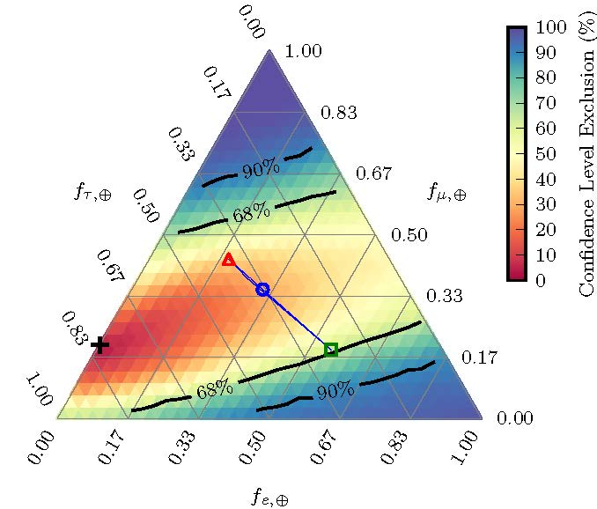
Isotropy & Flavor ratio
Without new phys.,
Nearly single parameter (~f_{e} @ source)

Slide 16
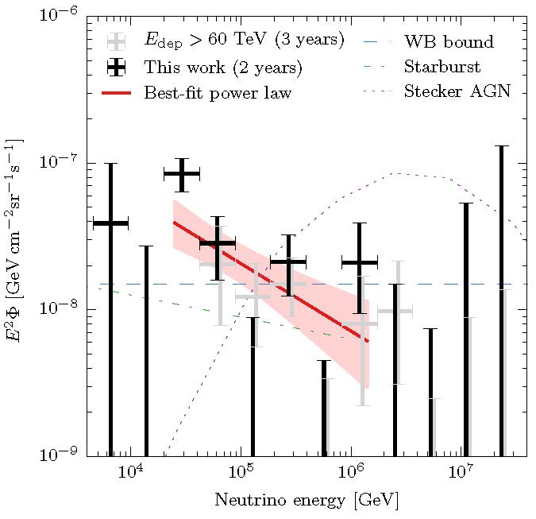
Lower energy: a ~30 TeV ‘excess’?
Excess at ~30TeV point →
d log n_{ν}/d log ε=-2.46+-0.12;
softer than 2.2 at 90% cl.
>50 TeV spectrum
d log n_{ν}/d log ε=-2 (-1.9+-0.2)
A new low E component?
Note:
- Binning,
- Southern hemisphere only,
(- Fermi XG γ bgnd limit).

Slide 17
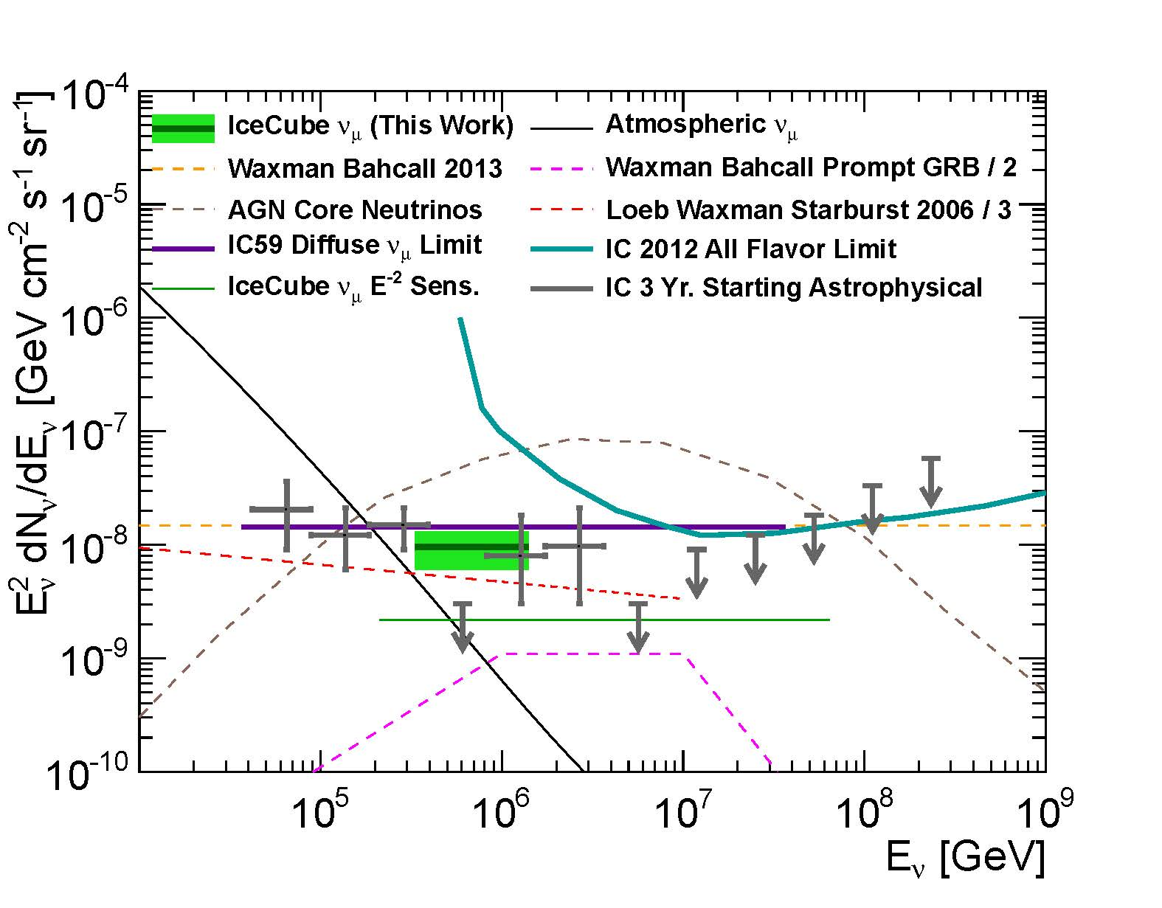
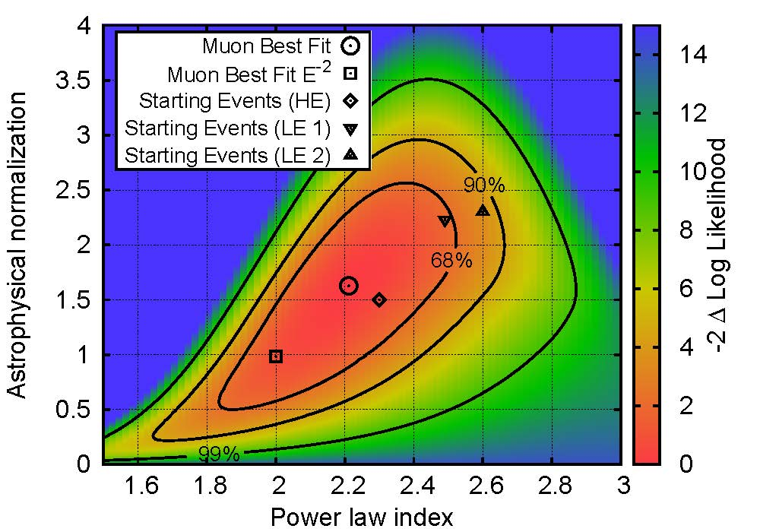
IceCube North sky muons [July 15]

Slide 18
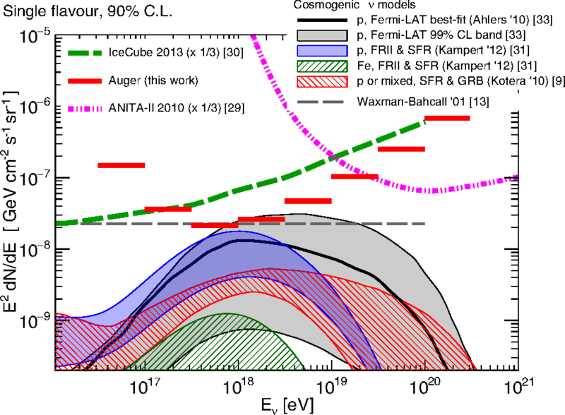
Auger’s UHE limit [May 15]

Slide 19
IceCube’s detection: Implications
DM decay?
The coincidence of 50TeV<E<2PeV ν flux, spectrum (& flavor)
with the WB bound is unlikely a chance coincidence.
Unlikely Galactic: Isotropy,
and ε²Φ_{γ}~10⁻⁷(E_{0.1TeV})^{-0.7}GeV/cm²s sr [Fermi]
→ ε²Φ_{ν} ~10⁻⁹(E_{0.1PeV})^{-0.7}GeV/cm²s sr << Φ_{WB}
If Galactic: New, unknown sources; Chance coincidence with WB.
→ XG sources.
Recall: known UHECR sources cannot account for IC’s flux (τ_{γp(pp)}<1)
[e.g. Murase et al. 2014].

Slide 20
IceCube’s detection: XG CR pion production
UHE CR sources reside in (<10¹⁷eV) “Calorimeters”,
UHE CR sources reside in (<10¹⁷eV) “Calorimeters”,
or
Q>>Q_{UHE} sources (unknown) with τ_{γp(pp)}<<1 (ad-hoc)
& Coincidence over a wide energy range.
dQ/d log E
(b)
τ_{γp(pp)}<<1
p
UHE
(a)
ν
τ_{γp(pp)}>1
IC ν’s
Log₁₀ E[eV]
15 17 19

Slide 21
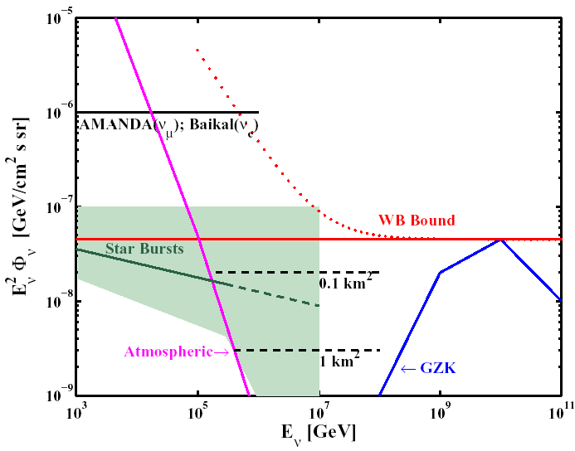
Candidate CR calorimeters:
Starburst galaxies
Radio, IR & γ-ray (GeV-TeV) observations
→ Starbursts are calorimeters for E/Z reaching (at least) 10PeV.
Most of the stars in the universe were formed in Starbursts.
If:
CR sources reside in galaxies
and
Q~Star Formation Rate (SFR),
Then:
Φ_{ν}(ε_{ν}<1PeV)~Φ_{WB} .
(And also a significant fraction of
the γ-bgnd).
[Loeb & EW 06]

Slide 22
A note on
Fermi’s XG diffuse γ-ray upper limit
Fermi diffuse XG: ε²Φ_{γ}(0.1TeV) <~ 10⁻⁷ GeV/cm²s sr.
IceCube diffuse XG: ε²Φ_{ν} (100TeV)~0.3x10⁻⁷GeV/cm²s sr.
Flat proton generation spectrum, d log n/d log ε>-2.2,
with significant contribution to the diffuse XG γ-bgnd.
[e.g. Tamborra, Ando, & Murase 14]
dQ/d log E
γ
p
UHE
τ_{γp(pp)}>1
ν
IC ν’s
Log₁₀ E[eV]
11 13 15 17 19

Slide 23
IceCube’s detection: XG CR pion production
UHE CR sources reside in (<10¹⁷eV) “Calorimeters”: Starbursts.
Implications:
G-XG transition @ 10¹⁹eV;
The (G) >10^{6.5}eV flux is suppressed due to propagation.
or
Q>>Q_{UHE} sources (unknown) with τ_{γp(pp)}<<1 (ad hoc, fine tuning)
& Coincidence over a wide energy range:
- AGN jets in Galaxy clusters,
dQ/dlog ε~10⁴⁷erg/Mpc³yr, τ_{pp}~10⁻²
- BL Lacs [“obtained through a fine-tuning with the data”, Tavecchio & Ghisellini 2015]
- Low L GRBs
.
.
.
[Murase, Inoue & Nagataki 2008]

Slide 24
Low Energy, ~10GeV
Our Galaxy- using “grammage”, local SN rate
Starbursts- using radio to γ observations
Q/SFR similar for different galaxy types,
dQ/dlog ε ~Const. at all ε!
[Katz, EW, Thompson & Loeb 14]

Slide 25
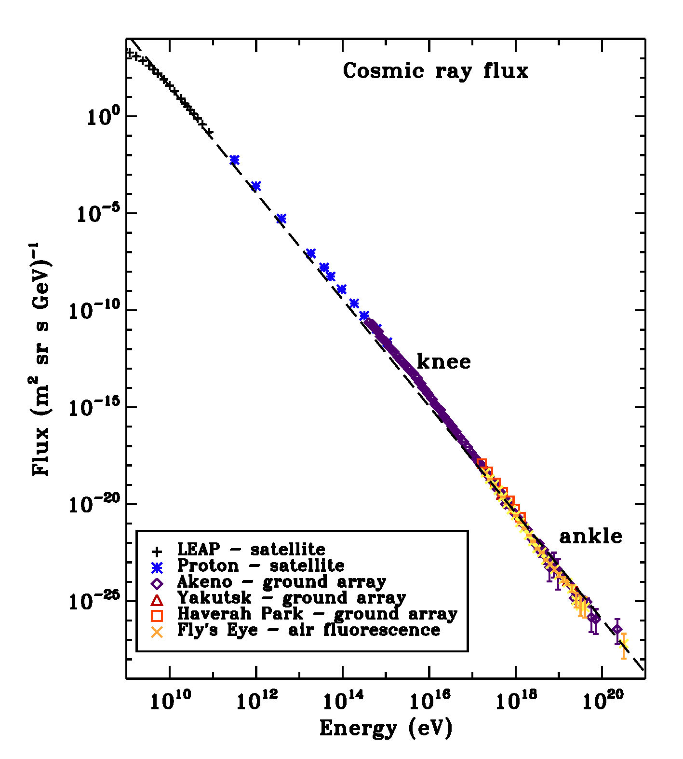
The cosmic ray spectrum
[From Helder et al., SSR 12]

Slide 26
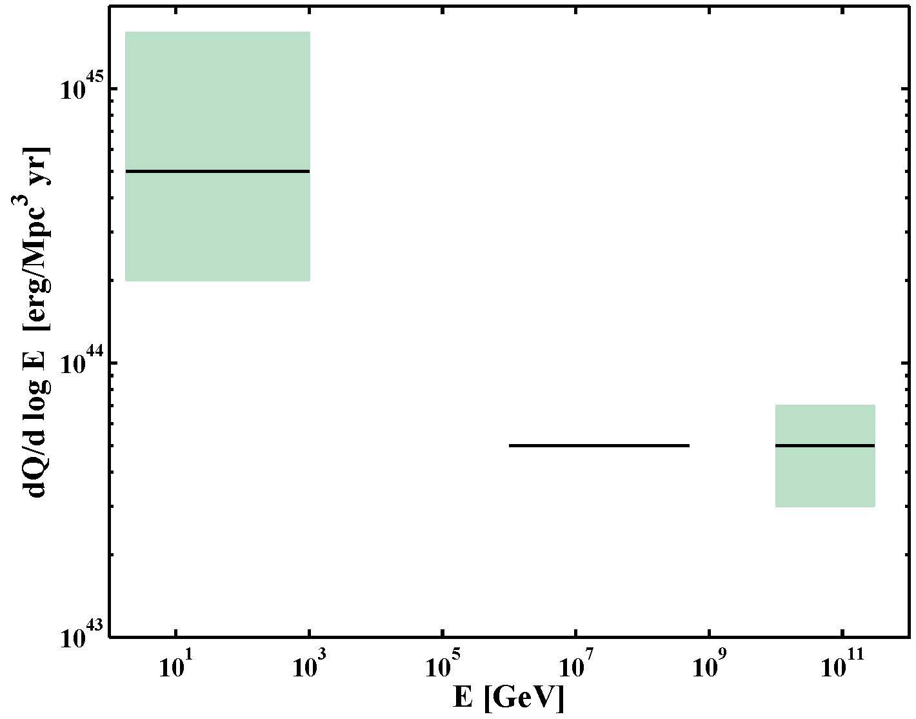
The cosmic ray generation spectrum
A single source?
MW CRs,
Starbursts
(+ CRs~SFR)
XG ν’s
XG CRs
[Katz, EW, Thompson & Loeb 14]

Slide 27
Constraints on source density
The absence of multiple-ν_{μ}-event sources implies:
Implications:
Identify sources by angular correlation with catalogs- unlikely:
Bright AGN (FSRQ, BL Lac, n~10⁻¹¹(10⁻⁸)/Mpc³)- Ruled out.
Starbursts, n~10⁻⁵/Mpc³- a few should be detected with A X 10.
[Murase & EW 15]

Slide 28
Identifying the CR sources
IC’s ν’s are produced by the “calorimeters” surrounding the sources.
ΔΘ~1deg → Identification by angular distribution impossible.
Our only (realistic) hope:
Identification of transient sources by temporal ν−γ association.
* UHE CR source must be transient:
L>10⁴⁷erg/s, GRBs or bright (yet to be detected) AGN flares.
Requires:
Wide field EM monitoring,
Real time alerts for follow-up of high E ν events,
and
Significant increase of the ν detector mass at ~100TeV
[Φ_{ν}(source) may be << Φ_{ν}(calorimeter)~Φ_{WB} [ e.g. Φ_{ν}(GRB) ~0.1 Φ_{WB}]].

Slide 29
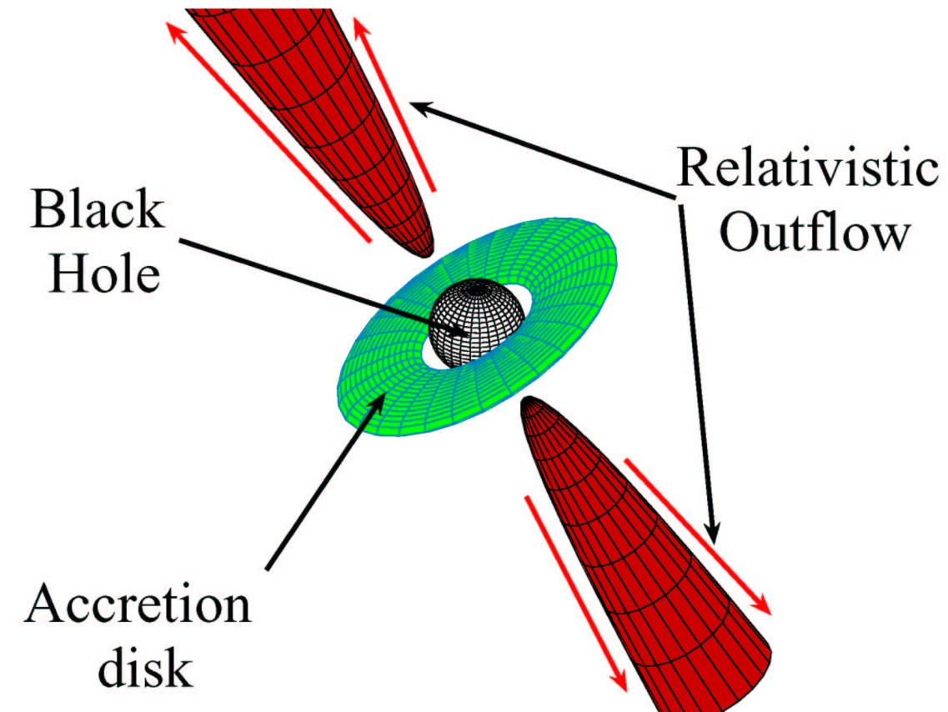
Source candidates & physics challenges
Electromagnetic acceleration in astrophysical sources requires
L> 10¹⁴ L_{Sun} (Γ²/β) (ε/Z 10²⁰eV)²
GRB: 10¹⁹L_{Sun}, M_{BH}~1M_{sun}, M~1M_{sun}/s, Γ~10^{2.5}
AGN: 10¹⁴ L_{Sun}, M_{BH}~10⁹M_{sun}, M~1M_{sun}/yr, Γ~10¹
No steady sources at d<d_{GZK} → Transient Sources (AGN flares?),
Charged CRs delayed compared to γ’s.
[Lovelace 76; EW 95, 04; Norman et al. 95]
Energy extraction;
Jet acceleration and
content (kinetic/Poynting)
Particle acceleration,
Radiation mechanisms

Slide 30
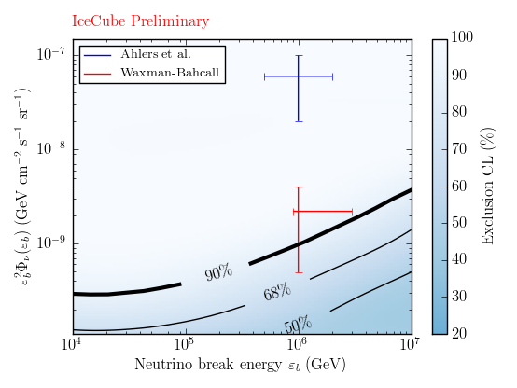
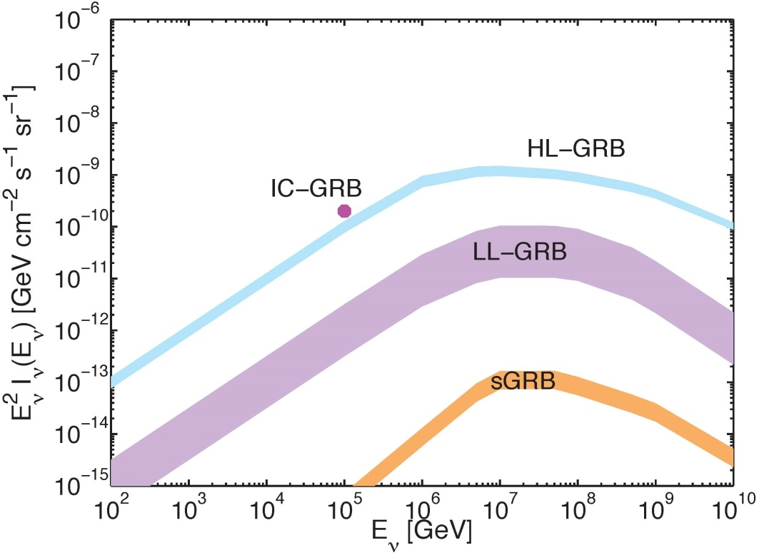
A note on GRBs
[EW & Bahcall 97]
E²Φ
WB
1%
10%
GRB
IC is achieving relevant sensitivity.
0.1 1
E (PeV)
[Tamborra & Ando 15;
Hummer, Baerwald, and Winter 12; Li 12; He et al 12 …]

Slide 31
What will we learn from ν−γ associations?
Identify the CR sources.
Resolve key open Qs in the accelerators’ physics
(BH jets, particle acceleration, collisionless shocks).
Study fundamental/ν physics:
- π decay → ν_{e}:ν_{μ}:ν_{τ} = 1:2:0 (Osc.)→ ν_{e}:ν_{μ}:ν_{τ} = 1:1:1
◊ τ appearance,
- GRBs: ν-γ timing (10s over Hubble distance)
→ LI to 1:10¹⁶; WEP to 1:10⁶ .
Optimistically (>100’s of ν’s with flavor identification):
Constrain δ_{CP}, new phys.
[Learned & Pakvasa 95; EW & Bahcall 97]
[EW & Bahcall 97; Amelino-Camelia,et al.98;
Coleman &.Glashow 99; Jacob & Piran 07]
[Blum, Nir & EW 05; Winter 10; Pakvasa 10;
… Ng & Beacom 14; Ioka & Murase 14;
Ibe & Kaneta 14; Blum, Hook & Murase 14;
Marfatia, McKay & Weiler 15;]

Slide 32
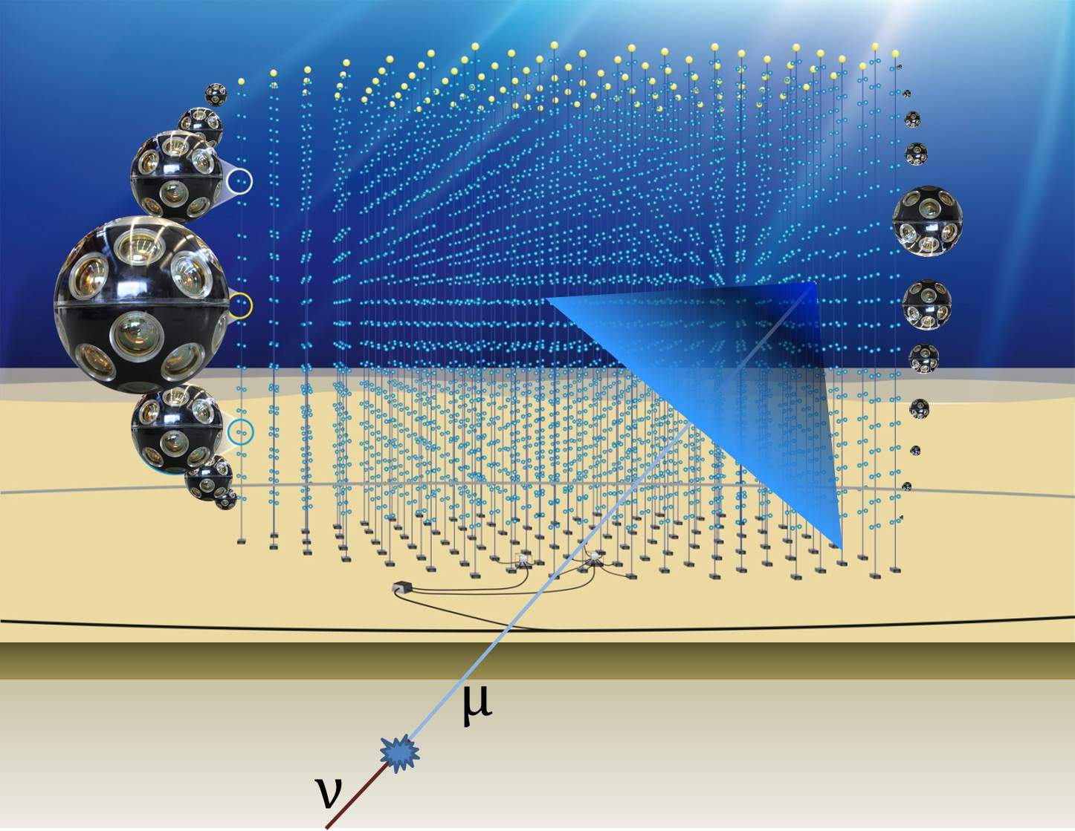
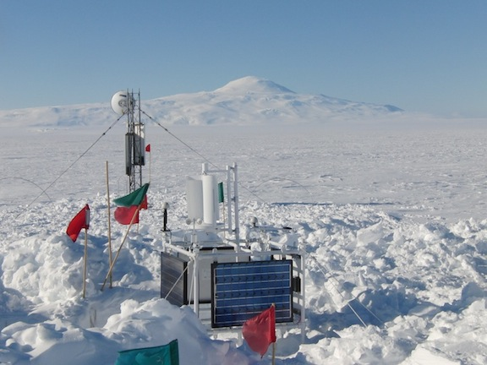
Future experimental developments
IC extension
Mediterranean
Km3Net (~5x IC)
ARA & ARIANNA:
Coherent radio Cerenkov,
10⁸ to 10¹⁰ GeV

Slide 33
Summary
IceCube detects extra-Galactic ν’s. Φ_{ν}=Φ_{WB} at 50TeV-2PeV.
* The flux is as high as could be hoped for.
* Φ_{ν}=Φ_{WB} implies a connection with UHECRs.
* Explained if UHECR sources reside in “calorimeters”- starbursts,
implying a single transient source for all >1PeV (>1GeV?) CRs.
* Strongly suggests UHECRs are p, G/XG transition at 10¹⁹eV.
→ Closing in on the origin of Cosmic-Rays.
Open Questions:
* Uncertainties in ν flux, spectrum, isotropy, flavor ratio.
* The CR/ν sources not identified [not unexpected].
Temporal ν−γ association is key to:
CR sources identification, Cosmic accelerators’ physics,
Fundamental/ν physics.

Slide 34
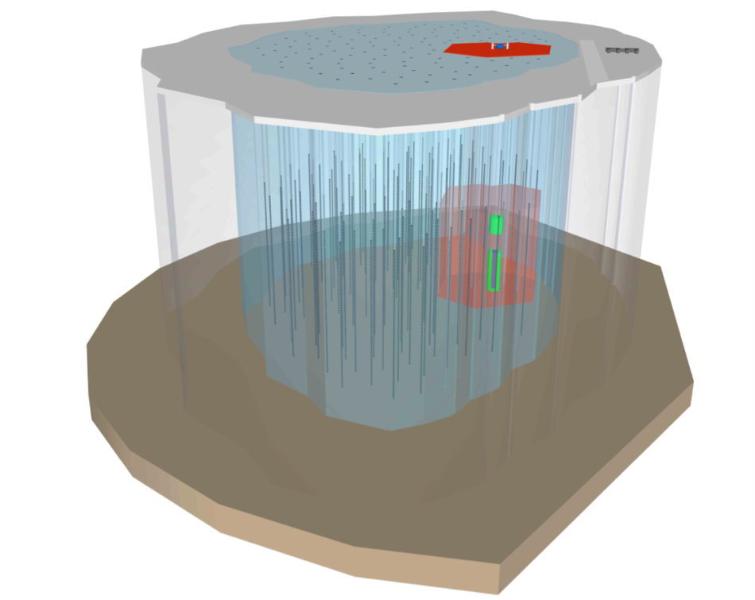
What is required for the next stage of the ν astronomy revolution?
IceCube’s detection rate
(~1/yr @ E>1 PeV, ~10/yr @ E>0.1PeV)
insufficient for precision
spectrum, flavor ratio and (an)isotropy,
and for source identification.
→ Expansion of ν telescopes M_{eff} @ ~1PeV
to ~10Gton (NG-IceCube, Km3Net).
Wide field EM monitoring.
Adequate sensitivity for detecting the ~10¹⁰GeV GZK ν’s.
HE γ-ray telescopes will play a key role

