Slide 1
The LHCb Upgrade
Outline
LHCb Detector
Selected Physics Results
Upgrade Plans
Test beam campaign (just a flash)
Summary
On behalf of the LHCb Collaboration
Tomasz Szumlak AGH-UST
XII International Conference on Heavy Quarks and Leptons (HQL)
25/08 – 29/08/2014, Mainz, Germany

Slide 2
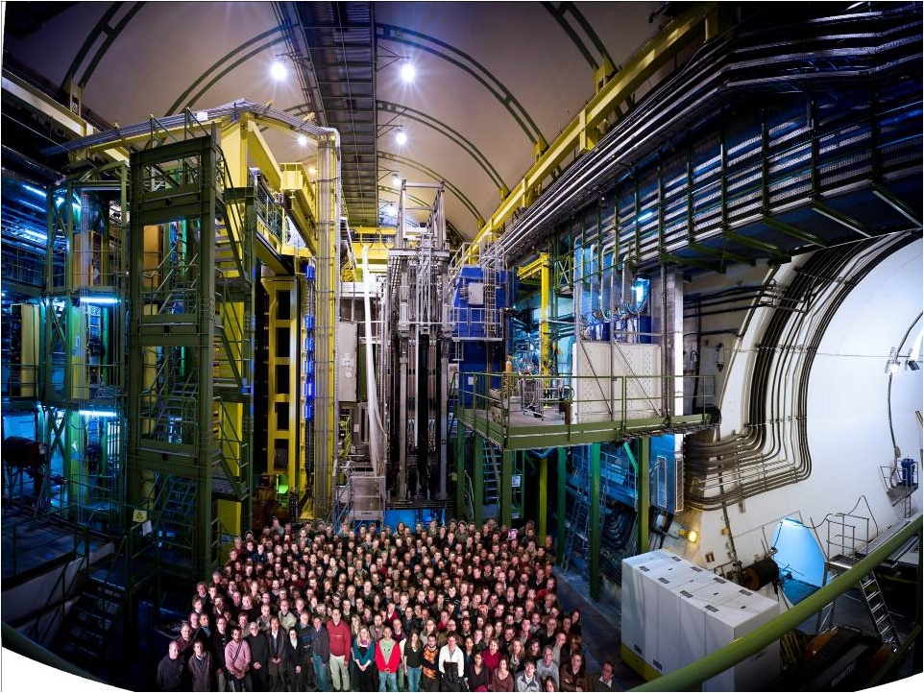
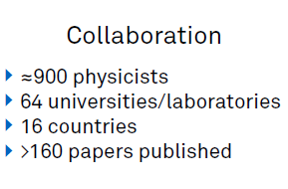
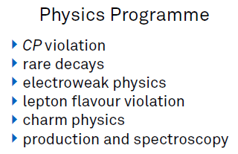

Slide 3
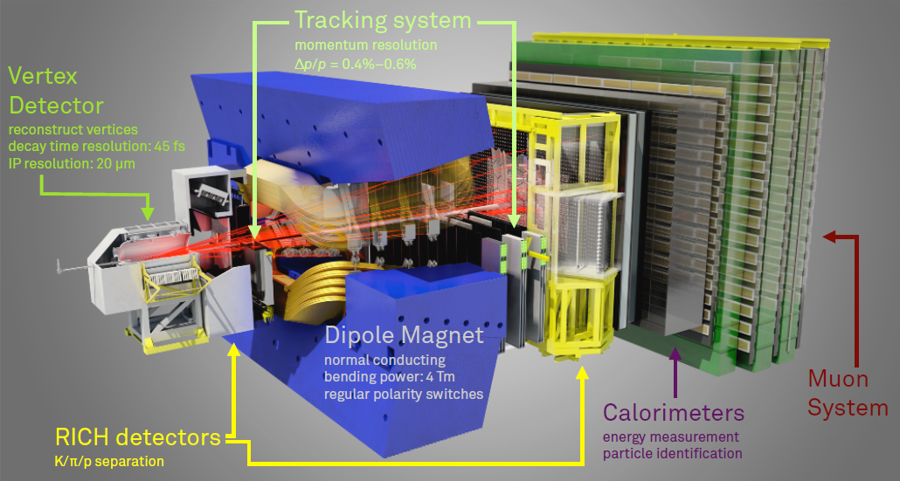
LHCb is dedicated for studying heavy quark flavour physics
It is a single arm forward spectrometer with pseudorapidity coverage 2 < η < 5
Precise tracking system (VELO, upstream and downstream tracking stations and 4 Tm magnet)
Particle identification system (RICH detectors, calorimeters and muon stations)
Partial information from calorimeters and muon system contribute to L0 trigger (hardware) that works at LHC clock – 40 MHz
Full detector readout at 1 MHz
The LHCb detector at LHC (JINST 3 2008 S08005)

Slide 4
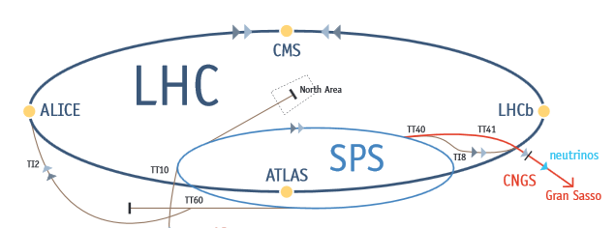
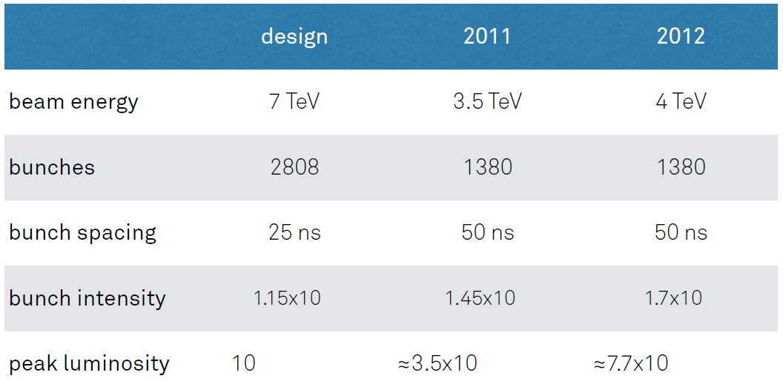
„Input” for the LHCb detector – LHC performance

Slide 5
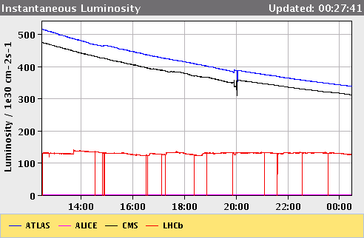
Operation conditions of the LHCb in 2011
recorded luminosity L ≈ 1,2 [fb⁻¹] at beam energy 3.5 [TeV]
LHCb stably operated at L_{inst} = 4.0 x 10³² [cm⁻²s⁻¹ ] (nominal 2.0 x 10³²)
Average number of visible interactions per x-ing µ = 1.4 (nominal 0.4)
Data taking efficiency ~90 % with 99 % of operational channels
HLT (High Level Trigger) input ~ 0.85 MHz, output ~ 3 kHz
Ageing of the sub-detectors monitored – according to expectations
Luminosity leveling
Use displaced p-p beams
Lower inst. Luminosity
Stable conditions during the run
Lower pile-up

Slide 6
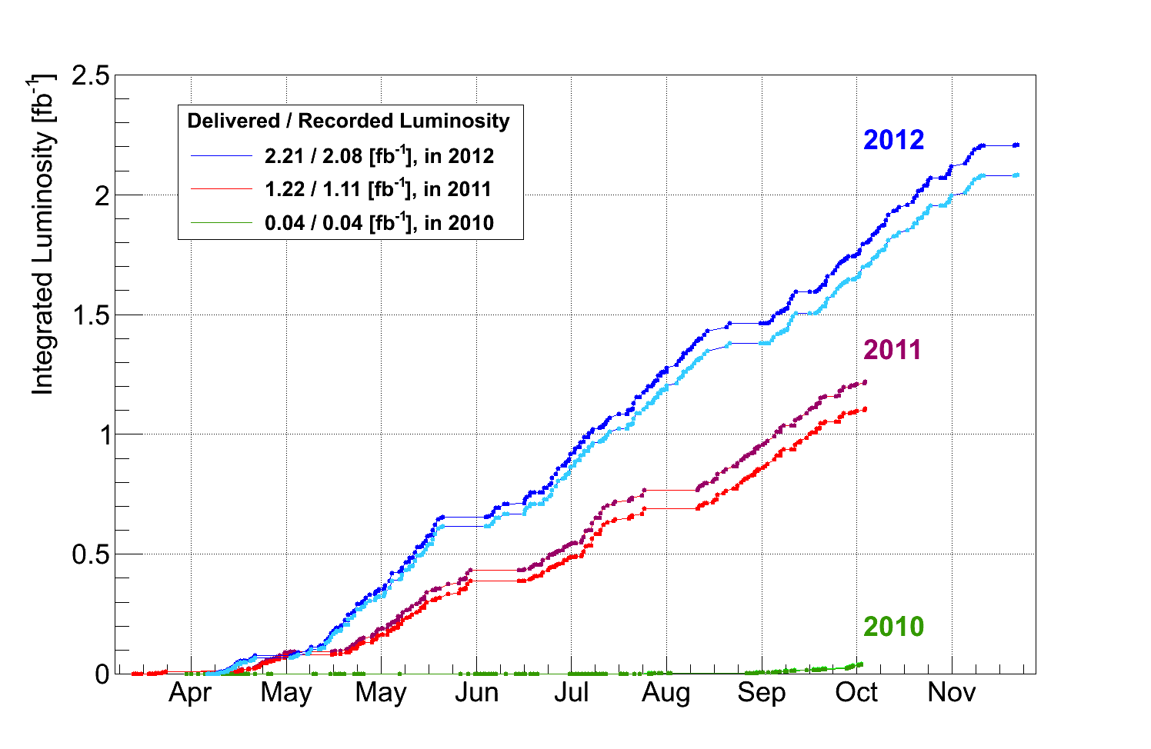
Operation conditions of the LHCb in 2012
Beam energy 4.0 [TeV] (15 % increase of the b-barb x-section)
Keep the luminosity at L_{inst} = 4.0 x 10³² [cm⁻²s⁻¹ ] for this year
Average number of visible interactions per x-ing slightly higher µ = 1.6
Keep high data taking efficiency and quality
HLT (High Level Trigger) input ~ 1.0 MHz, output ~ 5 kHz (upgraded HLT farm and revisited code)
Collected ~ 2.1 fb⁻¹ of collision data

Slide 7
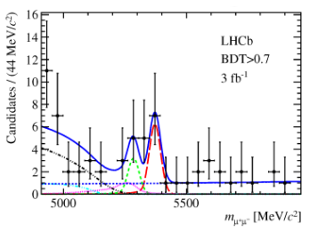
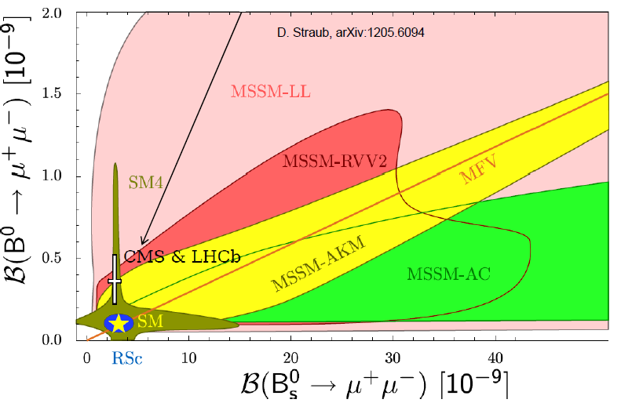
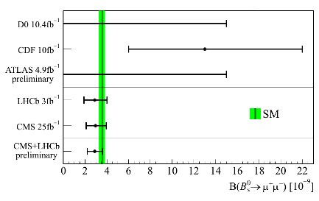
Selected physics results (1)
B_{s} → μ⁺μ⁻: constraining SUSY
Strongly suppressed in the SM
Theory - known with high precision
BR may be enhanced/different depending on New Physics contribution
World’s best measurement LHCb & CMS
New combination paper will be released shorlty

Slide 8
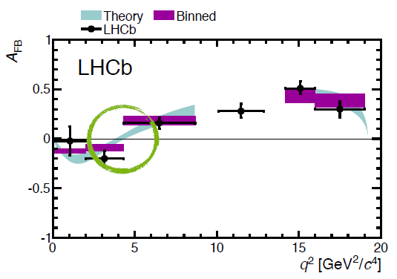
Selected physics results (2)
B⁰ → K*μ⁺μ⁻: NP in loops
The largest sample collected
Clear theoretical quantity
Sensitive to Wilson coefficients
World’s best measurement
(JHEP 1308 (2013) 131)

Slide 9
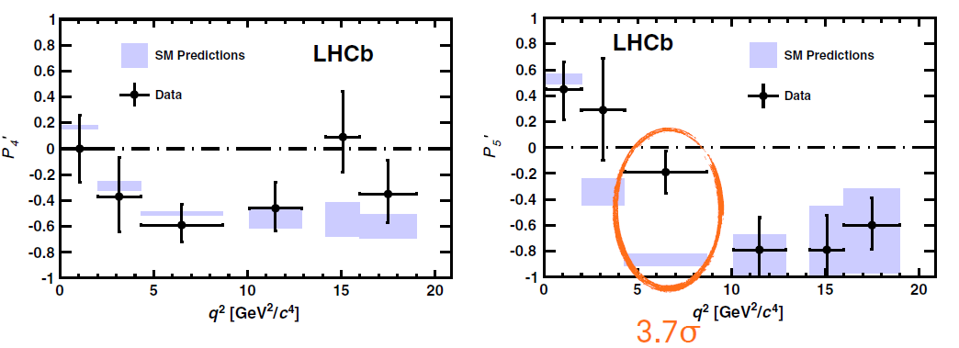
Selected physics results (3)
B⁰ → K*μ⁺μ⁻: NP in loops
Observed forward-backward asymmetry very similar to that predicted by the SM
Cannot clearly state any discrepancy – sample limitation
New base of observables proposed
Reduced dependency on hadronic form factors
Observed discrepancy may be a hint of new heavy neutral Z’ particle
(PRL 111, 191801 (2013))

Slide 10
Overall summary of Run I
LHCb:
Superb performance – greatly exceeded any expectations
Stable operation at inst. luminosity 100% higher than nominal
General purpose detector in forward direction
Many world leading results
Over 200 papers published!
The pinch of salt:
No conclusive BSM physics discovered
There is still room for NP!
Need push precision to the limits in order to challenge theoretical predictions
Need more data

Slide 11
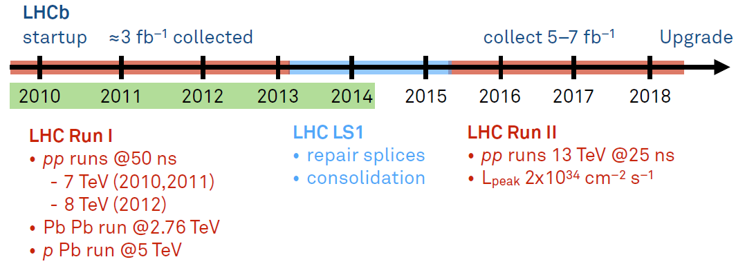
Data taking road map for LHCb before the upgrade

Slide 12
Upgrade Plans
Why upgrade (i.e., what’s wrong with the current design…?)
Superb performance – but 1 MHz readout is a sever limit
can collect ~ 2 fb⁻¹ per year, ~ 5 fb⁻¹ for the „phase 1” of the experiment
this is not enough if we want to move from precision exp to discovery exp
cannot gain with increased luminosity – trigger yield for hadronic events saturates
Upgrade plans for LHCb do not depend on the LHC machine
we use fraction of the luminosity at the moment
Upgrade target
full event read-out@40 MHz (flexible approach)
completely new front-end electronics needed (on-chip zero-suppression)
redesign DAQ system
HLT output@20 kHz, more than 50 fb⁻¹ of data for the „phase 2”
increase the yield of events (up to 10x for hadronic channels)
experimental sensitivities close or better than the theoretical ones
expand physics scope to: lepton flavour sector, electroweak physics, exotic searches and QCD
Installation ~ 2018 - 2019

Slide 13
Sensitivities to key flavour observables
(for more see: LHCb Upgrade: Technical Design Report, LHCb-TDR-12)

Slide 14
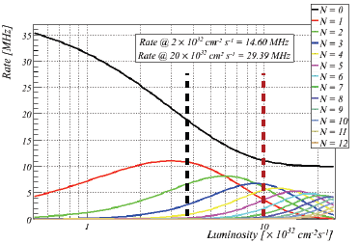
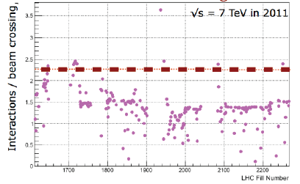
Projected running conditions for the upgrade
Operational luminosity up to L_{inst} = 2 x 10³³ [cm⁻²s⁻¹]
25 ns bunch time spacing
Average number of visible interaction per x-ing µ ≈ 2.6
Challenging environment for tracking and reconstruction
Radiation damage
High µ already seen in LHCb!

Slide 15
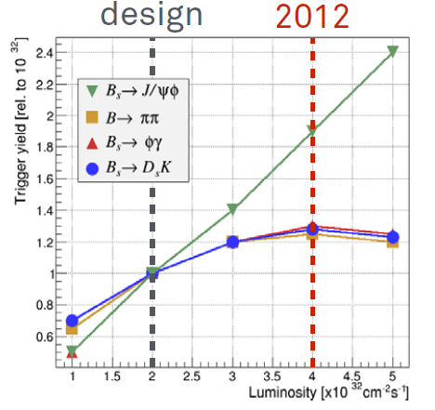
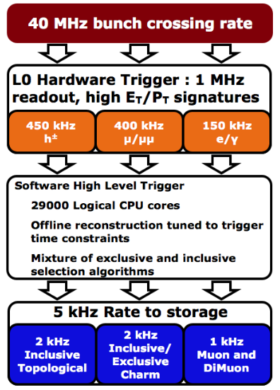
Tomasz Szumlak AGH – University of Science and Technology WIT Pisa 03 – 05/05/2012
Current trigger system
Problem for hadronic channels:
saturation with increasing luminosity
no gain in event yields

Slide 16
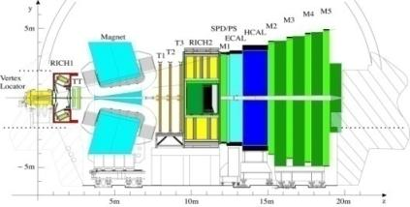
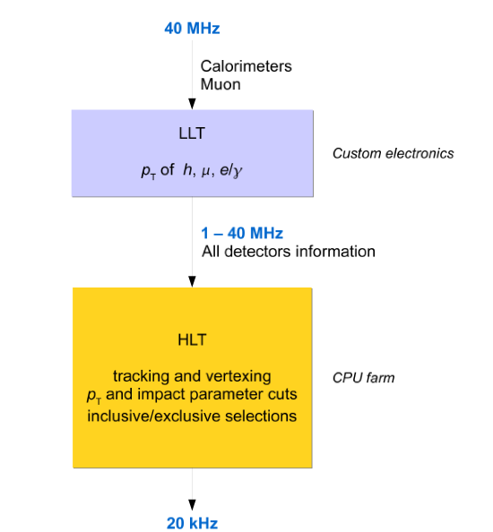
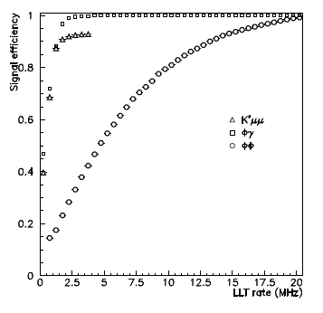
… and the upgraded one
Staged approach:
use Low Level Trigger (LLT) as a throttle
enormous gain for hadronic final states such ΦΦ
do as much as you can in HLT

Slide 17
Tracking is at heart of the current LHCb success
Upgrade cannot compromise this performance
This is not an easy task
At high luminosity we are expecting
More interactions per x-ing
Higher track multiplicities, more vertices, higher detector occupancy
More ghosts (scary and dangerous in many ways…)
Spill-over
We need to maintain
High tracking efficiency (~ 90% for p > 5 GeV)
High relative momentum resolution (~ 3.5 x 10⁻³)
Ghost rate as low as possible (less than ~ 10 %)
Single event processing time in HLT as short as possible (~ 25 ms)
And do not add to the material budget…
And in addition all of this using full detector information@40 MHz

Slide 18
Some truly revolutionary ideas are also intended for the LHCb Upgrade
Perform all the processing for the trigger in the high level software part
The hardware components act in principle as throttles
Bring on-line tracking as close to the off-line
Do not refit tracks off-line
Discard raw data
Keep on tape only high level objects
Some of these ideas are going to be checked/implemented already in RUN 2

Slide 19
What we must change to cope with the 40 MHz read-out
VELO
Si strips
(replace all)
Silicon Tracker
Si strips
(replace all)
Outer Tracker
Straw tubes
(replace R/O)
Muon MWPC
(almost compatible)
RICH
HPDs
(replace HPD & R/O)
Calo
PMTs (reduce PMT gain, replace R/O)

Slide 20
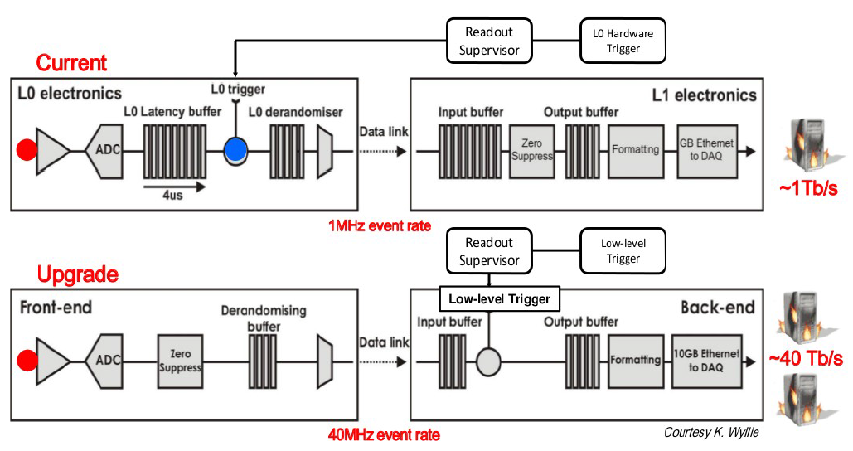
New front-end electronics
Trigger-less
Sends out data with the machine frequency
On chip zero-suppression (SoC)

Slide 21
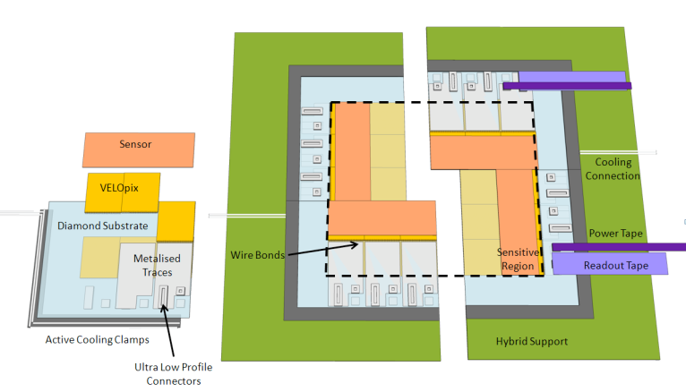
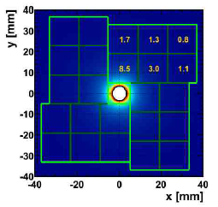
VErtex LOcator VELO2
Current design: R-Φ geometry Si strip sensors with pitch between 38 – 100 µm
To be replaced with pixel based device
low occupancy
much easier patter recognition
easier to control alignment
radiation hardness
extremely high data rate ~ 12 Gbit/s
un-uniform data rates/radiation damage
micro-channel CO₂ cooling
Read-out ASIC, VeloPix, based on TimePix/Medipix chip
256x256 pixel matrix
equal spatial resolution in both directions
IBM 130 nm CMOS process
great radiation hardness potential ~ 500 Mrad

Slide 22
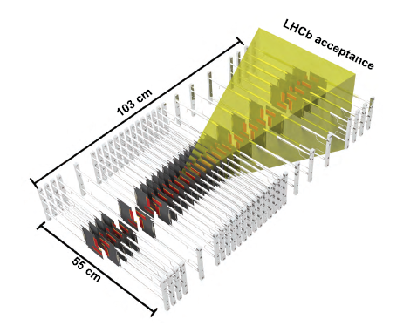
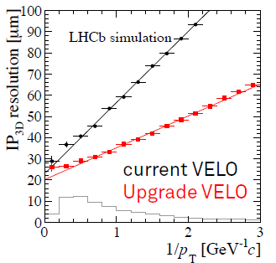
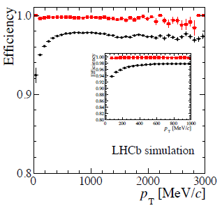
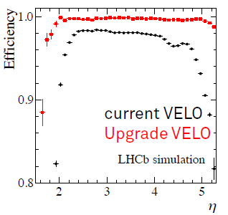
VErtex LOcator VELO2
Predicted performance superior in almost any aspect w.r.t the current VELO
This is essential for physics performance of the upgraded spectrometer
TDR document is out!
(VELO Upgrade: Technical Design Report, LHCb-TDR-13)

Slide 23
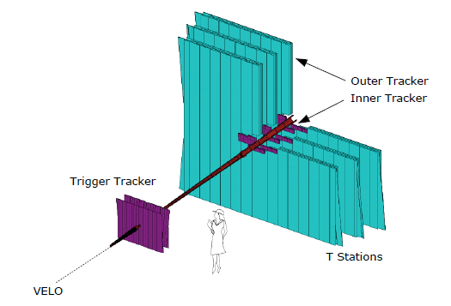
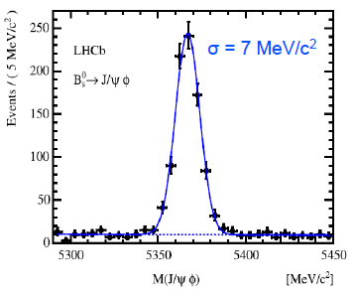
TT and T (IT + OT) trackers
TT and IT part of the T stations are Si strips based detectors
pitch 200 µm
long strips 11, 22 and 33 cm
OT is a gaseous detector
very long (2.4 – 5 m)
and thin straws (5 mm)
occupancy limited to ~ 10 – 25 %
World’s best b hadrons mass measurement!

Slide 24
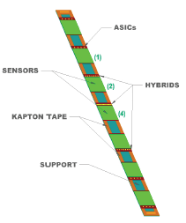
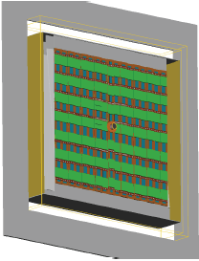
TT tracker upgrade
Features after the upgrade
high momentum track on-line selection (part of the trigger)
reconstruct long lived particles decaying outside the VELO
momentum estimate for slow particles
improved matching with VELO segments
Upgrade technology
4 – 6 detector planes of Si strip detectors
reduced silicon thickness 500 → 300 μm
strip length 2.5 – 10 cm
increase acceptance at low η
new read-out electronics with on-chip zero-suppression SALT chip (AGH Krakow)
(Tracking Upgrade: Technical Design Report, LHCb-TDR-15)

Slide 25
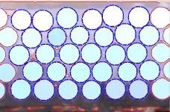
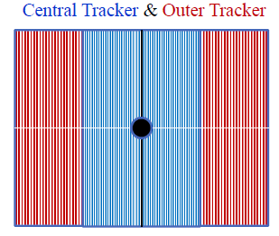
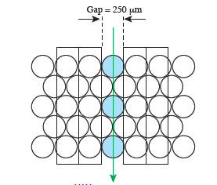
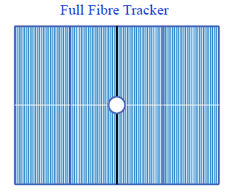
T stations upgrade
IT must be completely removed
integrated 1 MHz electronics
Decrease the occupancy
First option (Central Tracker)
central part: scintillating fibers with SiPM readout (128 readout channels)
build with 5 layers of 250 µm scintillating fibers
outer part is kept as is (straws)
Second option (Full Fiber Tracker)
OT removed completely with 1 mm scintillating fibers
(Tracking Upgrade: Technical Design Report, LHCb-TDR-15)

Slide 26
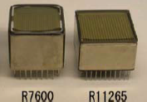
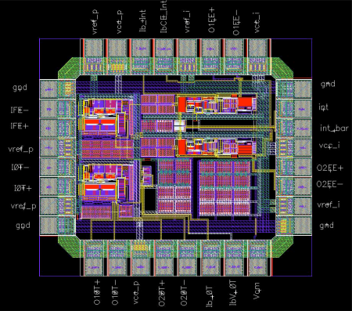
Particle ID and Calorimeters
MaPMTs by Hamamatsu
Both RICH1 and RICH2 remains
new photo detectors (MaPMTs)
square design to increase coverage
40 MHz read-out ASIC
remove aerogel (cannot operate at expected luminosities)
ASIC prototype
Calorimeters (ECAL and HCAL) are maintained
PS/SPD removed (no L0!), e/γ separation provided by tracker (worked out in HLT)
inner modules of the ECAL may be replaced due to radiation damage (LS3)
front-end electronics adapted to 40 MHz read-out
first prototype ready – under study
lower gain
(PID Upgrade: Technical Design Report, LHCb-TDR-14)

Slide 27
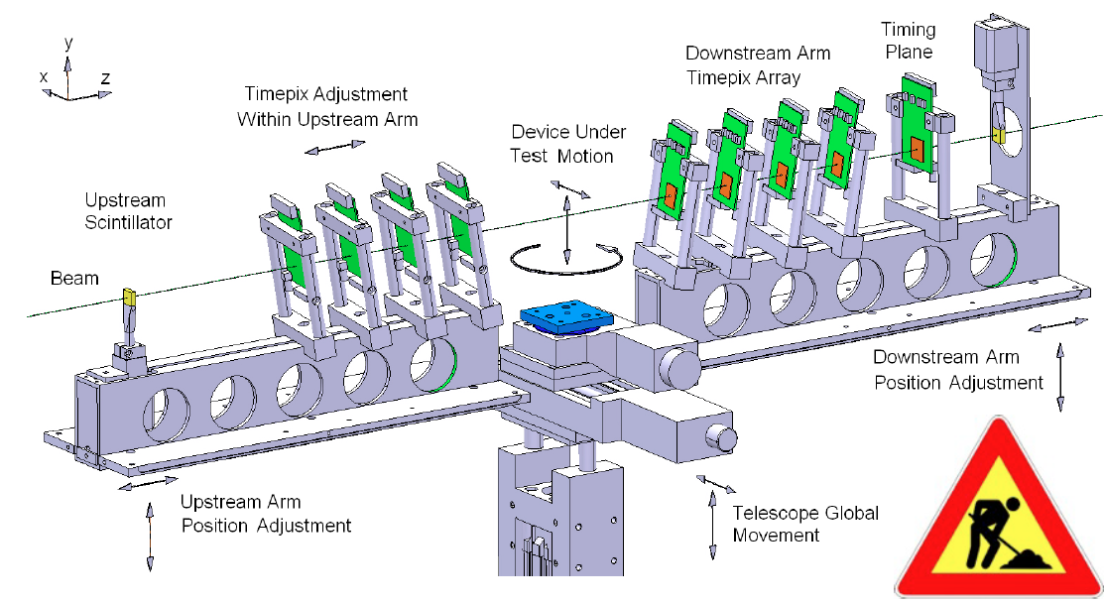
In order to build the new detector we need to test a lot of new state of the art technologies!
almost all sub-detectors started their respective test beam campaigns
in order to test new pixel chips VELO group created a real beauty – TimePix(3) telecope
the main goal is to test the direct precursor of the final read out chip for the upgraded VELO
can also serve as a test bed for various DUTs
during the July/August test beam the UT group used the TimePix telescope to test its sensors

Slide 28
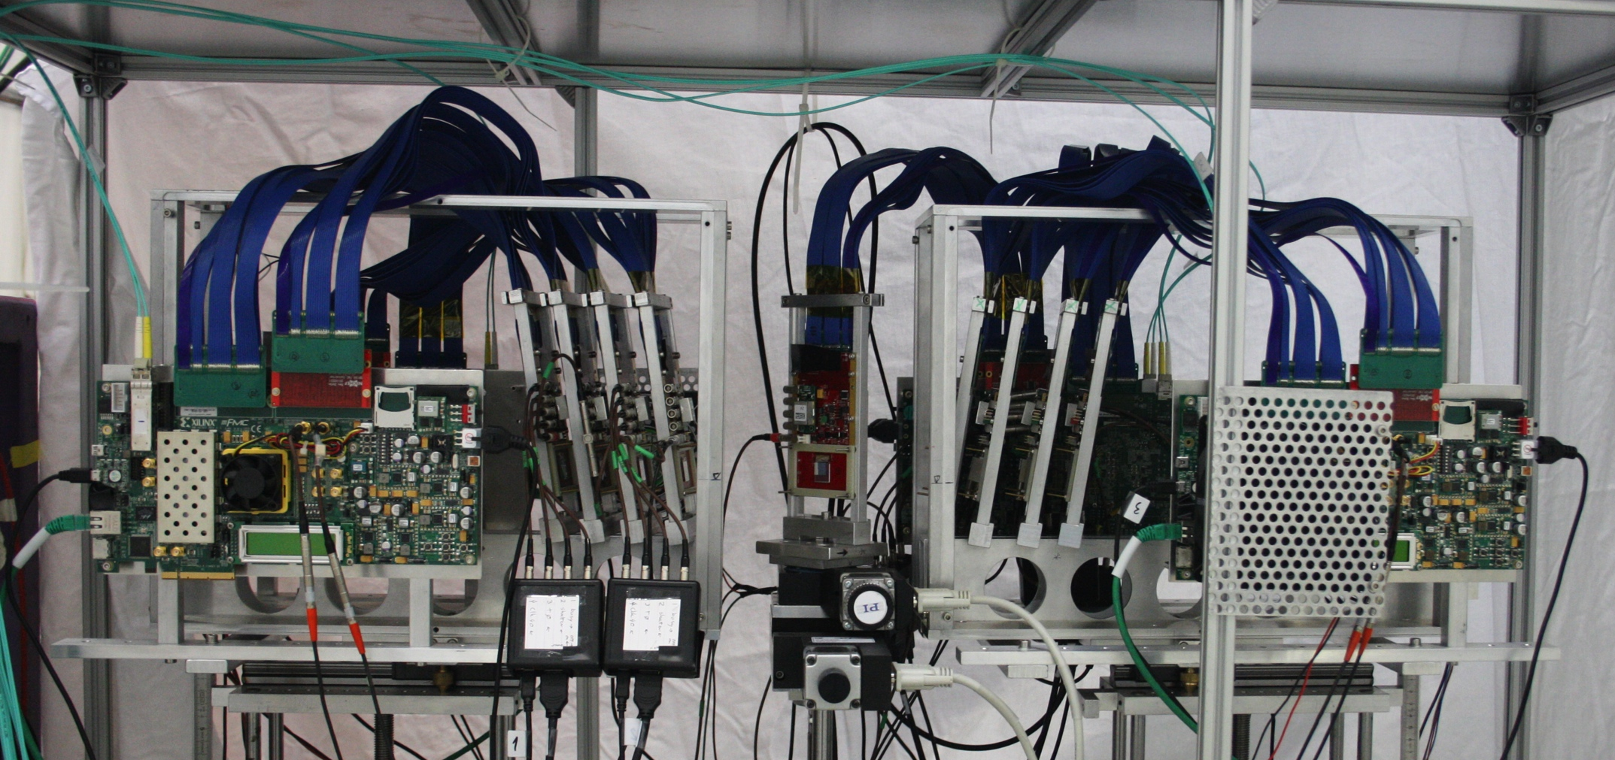
In order to build the new detector we need to test a lot of new state of the art technologies!
almost all sub-detectors started their respective test beam campaigns
in order to test new pixel chips VELO group created a real beauty – TimePix(3) telecope
the main goal is to test the direct precursor of the final read out chip for the upgraded VELO
can also serve as a test bed for various DUTs
during the July/August test beam the UT group used the TimePix telescope to test its sensors

Slide 29
Summary
Run II and the upgrade road map

Slide 30
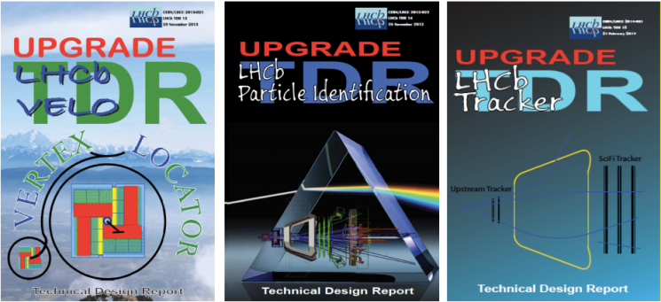
Superb performance of the LHCb experiment during Run I
Large number of world’s best physics results
More than 180 papers published
We did not make any considerable dents on the Standard Model
Upgrade of the present detector essential for discovery potential of the LHCb – origin of the CP violation and NP
Can collect ~ 50 fb⁻¹ of data between 2019 and 2028
Base-line technologies of the upgrade have been chosen
Respective TDRs have been/are being submitted to the LHCC
Stay tuned! A lot of exciting time is ahead!

Slide 31
Back-up

Slide 32
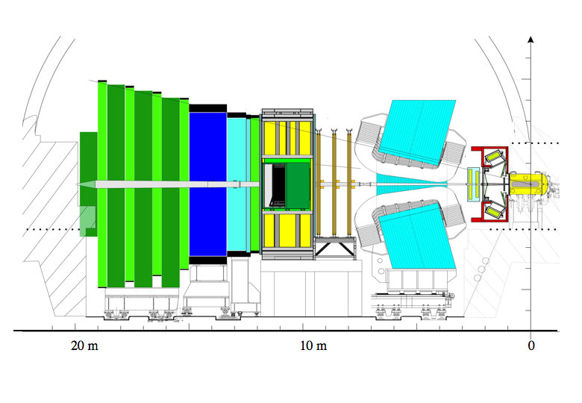
Muon system
TT+IT (Silicon Tracker)
300(H)/250(V) mrad
OT
Calorimeters
Dipole magnet
Vertex Locator
15mrad
Interaction
Point
OT – Outer Tracker
IT – Inner Tracker
TT – Trigger Tracker
RICH detectors
Single arm spectrometer geometry
Fully instrumented in rapidity range 2 < η <5
Capable of reconstructing backward tracks (-4 < η < -1.5)

