Slide 1
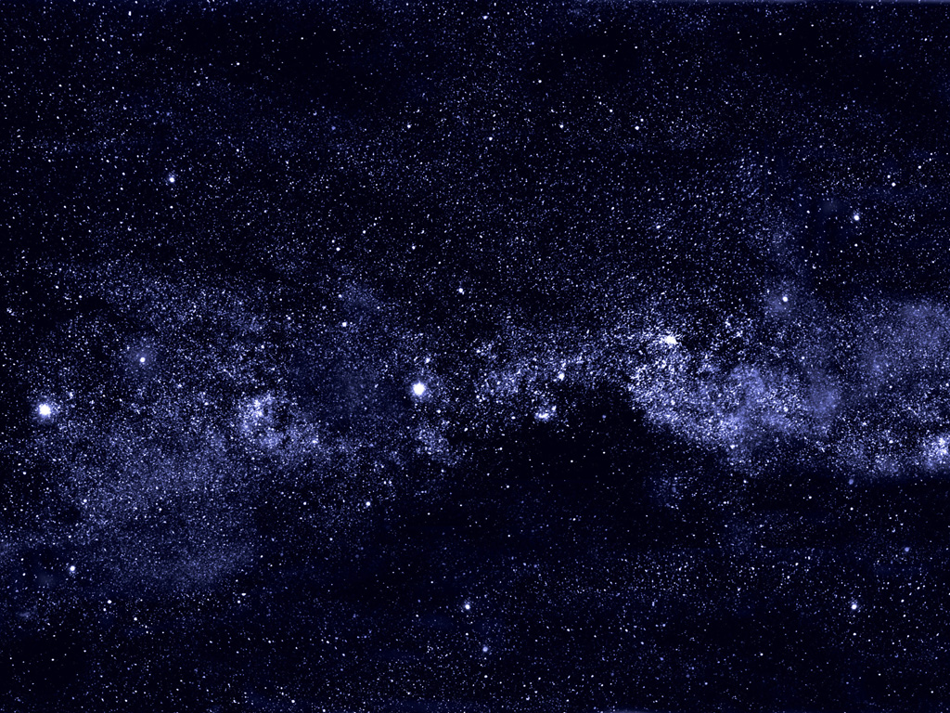
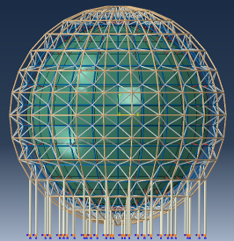
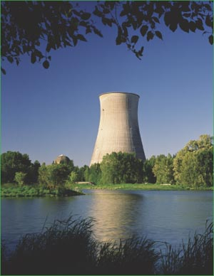
Jiangmen Underground Neutrino Observatory
JUNO
29. August 2014
Achim Stahl – RWTH Aachen Univ.

Slide 2
Physics of JUNO
Mass Hierarchy
Others
Super Nova
Direct observation
Diffuse Super Nova background
Solar Neutrinos
Oscillation parameters
Metallicity
Atmospheric Neutrinos
Oscillations
Mass hierarchy ?
Geo Neutrinos
Models of the earth‘s interior
Heat production → climate
Nucleon Decay
i.e. p → K⁺ ν
Dark Matter
χ → νν
Sterile Neutrinos
With radioactive sources
ν-oscillations with reactor neutrinos:
Mass hierarchy
Precision Measurements
2

Slide 3
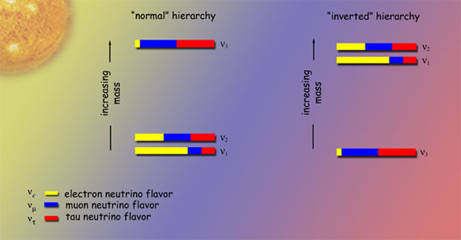
Normal or inverted hierarchy ?
Precision measurements ?
Majorana or Dirac neutrinos ?
CP-violation ?
Absolute mass scale ?
JUNO / PINGU / LBNE / INO
JUNO and others
2β0υ decays
ν-factory, LBNE(?)
KATRIN
3

Slide 4
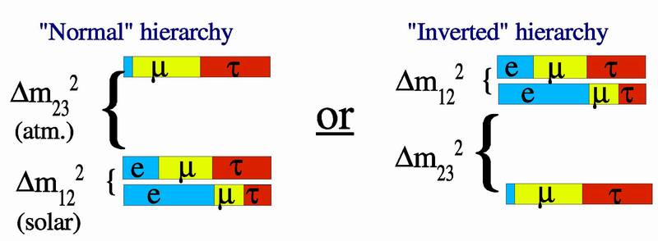
Mass Hierarchy
Reactor Electron-Anti-Neutrino Disappearance
$$P\left({\overline{ν}}_{e}→{\overline{ν}}_{e}\right)=1 −4\sum_{i,j}{{\left|U_{ei}\right|}^{2}{\left|U_{ej}\right|}^{2}\sin^{2}{Δ_{ij}}}$$
$$Δ_{ij}=\frac{Δm_{ij} L}{4E}$$
3-flavour scenario
$$\begin{matrix}P\left({\overline{ν}}_{e}→{\overline{ν}}_{e}\right)=1 \\ −\cos^{4}{θ_{13}}\sin^{2}{2θ_{12}}\sin^{2}{Δ_{21}} \\ \begin{aligned}−\cos^{2}{θ_{12}\sin^{2}{2θ_{13}}}\sin^{2}{Δ_{31}} \\ −\sin^{2}{θ_{12}}\sin^{2}{2θ_{13}\sin^{2}{Δ_{32}}}\end{aligned}\end{matrix}$$
$$Δm_{ij}=m_{i}^{2}−m_{j}^{2}$$
low frequency
high frequency
high frequency
Yu-Feng Li et al.,
Phys.Rev. D88 (2013) 013008
$$\left|Δm_{31}^{2}\right|=\left|Δm_{23}^{2}\right|+\left|Δm_{12}^{2}\right|$$
$$\left|Δm_{31}^{2}\right|=\left|Δm_{23}^{2}\right|−\left|Δm_{12}^{2}\right|$$
4

Slide 5
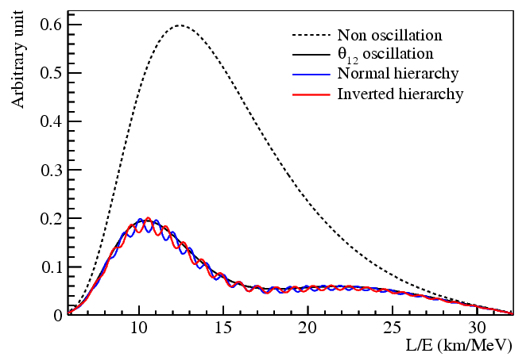
Mass Hierarchy
typ. ν-energy: 5 GeV
different frequencies
good L: 50 … 60 km
5

Slide 6
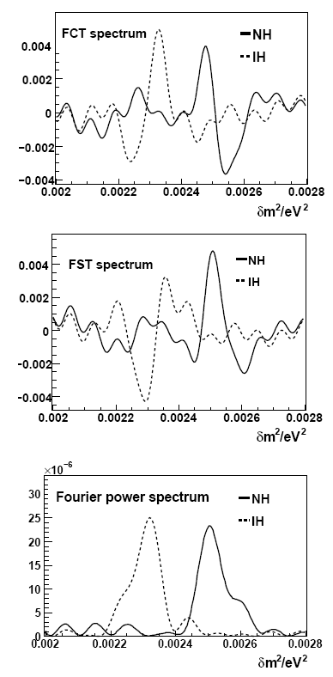
Mass Hierarchy
$$\cos{\frac{L}{E}}$$
Fourier analysis of signal
$$\sin{\frac{L}{E}}$$
6

Slide 7
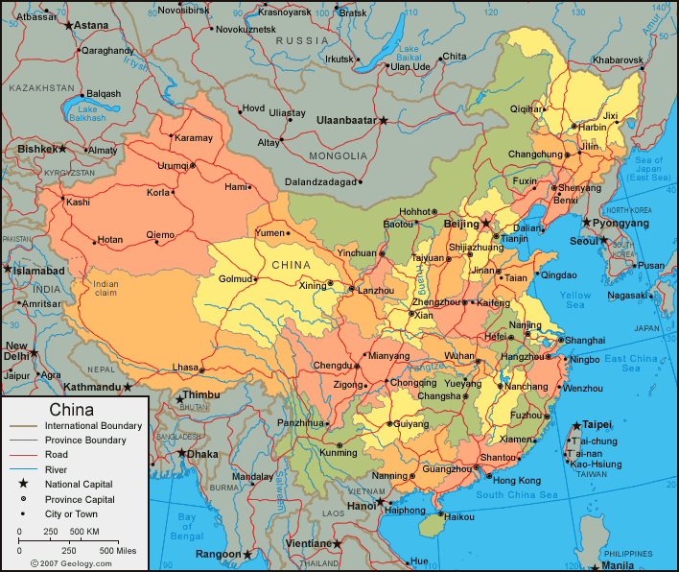
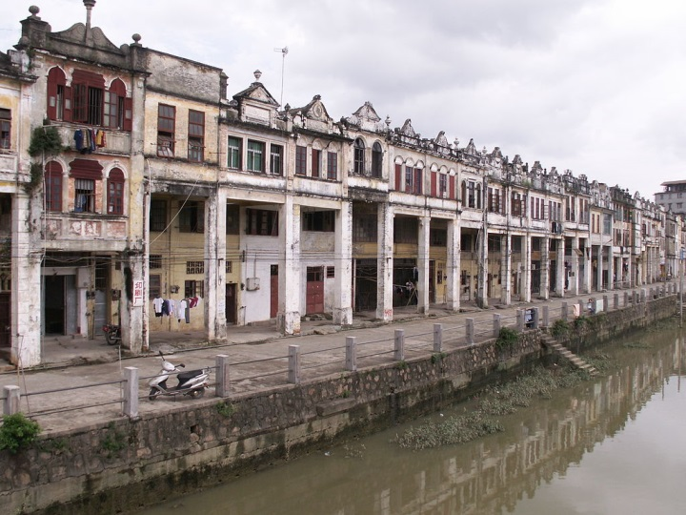
The Site
Guangdong province
Jiangmen prefecture
Kaiping city
7

Slide 8
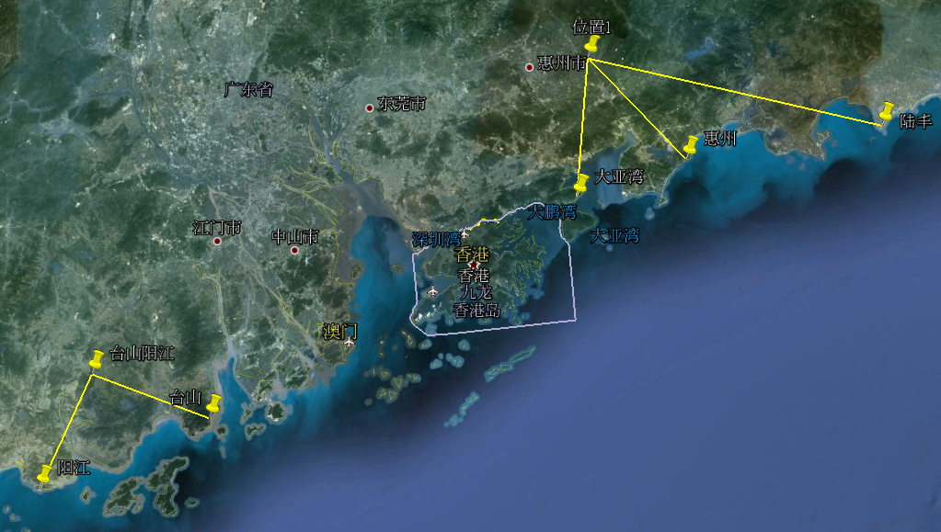
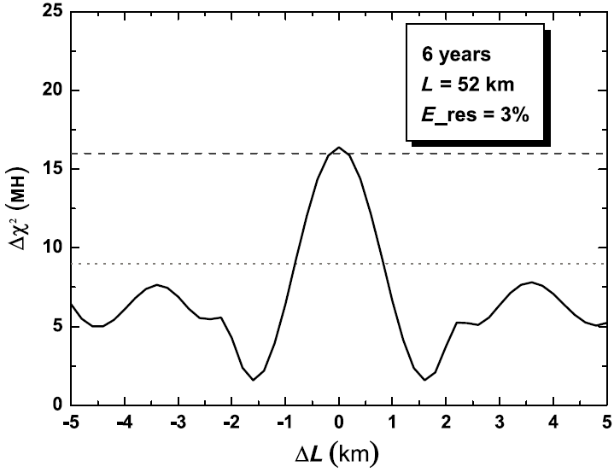
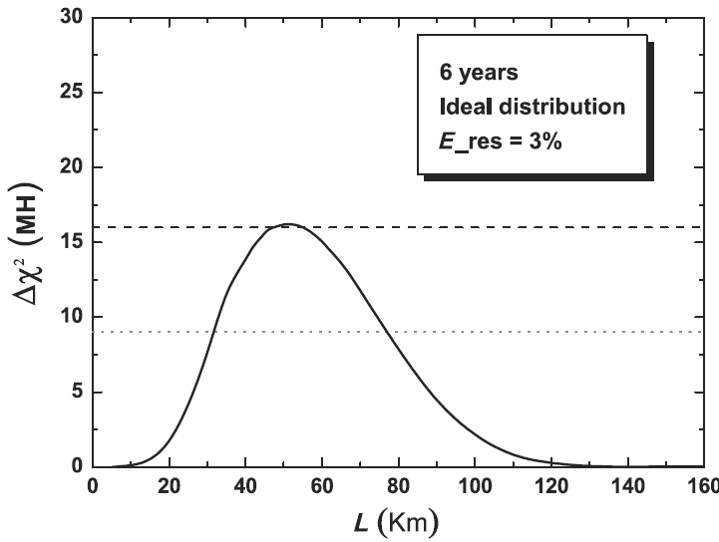
The Site
Jiangmen
Kaiping
JUNO
Hongkong
Macao
55km
55km
Taishan
18.4 GW
Yangjiang
17.4 GW
8

Slide 9
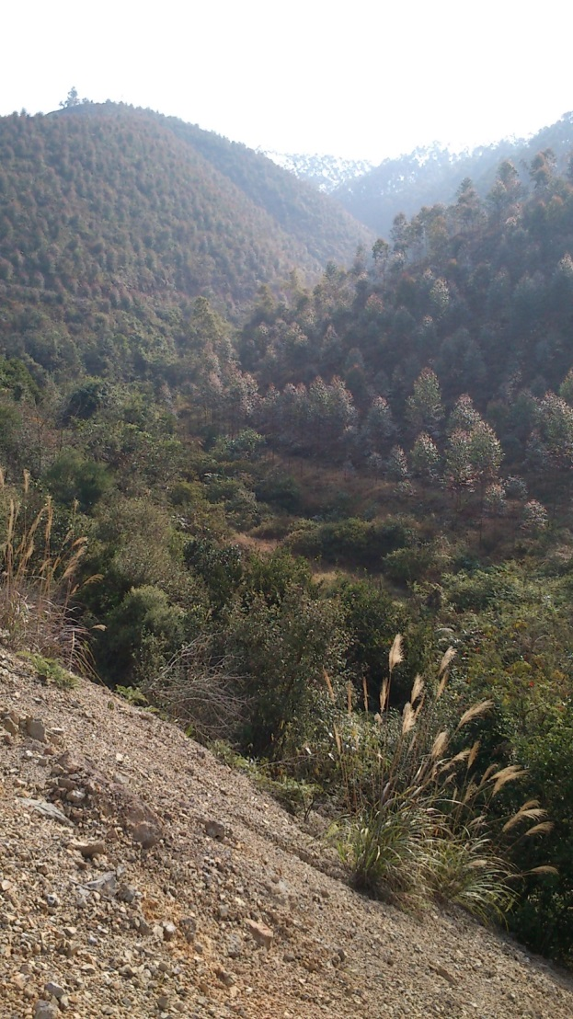
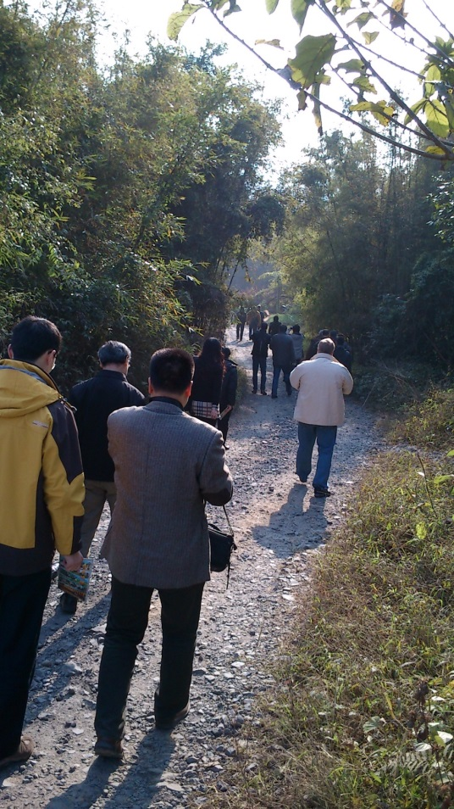
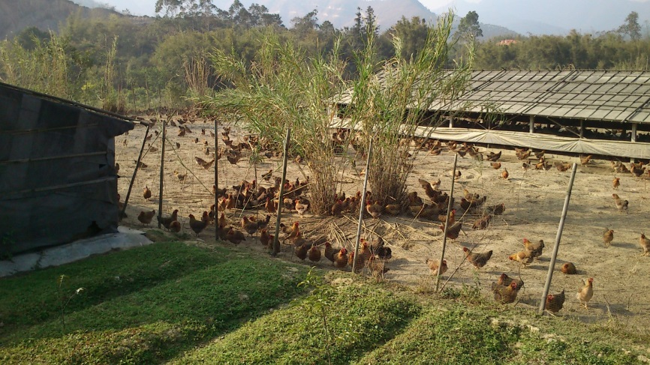
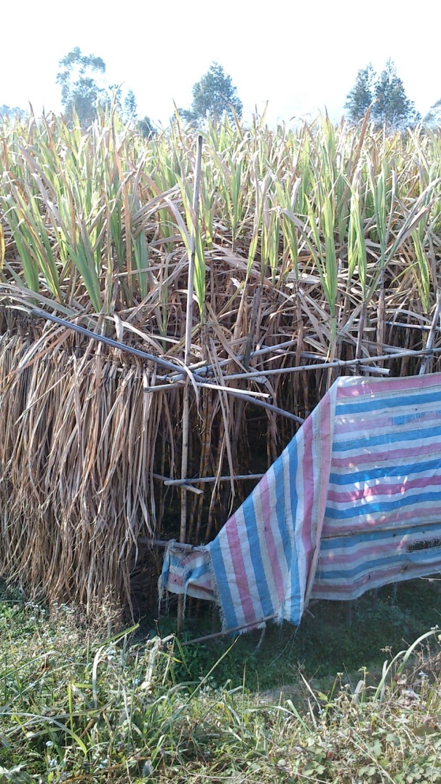
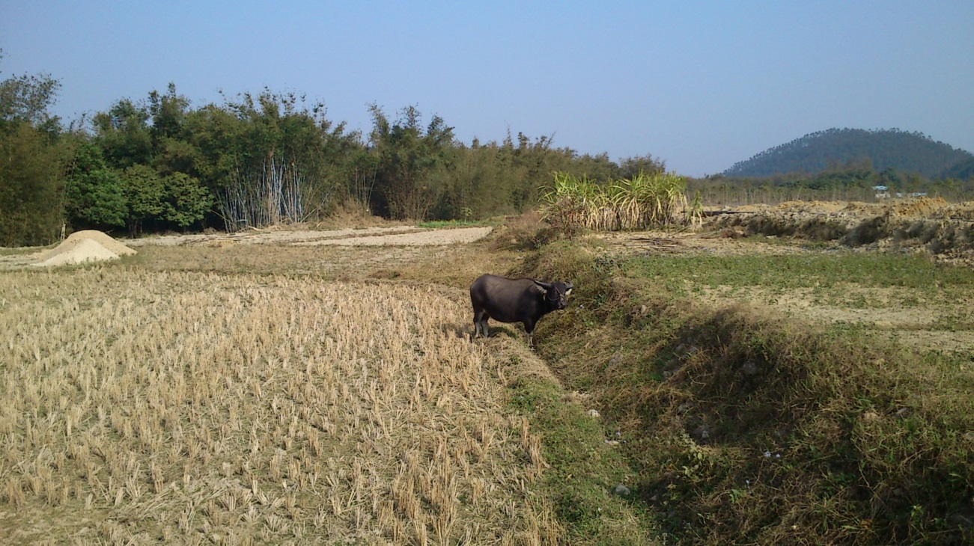
The Site
Jiangmen
Kaiping
JUNO
Hongkong
Macao
55km
55km
Taishan
18.4 GW
Yangjiang
17.4 GW
9

Slide 10
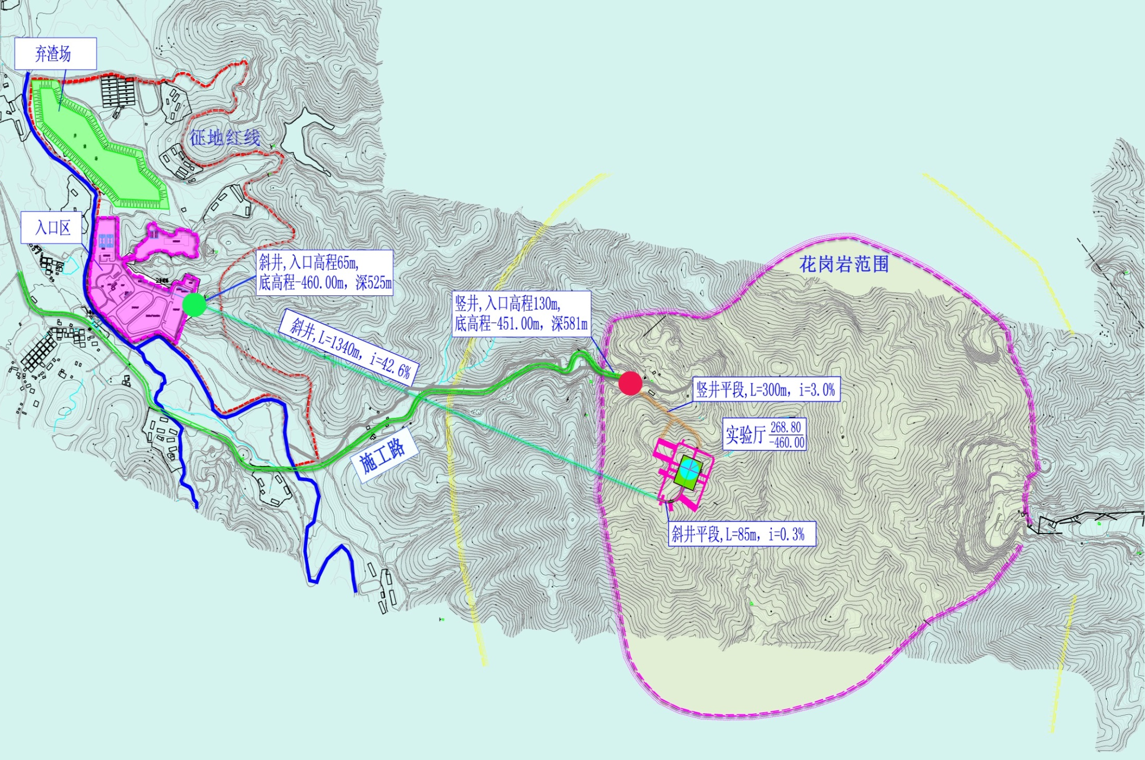
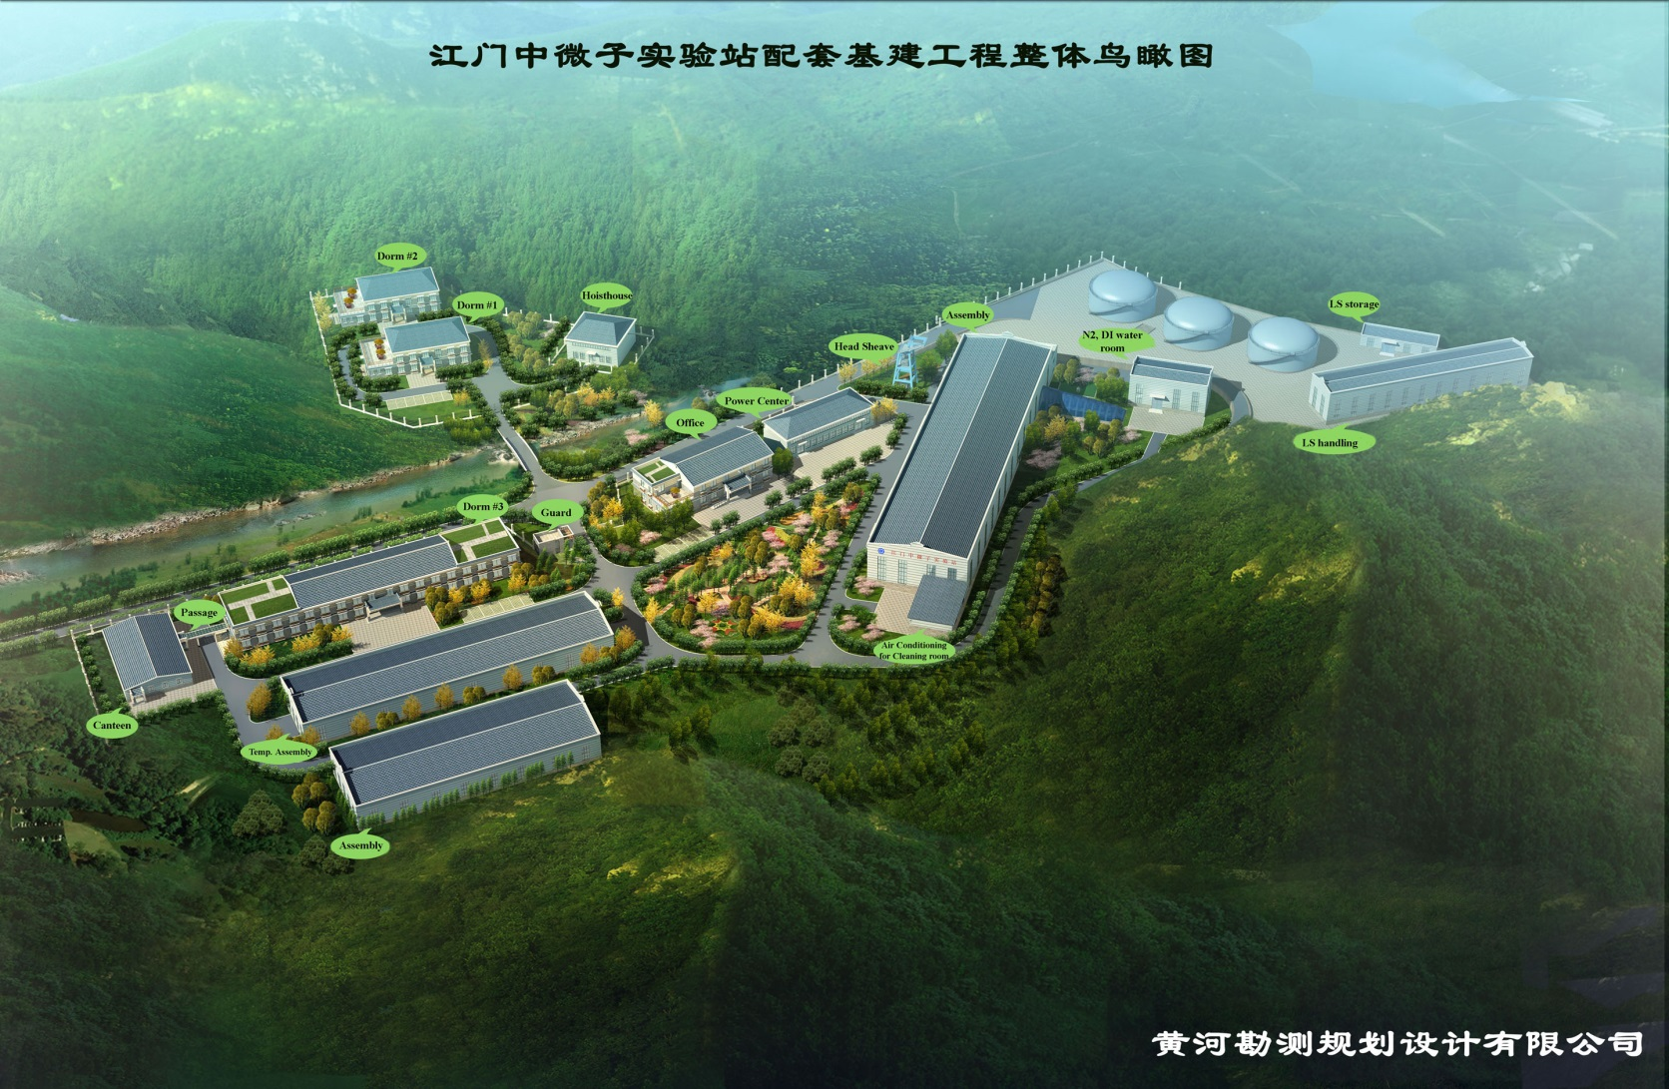
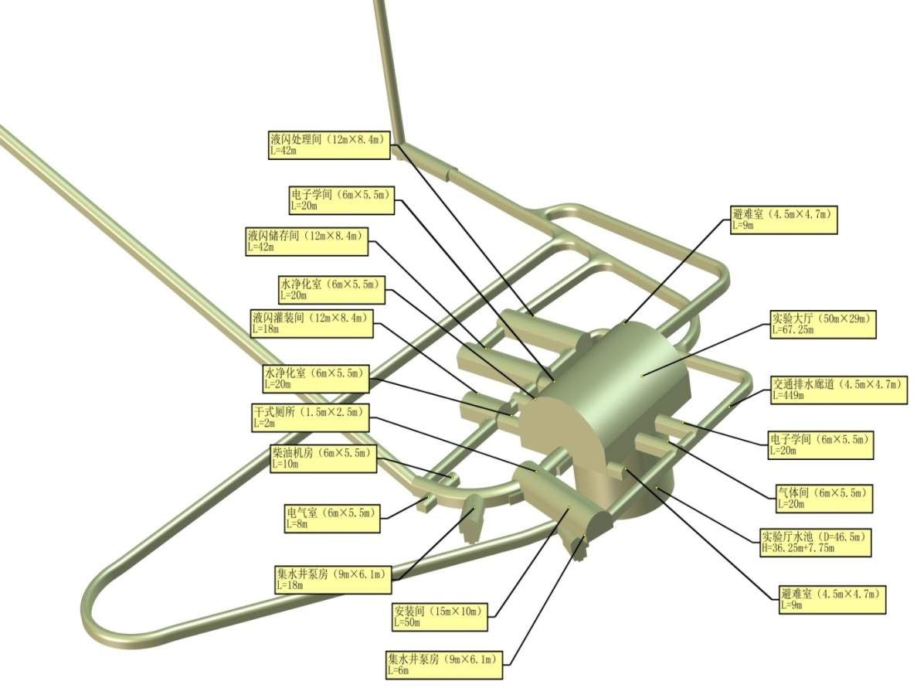
Underground Laboratory
access tunnel
access shaft
JUNO
Entrance site
Labs / offices / dormitories
Overburden: 700 m rock
10

Slide 11
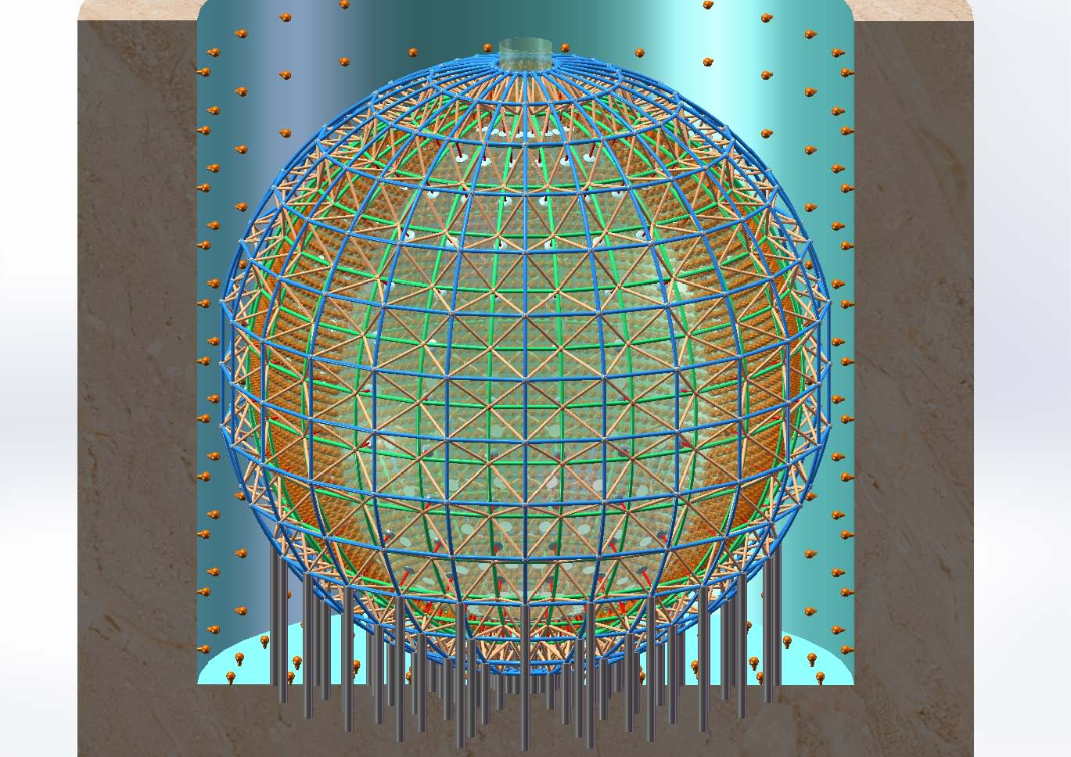
The detector
muon tracker
water Čerenkov
veto
acrylic sphere
16.000 PMTs
20 kt
liquid scintillator
(ID 35.5 m)
water buffer
steel truss
11

Slide 12
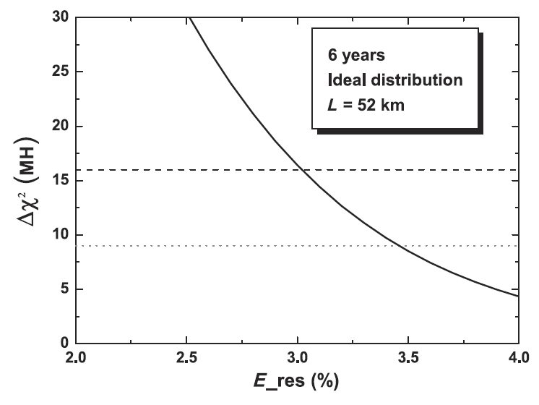
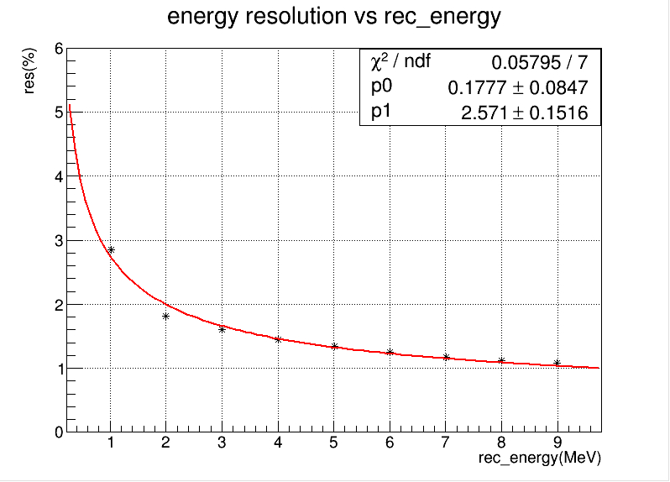
The challenge
total charge-based energy reconstruction with an ideal vertex reconstruction
Monte Carlo
12

Slide 13
The challenge
Excellent Energy Resolution (1% @ 1 MeV)
Photonstatistics
high lightyield
good transparency
PMT-coverage
PMT-QE
Calibration
α/β sources (in all positions)
light pulsers (in all positions)
UV-laser (in many positions)
e⁺ beam (along axis)
&
13

Slide 14
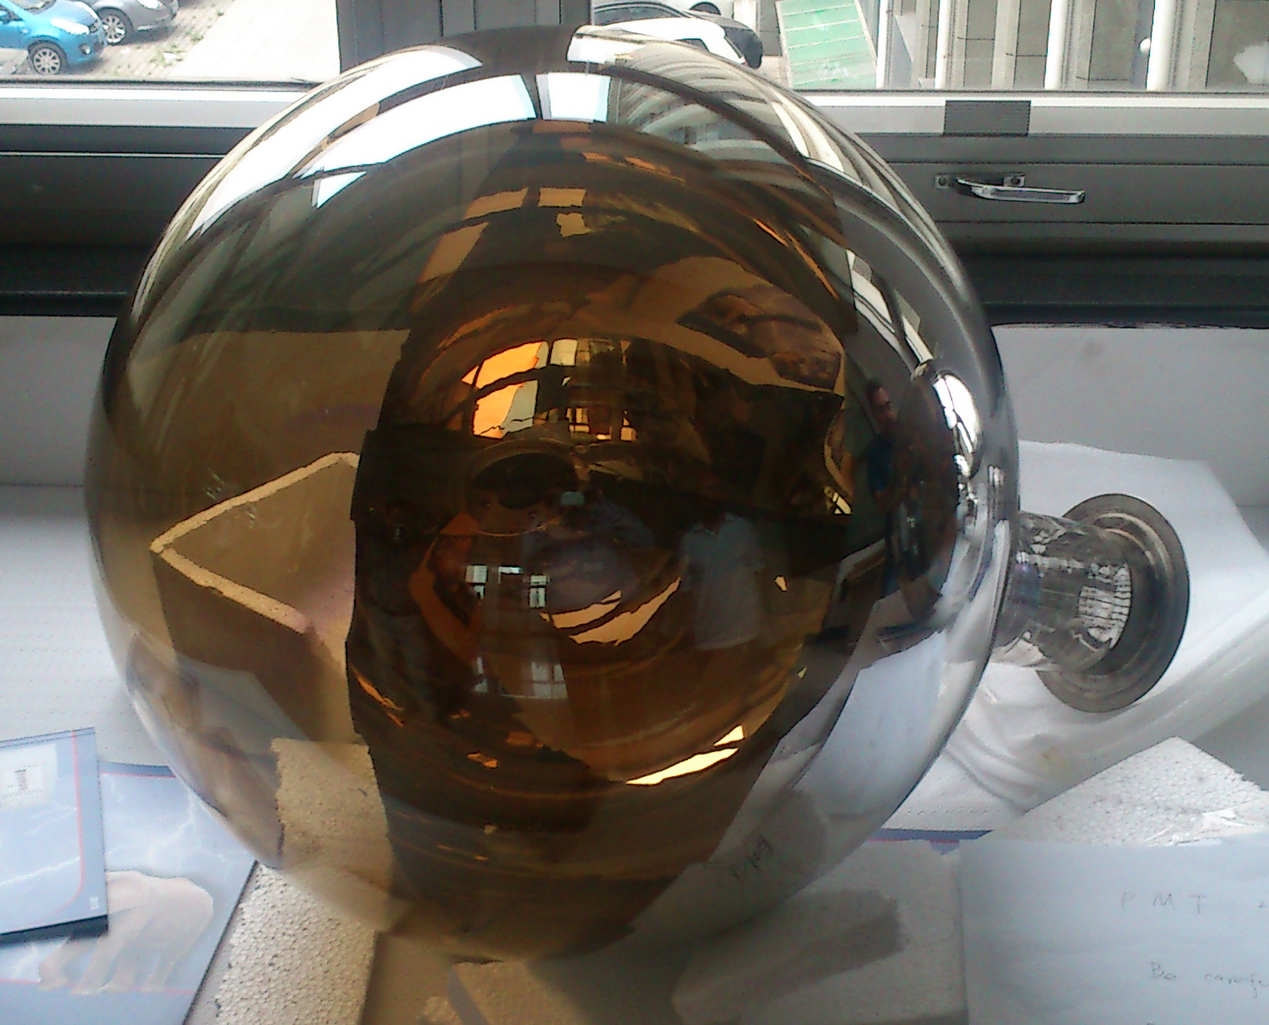
The MCP-PMT
transmission
cathode
reflexion
cathode
Photoelectron
MCP A
MCP B
Photoelectron
Photon
14

Slide 15
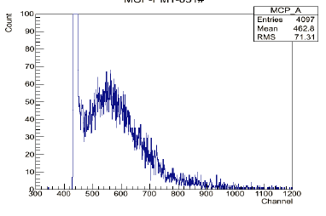
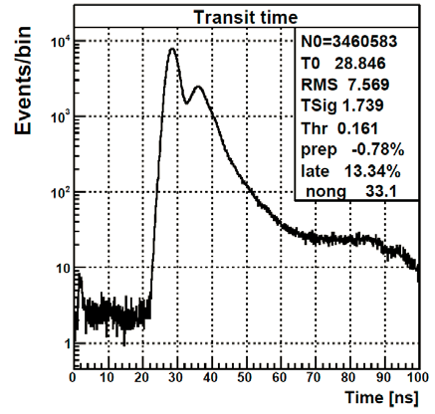
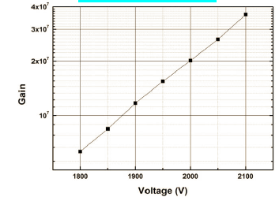
Prototypes
P/V ≈ 2
Sizes 8“ and 20“
Results from good MCP-PMTs
QE@410 nm: 25%
single p.e. 17 mV
risetime 5 ns
TTS ≈ 3.5 ns
15

Slide 16
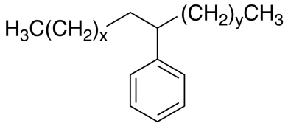
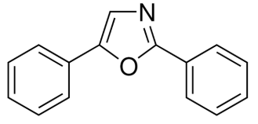
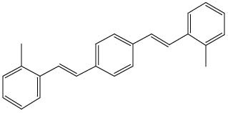
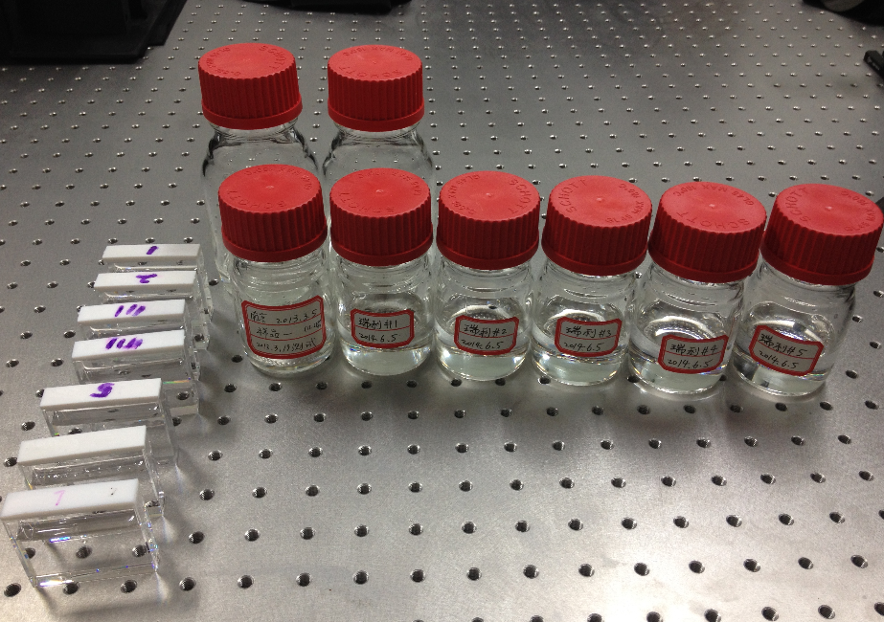
Liquid Scintillator
Linear AlkylBenzene
(solvent)
LAB + PPO + BisMSB
PPO (2,5-diphenyloxazole)
(3 g/l)
Lightyield: ≈10000 ph./MeV
→ 1200 p.e./MeV
Attenuation length > 22m @ 430 nm
scattering length ≈ 30 m
absorption length ≈ 90 m
bis-MSB (MethylStyryl-Benzene)
(15 mg/l)
KAMLand
JUNO
16

Slide 17
Physics of JUNO
Mass Hierarchy
Others
Super Nova
Direct observation
Diffuse Super Nova background
Solar Neutrinos
Oscillation parameters
Metallicity
Atmospheric Neutrinos
Oscillations
Mass hierarchy ?
Geo Neutrinos
Models of the earth‘s interior
Heat production → climate
Nucleon Decay
i.e. p → K⁺ ν
Dark Matter
χ → νν
Sterile Neutrinos
With radioactive sources
MC-studies:
>3 sigma in 4 years
(3% resolution @ 1 MeV)
ν-oscillations with reactor neutrinos:
Mass hierarchy
Precision Measurements
17

Slide 18
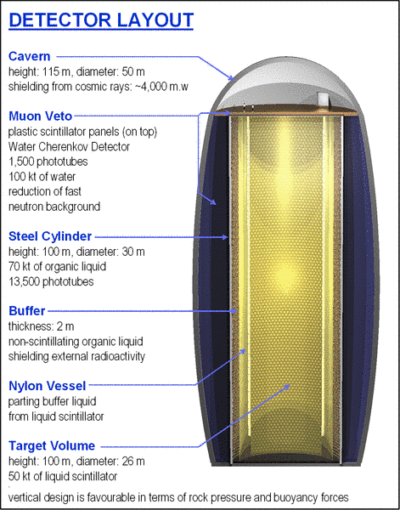
Physics of LS-Detectors
Others
Others
LENA @ Phyäsalmi
JUNO @ Jiangmen
LENA
50 kt LS
1400 m overburden
> 200 km to next reactor
7% resolution @ 1 MeV
JUNO
20 kt LS
700 m overburden
35 GW at 55 km
3% resolution @ 1 MeV
ν-oscillations with reactor neutrinos:
Mass hierarchy
Precision Measurements
18

Slide 19
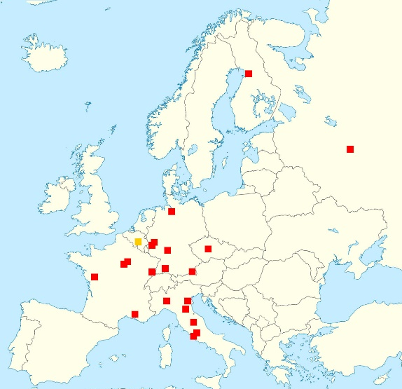
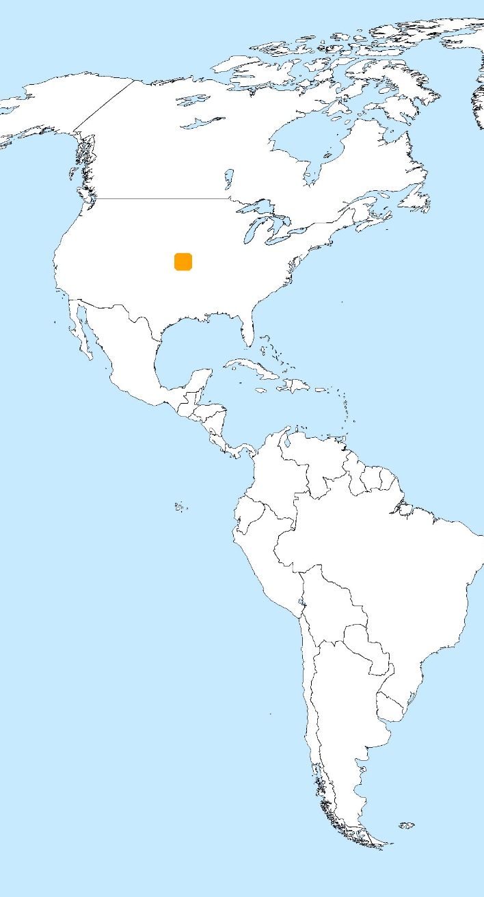
JUNO
Collaboration
US institutions (Observers)
Status
CDR in a few weeks
approval by end of 2014
start construction Jan. 2015
start datataking 2021
Europe (20)
APC Paris
Charles U.
CPPM Marseille
FZ Jülich
INFN-Frascati
INFN-Ferrara
INFN-Milano
INFN-Padova
INFN-Perugia
INFN-Roma 3
U. libre de Bruxelles (Observer)
IPHC Strasbourg
JINR
LLR Paris
RWTH Aachen U.
Subatech Nantes
TU Munich
U.Hamburg
U.Mainz
U.Oulu
U.Tuebingen
Asia (25)
Beijing Normal U.
CAGS,
CIAE
DGUT
ECUST
Guangxi U.
IHEP
Jilin U.
Nanjing U.
Nankai U.
Natl. Chiao-Tung U.
Natl. Taiwan U.
Natl. United U.
NCEPU
Pekin U.
Shandong U.
Shanghai JT U.
Sichuan U.
SYSU
Tsinghua U.
UCAS
USTC
Wuhan U.
Wuyi U.
Xi'an JT U.
19

Slide 20
Conclusions
Excellent Physics Potential Mass hierarchy & Astro-/Geo-/Solar-/p-decay
Challenging Detector Concept Good progress with PMTs / LS / etc.
Approval ahead Start construction Jan. 2015
More Collaborators Welcome
thanks
20

