Slide 1
Science Policy – Why and How?
Summer School ‘Symmetry Breaking’
Chiemsee, September 2014
Jos Engelen
Netherlands Organisation for Scientific Research (NWO) – Chairman of the Governing Board
University of Amsterdam – Faculty of Science and NIKHEF
1-9-2014
1

Slide 2

Photo: Klaus Leidorf
Location: Chiemsee
Mathematics of wave pattern: Lord Kelvin

Slide 3
A preliminary:
Science Policy and related to that Research Funding Organisations
became more important in many (Western) nations right after
the second world war. The importance of scientific leadership
was realized because of the tragic period the world had just left
behind it and with a view to a better future.
Vannevar Bush wrote an influential report for the US government
in 1945: ‘Science, The Endless Frontier’
From the summary of this report: Scientific progress is essential;
For the war against disease; For our national security; And for
the public welfare; We must renew our scientific talent; Including
those in uniform; The lid must be lifted; A program for action
(the NSF was founded in 1950; in the NL NWO, then called ZWO,
also started in 1950; DFG in 1951)

Slide 4
Introductory remarks:
Even if most scientists would prefer to receive research funding without
being bothered too much, it is understood that:
spending public resources (‘tax payer’s money’) needs to be justified
(‘it should be useful’) and accounted for.
-’guideline’ (EU): sum equal to 1% of GDP to be spent as part of the
government’s budget → ‘publicly funded R&D’
D: GDP 2715 G€ (2013) – 32.5 K€ per capita
NL: GDP 600 G€ (2013) – 32.6 K€ per capita
(PM: same guideline indicates additional 2% from GDP as private sector
R&D spending)
D in 2011 (EU publication 2013): almost on target (2.84%) and
NL in 2011 below target (2.04%)

Slide 5
Publicly funded Research Funding Organisations
(NWO, DFG, ANR, CNR, ...) and also publicly funded
Research Performing Organisations (Institutes, Universities,
Max Planck Gesellschaft, Helmholz Gemeinschaft, CNRS,...)
(need to) develop strategic agendas to convince society (‘politics’)
that what they fund and what they ‘research’ is useful...
What is the definition of useful and how does one draw
up a strategic agenda? (My ‘calibration’: if we can succesfully
argue that String Theory is useful, i.e. that research on String
Theory is worth funding, we have a good strategic agenda).
I will present the NWO approach and refer to the European
and wider context – and I look forward to hearing your
suggestions during the talk and the discussion!

Slide 6
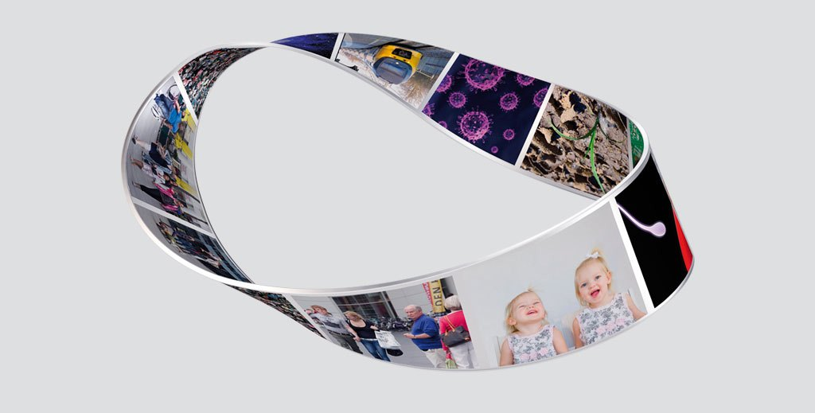
Excellence (‘peers’) and Relevance (‘stakeholders’) leading criterea; no compromise on excellence; fundamental – curiosity driven – applied – demand driven – private-public research partnerships: all part of an overarching strategy

Slide 7
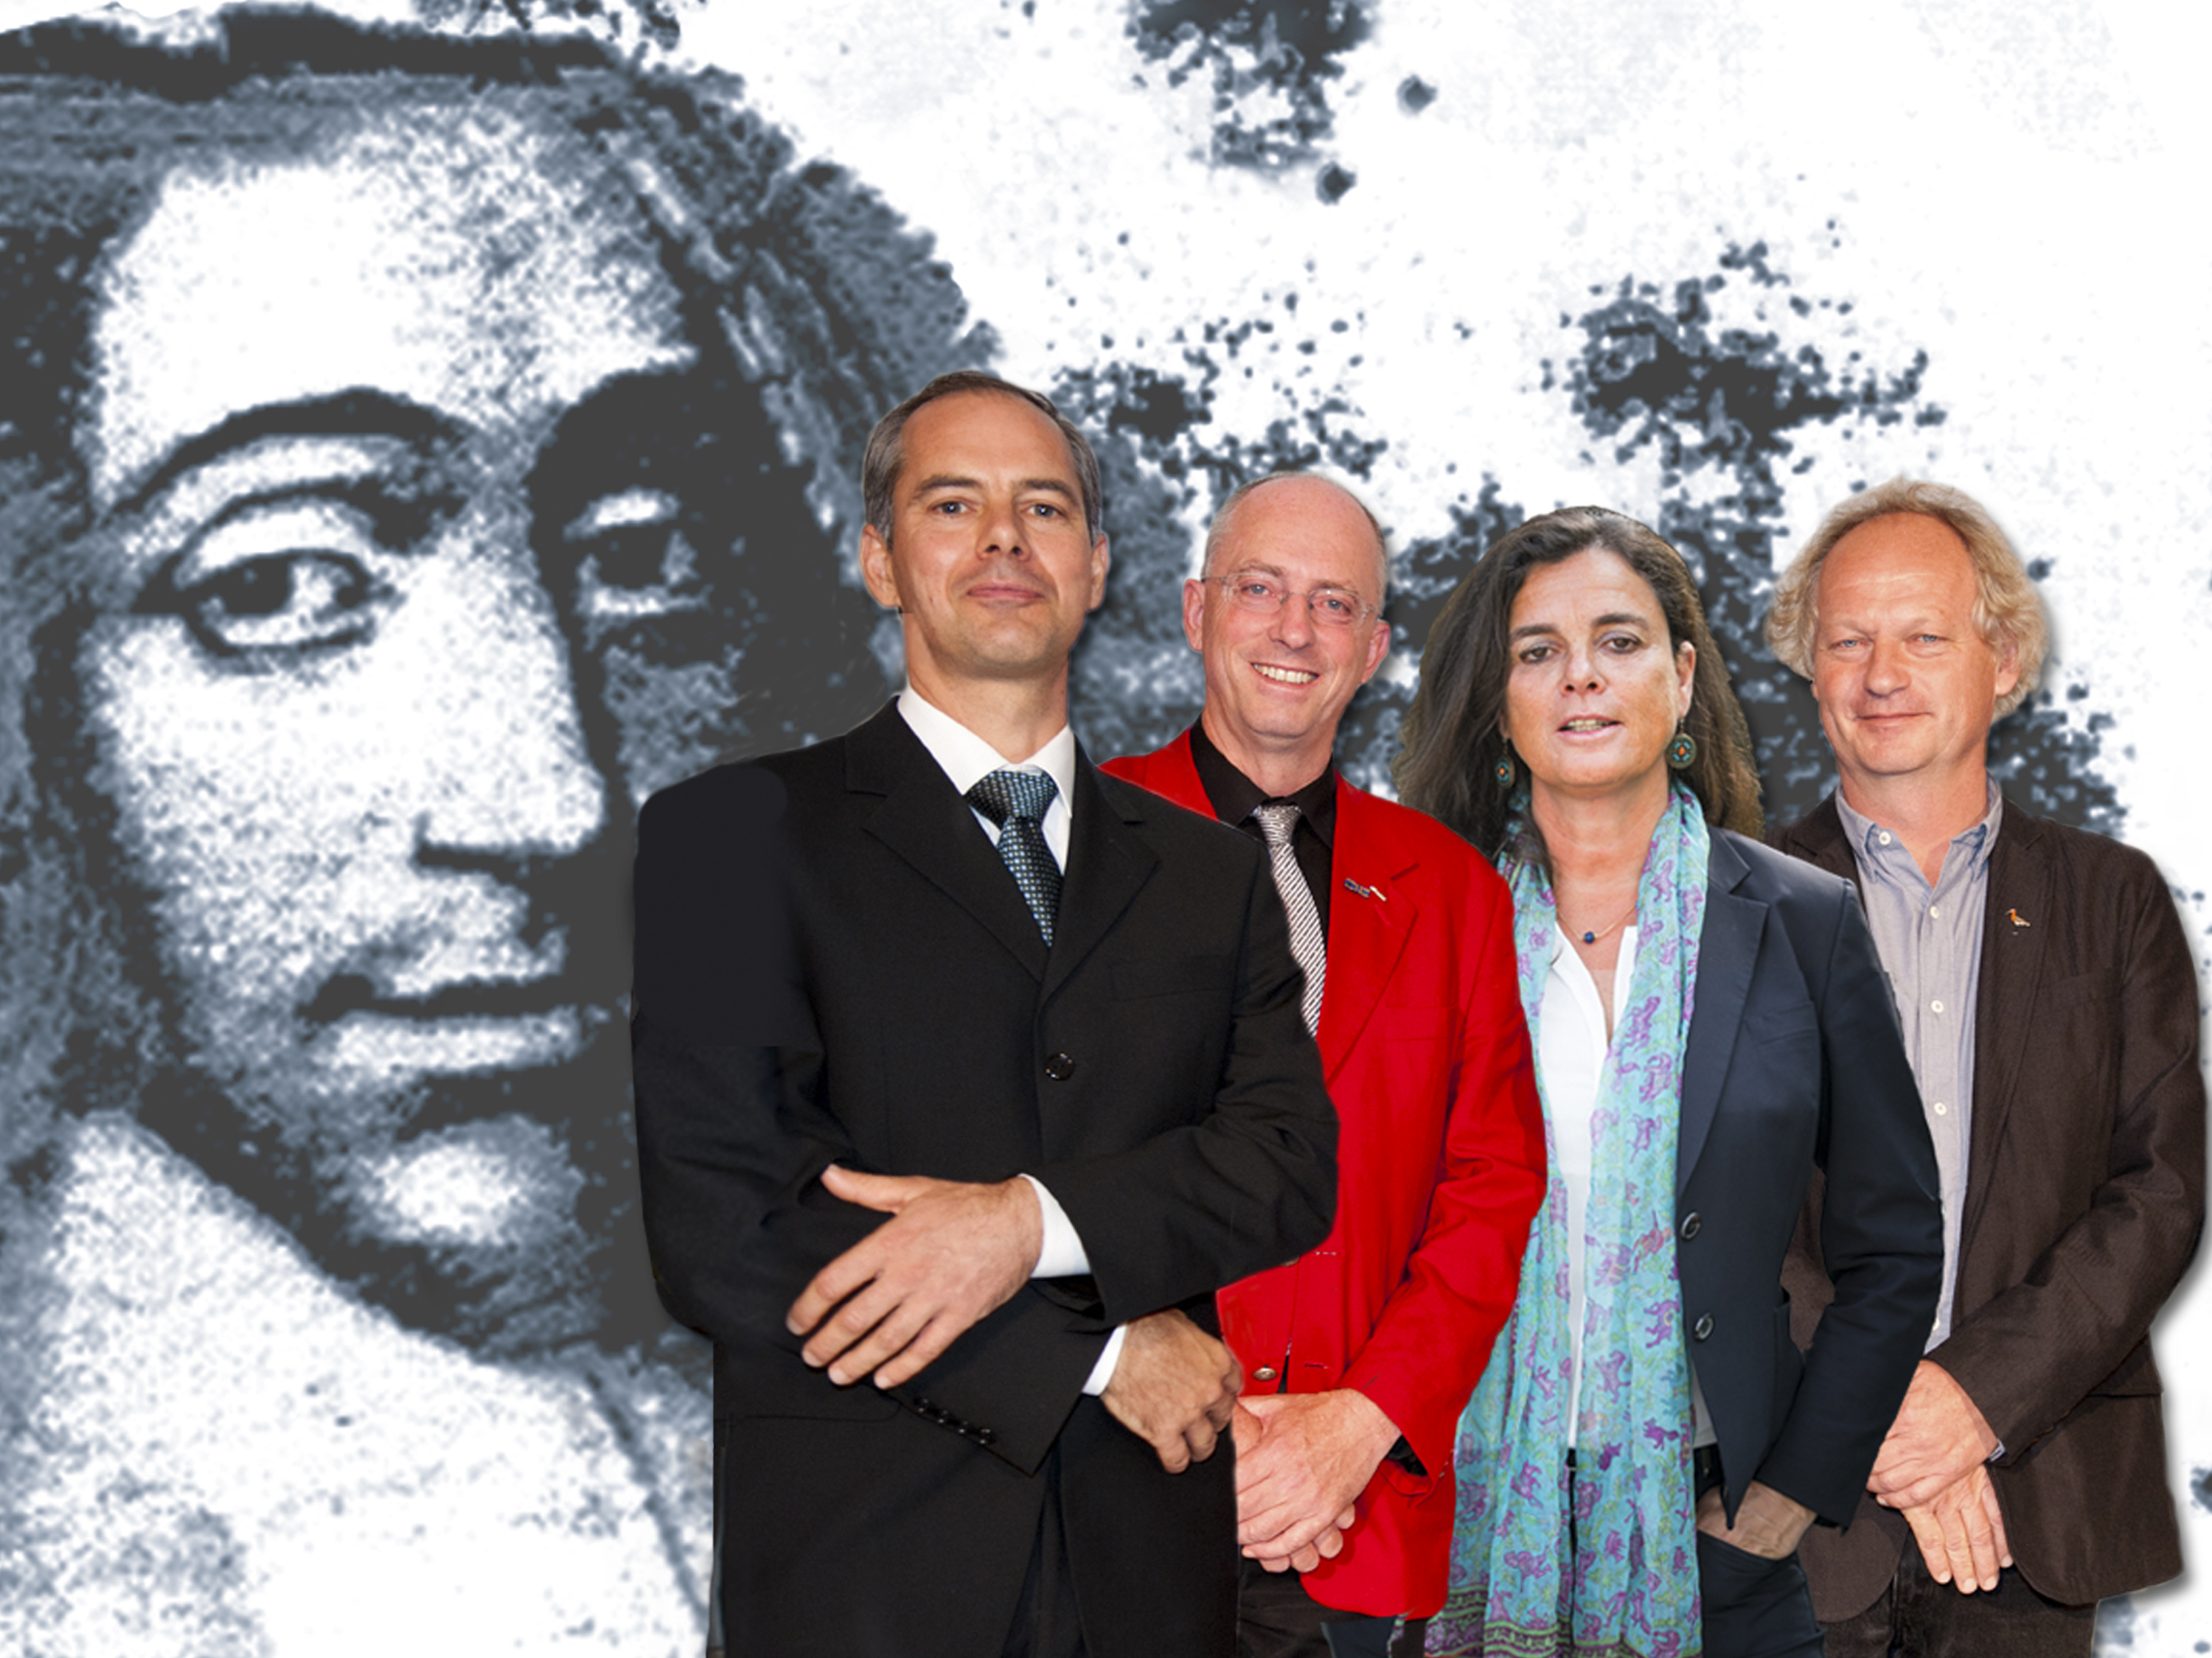
NWO Spinoza laureates 2014 (4x2.5 M€)
Bouwmeester: quantum teleportation and more
Van Loosdrecht: from microbial ecology to waste water treatment and
production of raw materials from waste flows
Hofman: Caribbean Archeology, new insights into the colonial history
Piersma: Global Flyway Ecology, influence of food, climate, predators,
pathogens, genetics

Slide 8
Nature 390, 575-579 (11 December 1997) | doi:10.1038/37539; Received 16 October 1997; Accepted 18 November 1997
Experimental quantum teleportation
Dik Bouwmeester, Jian-Wei Pan, Klaus Mattle, Manfred Eib, Harald Weinfurter & Anton Zeilinger
Institut für Experimentalphysik, Universität Innsbruck, Technikerstr. 25, A-6020 Innsbruck, Austria
Correspondence to: Dik Bouwmeester. Correspondence and requests for materials should be addressed to D.B. (e-mail: Email: Dik.Bouwmeester@uibk.ac.at).
Top of page
Abstract
Quantum teleportation — the transmission and reconstruction over arbitrary distances of the state of a quantum system — is demonstrated experimentally. During teleportation, an initial photon which carries the polarization that is to be transferred and one of a pair of entangled photons are subjected to a measurement such that the second photon of the entangled pair acquires the polarization of the initial photon. This latter photon can be arbitrarily far away from the initial one. Quantum teleportation will be a critical ingredient for quantum computation networks.
Back

Slide 9

Simultaneous COD, nitrogen, and phosphate removal by aerobic granular sludge
M.K. de Kreuk*,
J.J. Heijnen and
M.C.M. van Loosdrecht
Article first published online: 22 APR 2005
DOI: 10.1002/bit.20470
Nereda treats wastewater with the unique features of so-called aerobic granular biomass: purifying bacteria that create compact granules with superb settling properties. The technology was invented by the Delft University of Technology, in the Netherlands, and developed in a unique public private-partnership between the University, the Dutch Foundation for Applied Water Research (STOWA), the Dutch Water Boards and Royal HaskoningDHV. After 20 years of research and development this innovative biological solution is now proving itself to be a leap forward in wastewater treatment technology.
Back

Slide 10
Laffoon J.E., Valcárcel Rojas R. & Hofman C.L. (2013), Oxygen and Carbon Isotope Analysis of Human Dental Enamel from the Caribbean: implications for investigating individual origins, Archaeometry 55(4): 742-765.
Back

Slide 11
Lourenço, P.M., Mandema, F.S., Hooijmeijer, J.C.E.W., Granadeiro, J.P. & Piersma, T. (2010) Site selection and resource depletion in black-tailed godwits Limosa l. limosa eating rice during northward migration. Journal of Animal Ecology, 79, 522-528.

Slide 12
Who are the stakeholders and what do they expect?
The private sector: no direct stakeholder, but very important
for a nation’s wealth and therefore politically very influential
(e.g. through employers organisations); also direct stakeholder
through private-public partnerships
The government: largest part of the funding; science for
competitivenes; science for society and, of course, science
for science (cultural value, national pride, education)
The research performers (scientists) and their employers
(universities, institutes)

Slide 13
Economic Top Area Policy of the Dutch government
(Rutte I, Oct. 2010 – April 2012; Rutte II, Nov. 2012)
Somewhat abruptly the government urged NWO et al to dedicate
a considerable fraction of its budget to funding research relevant
for nine priority areas:
Agri&food
Chemistry
Creative Industry
Energy
High Tech (systems and materials)
Logistics
Lifesciences and Health
Horticulture
Water
So where does that leave string theory..?

Slide 14
Meetings with the Minister of Economic Affairs at his Ministry,
with further present:
Statesecretary Education, Culture, Science (NWO’s main funder)
President Dutch Employers Organisation and representatives of
the ‘top areas’
President Royal Netherlands Academy of Arts and Sciences
(Dijkgraaf, now succeeded by Clevers)
President Organisation of NL Universities (Noorda, now Dittrich)
President Org. of NL Universities of Applied Sciences (De Graaf)
President Org. Applied Research TNO (Mengelers, now vacancy)
President Netherlands Organisation for Scientific Research
NWO did not ‘turn its back’ on the economic top area policy,
but put forward in the discussion that:

Slide 15
De facto most of these areas are already served by the
‘standard’ NWO strategy and funding instruments; not by
a priori earmarking but in a rather natural bottom-up manner
NWO feels a great responsibility for leaving sufficient room
in its budget for funding fundamental research and excellent
bottom-up proposals
NWO feels a great responsibility for funding exellent research
over the full spectrum of scientific research, including areas
that are not (easily) covered by the top areas (including
humanities, social sciences, etc.)
NWO would, with this in mind and within its possibilities,
implement the top areas in its strategy, including
modalities for private-public partnerships

Slide 16
From initially quite tedious discussions in an atmosphere of distrust
we, public and private parties together, have finally found common
ground and sent two ‘manifestos’ to the government with a plea
for adequate (increased, as soon as possible) research funding.
The (severe) austerity measures of the past years have largely
spared the science budget and a modest increase has been granted
this year with a further increase promised for the years after
(numbers will follow later in this talk).

Slide 17
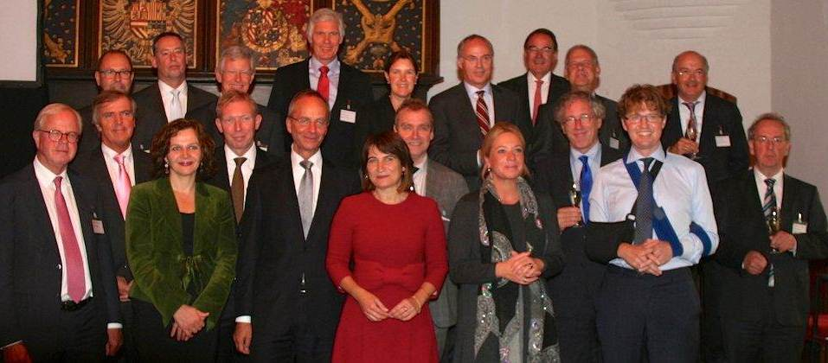
Signing Ceremony ‘Innovation Contract’ between Government,
Private Sector, and publicly funded research organisations

Slide 18
Research themes (taking into account economic priority
areas):
Agro, Food and Horticulture
Connecting Sustainable cities
Creative Industry
Cultural and Societal Dynamics
Healthy Living
High Tech Systems and Materials
Materials – Solutions for Scarcity
Sustainable Energy
Water and Climate

Slide 19
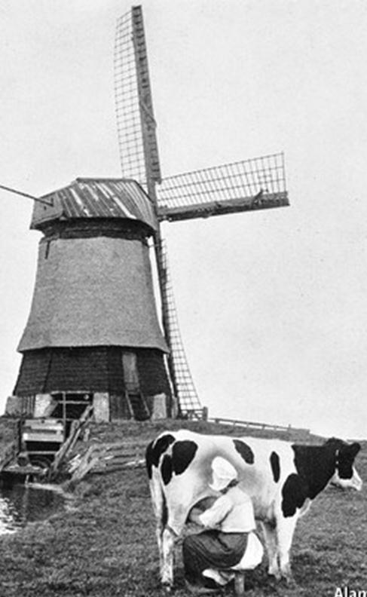
Economist,
August 23, 2014
How long until the robots arrive?

Slide 22
As an example of private-public cooperation
two recent initiatives (supported by NWO):
QuTech: to develop technologies for quantum-computing
around successful ‘q-bits’ fundamental research, in particular
at Technical University Delft (Kouwenhoven)*
ARC-NL: advanced research centre for nanolithography,
together with ASML, a leading company for the production
of machines for IC production. Present feature size 90 nm,
further reduction requires new breakthroughs...
* DOI: 10.1126/science.1222360
Science 336, 1003 (2012);
V. Mourik et al.
Superconductor-Semiconductor Nanowire Devices
Signatures of Majorana Fermions in Hybrid
Superconductor-semiconductor
Nanowire Devices

Slide 23

QuTech - Advanced Research Center
a TUDelft-TNO partnership
with support from
NWO, FOM, STW.
Prof. L.P. Kouwenhoven
Notes:
aankondiging Minister Kamp vorig jaar 2 oktober
wat is de plotselinge motivatie voor zo’n initiatief?
Wereldwijde golf van quantum initiatieven.

Slide 24
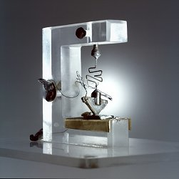
QuTech’s ambition is to build the first quantum computer.
first transistor at Bell labs

Slide 25
QuTech’s ambition is to build the first quantum computer.
The Grand Challenges
Health, Energy, Food, Climate,…..
are
Materials and Chemistry Challenges
The Grand Challenges are
Quantum Challenges

Slide 26
QuTech has 3 primary roadmaps
Fault-Tolerant
Quantum Computing
i.e. surface code
Topological
Quantum computing
i.e. Majoranas
Quantum Internet
i.e. Cryptography

Slide 27
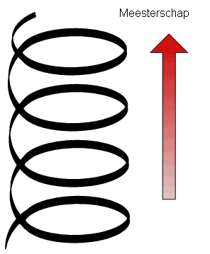
Science
1 out of 10 samples work,
develop prototypes
quantum circuits running on
quantum software
Challenges
-(de)coherence
-measurement problem
-classical-quantum border
-quantum topology
-non-Abelian statistics
Engineering
999 out of 1000 samples work,
develop circuits
Low-power electronics making
full use of a 4K temperature
Challenges
-dissipation
-Beyond Moore means a New Moore
-exploit superconducting electronics
-develop new principles for classical
computing.
Breakthrough Engineering !
Game Changers !

Slide 28

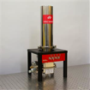



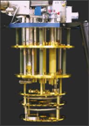


Bringing Science to Technology
From QC-Lab to QuTech
Private
Companies
Investment
funds
QC-Lab
© Single Quantum
QuTech
Startups
QC-Lab
ICT
Security
EU
H2020
© ID Quantique
International
Networks
Suppliers
National
Laboratories

Slide 29
QuTech’s ambition is to build the first quantum computer.
Organizational ambitions
EU Flagship in ~ 2016
Max Planck Munich
ETH, Aachen,
Niels Bohr Institute
Growth & Timeline
Building in 2016
150 fte in 2017
15 M€ in 2017
Notes:
aankondiging Minister Kamp vorig jaar 2 oktober
wat is de plotselinge motivatie voor zo’n initiatief?
Wereldwijde golf van quantum initiatieven.

Slide 30
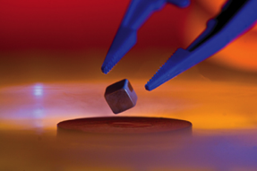
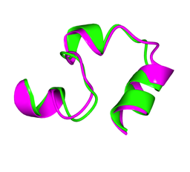

What Quantum Computers can do
→ Game changer for new materials and security
Energy:
Room-temperature superconductivity
Health:
Quantum (bio)-chemistry
Internet Security
A perfect battery
solves the energy
challenge
From try-and-error
to predictive
simulations
Internet security
protected by
quantum laws
Notes:
Perpetuum Mobile, the perfect (lossless) battery
Calculate and predict chemical properties (instead of try and error)
Secure Internet

Slide 31
When do we have a Quantum Computer ?
Energy:
Room-temperature superconductivity
Health:
Quantum (bio)-chemistry
Internet Security
~15 years
~20 years
~10 years
Notes:
Perpetuum Mobile, the perfect (lossless) battery
Calculate and predict chemical properties (instead of try and error)
Secure Internet

Slide 32
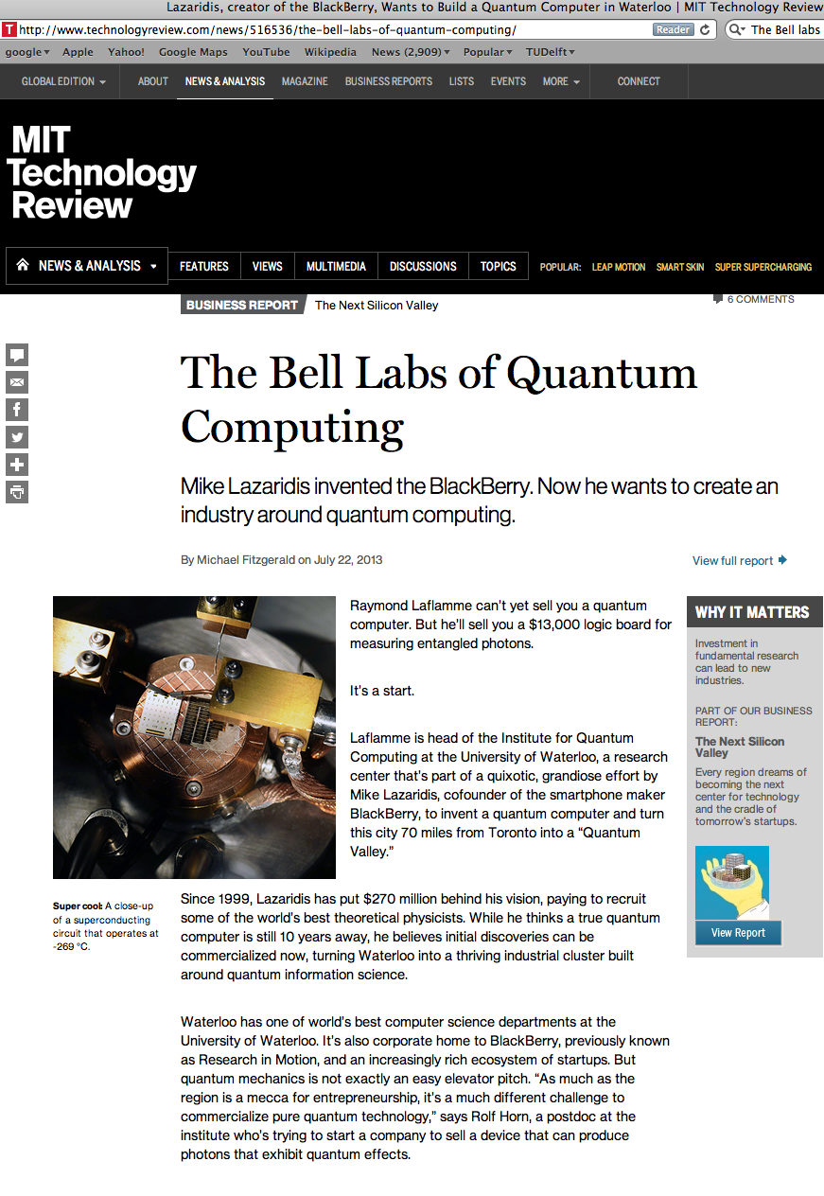
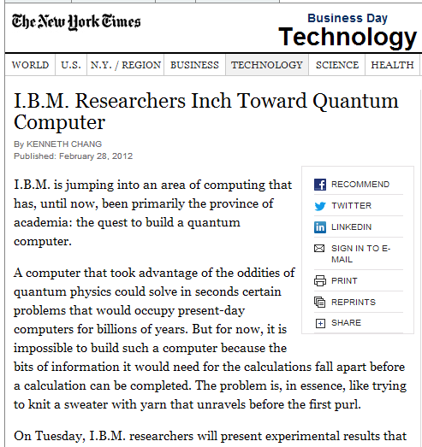
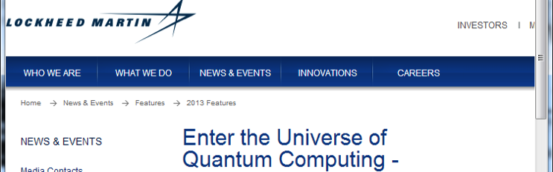
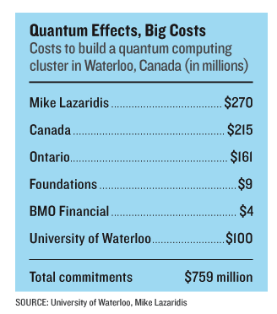
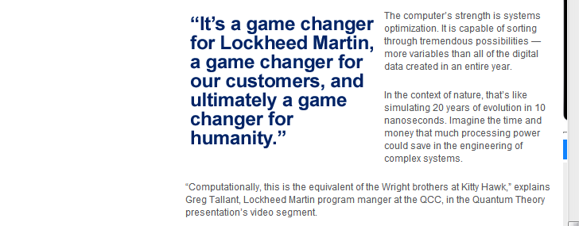
Current industry interest worldwide
Notes:
Quantum technology initiatives around the world

Slide 33
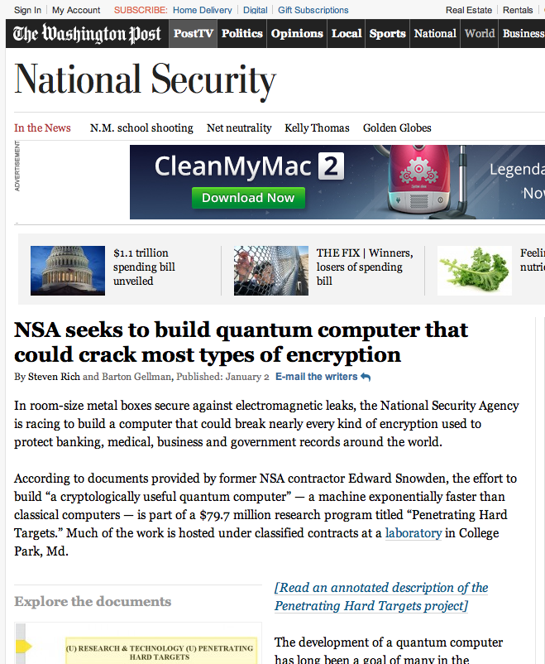
Notes:
….wat er bij de NSA gebeurt.
Wat is quantum ook alweer en wat is de nieuwe trend? CLICK

Slide 34
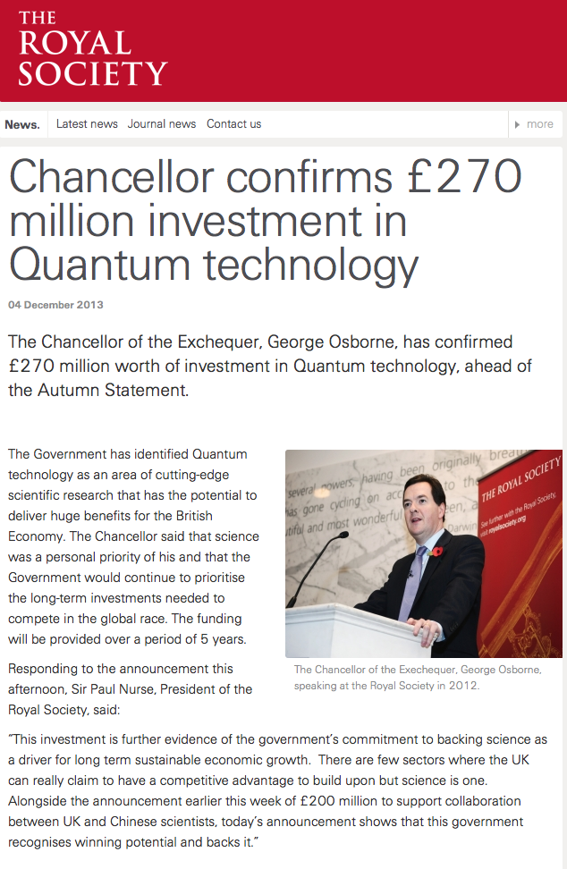


Europe
Swiss National Program
on Quantum
idem China
idem Russia
Notes:
maar misschien weten we wel niet wat er nog achter gesloten deuren plaatsvindt aan onderzoek. Nou, sinds Edward Snowden weten we wel…..CLICK

Slide 35
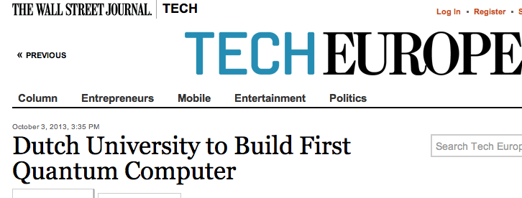

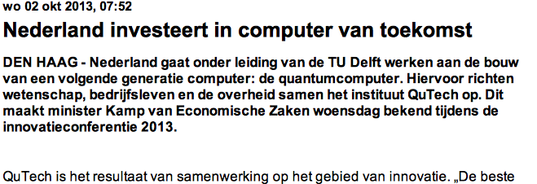
Notes:
We zien dit jaar, in 2013 de interesse van de industrie dan ook toenemen.
Overal ter wereld stapt men in quantum computing.
Wij hebben een groot voordeel: wij hebben een voorsprong in het bouwen van relatief stabiele en reproduceerbare qubits, met een schaalbare technologie.
Hier iets over Microsoft interesse zeggen bijv:
Dit is een van de hoofdredenen dat Microsoft naar ons toe is gekomen met het voorstel om hier in Delft onderzoek te verrichten.

Slide 36

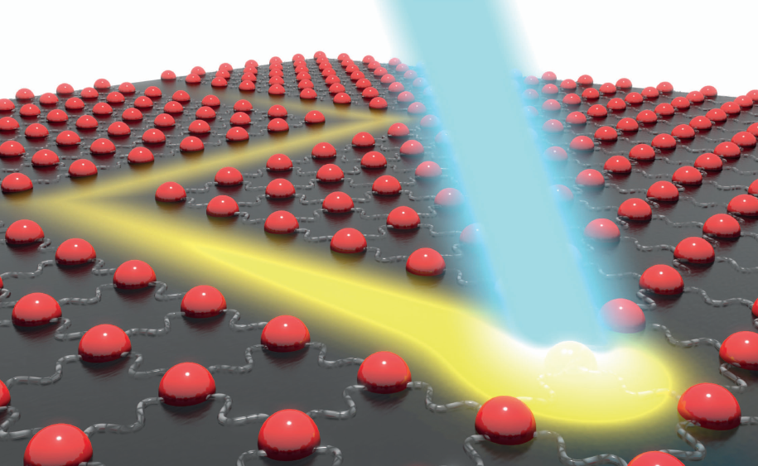
Advanced Research Center
for Nanolithography
MISSION
The research of ARCNL focuses on the fundamental physics that is involved in or related to current and future technologies that are or will be employed in the context of lithography and nanolithography, primarily for the semiconductor industry.
PARTNERS
Foundation for Fundamental Research on Matter (FOM/NWO), University of Amsterdam, VU University Amsterdam, ASML – www.asml.com (Headquarters in Veldhoven, NL)
LOCATION
Amsterdam Science Park (launched from AMOLF); director Prof. Joost Frenken

Slide 37
ARCNL
Advanced Research Center for Nanolithography
Nucleus: Instigated in 2013 by ASML
Partners: ASML, FOM/NWO, UvA, VU
Form: New type of public-private partnership (ARC)
Financial: 50% base funds from ASML, 50% from the others
Size: ~100 fte
Style: Managed as an FOM-institute
Location: Science Park, Amsterdam
Embryonic stage: Starting from within AMOLF

Slide 38
ARCNL
Research Program (preliminary)
IR laser physics
EUV generation
EUV targets (e.g. droplets)
Plasma analysis
Surfaces and thin films
Nano-photochemistry
Other light (FEL)
Other forms of lithography…

Slide 39
Back to research funding (organization):
The budget should indicate whether there is a ‘reasonable’
balance between ‘directed’ research and ‘free’ research
(‘directed’ and ‘free’ refer to the agenda; research is of course
always free!)
In the NL the situation remains tight; in D it is more relaxed
Government (2014) 4.300 M€ for R&D (3.800 M€ by Ministry of
E, C and Science and Ministry of Economic Affairs)
2.500 M€ to Universities & Univ. Hospitals directly and
700 M€ structurally via NWO (to Univ., Institutes) +PM
out of this 275 M€ is supposed to benefit the economic
priority areas; that is not a small fraction

Slide 40
Next step: take a ‘grander’ view;
connect economic priority areas and societal ‘challenges’
and indicate important research domains for the future
Quality of Life
-
Circular Economy
-
Big Data
-
Complexity: dealing with unpredictability
-
Building Blocks of life
-
Resilient Societies

Slide 41
There should be a good match between the strategies
of the Research Funding Organisations (such as NWO)
and the Research Performing Organisations (in NL mainly
the universities); national dialogue, not easy
This is also very important at the European level
Horizon2020: 80 G€ for the period 2014-2020

Slide 42
Horizon 2020 programme sections
Excellent Science
European Research Council -------------------- 13 G€ *
Future and Emerging Technologies
Marie Skłodowska-Curie actions *
European Research Infrastructures, including e-Infrastructures *
Industrial Leadership
Leadership in Enabling and Industrial Technologies
Information and Communication Technologies
Nanotechnologies, Advanced Materials, Advanced Manufacturing and Processing and Biotechnology
Space
Access to risk finance
Innovation in SMEs
Societal Challenges
Health, Demographic Change and Wellbeing
Food Security, Sustainable Agriculture and Forestry, Marine, Maritime and Inland Water Research and the Bioeconomy
Bioeconomy
Secure, Clean and Efficient Energy
Smart, Green and Integrated Transport
Climate Action, Environment, Resource Efficiency and Raw Materials
Europe in a changing world - Inclusive, innovative and reflective societies
Secure societies – Protecting freedom and security of Europe and its citizens

Slide 43
Main elements of strategy (NWO):
Frontier/’free’/’new’/’riskful’ research; bottom-up proposals
Multi-disciplinary research (science; society)
Where desirable/appropriate: funding of medium and long term research initiatives
Connect: economic top areas – European Grand Challenges – national priorities
National strategy for large research infrastructures and international cooperation
Promote Open Access; publications, data
Minister wants us to make choices: ‘we cannot do everything’
Answer: we should fund research in and across all disciplines that are
‘pushing back boundaries’; not every university needs to do everything,
they can cooperate and define their own profiles; at the national level
we should be active on all frontiers!

Slide 44
Two recent developments as an illustrattion:
‘Gravity’ program to stimulate (cooperation between) excellent
(high potential) university research groups; 500 M€ over 10 years;
no ‘strings attached’ w.r.t. research agenda
(Next slide)
Thematic areas in forthcoming NWO strategy:
(Already presented)

Slide 45
‘Gravity’ programme
In 2012 (M€ 167)
Cancer Genomics Centre Netherlands (CGC.nl)
Frontiers of Nanoscience (NanoFront)
Language in Interaction
Individual development: Why some children thrive, and others don't
Research Centre for Functional Molecular Systems
Delta-Institute for Theoretical Physics: Matter at all Scales
In 2013 (M€ 153)
The Soehngen Institute for anaerobic microbiology: microbes for health and
environment
Networks
The Institute for Chemical Immunology (ICI)
Netherlands Earth System Science Centre (ESSC).
Research Centre for Integrated Nanophotonics
Netherlands Center for Multiscale Catalytic Energy Conversion
Interuniversity Initiatives; ‘calibration’ = international top

Slide 46

NWO’s divisions
What is the right key to distribute the budget?
Science Divisions
Institutes
Earth and Life Sciences (ALW)
ASTRON Netherlands Institute for Radio Astronomy
Chemical Sciences (CW)
Centrum Wiskunde & Informatica (CWI)
Physical Sciences (EW)
FOM Institute for Subatomic Physics Nikhef
Humanities (GW)
FOM Institute AMOLF
Social Sciences (MaGW)
FOM Institute DIFFER (Dutch Institute for Fundamental Energy
Research)
Medical Sciences (managed by ZonMw)
Physics (N – managed by FOM Foundation)
NIOZ Royal Netherlands Institute for Sea Research
Technical Sciences (managed by TechnologyFoundation STW)
Netherlands Institute for the Study of Crime
and Law Enforcement (NSCR)
WOTRO Science for Global Development
SRON Netherlands Institute for Space Research
Temporary taskforces
NRO
National Initiative Brain & Cognition (NIHC)
NRPO-SIA

Slide 47
Conclusion:
Science Policy why? To stimulate/enable scientific research
and establish it as a national/European/global priority
Science Policy how? By establishing a Strategy together
with all stakeholders: research performers (scientists) and
their organisations; government; the private sector
with the independent Research Funding Organisation in the
lead (symmetry breaking...)

Slide 48
Having heard this, what is the reaction of young
scientists at the beginning of their career and
interested in field theory, cosmology etc.?
How would you enter the dialogue with politicians
and with representatives of the private sector?
And finally: I personally would never have thought,
not 40 years ago, not twenty years ago, not even
10 years ago that I would ever give a talk on
the subject of science policy..! How about you?

Slide 49
In the light of ‘science policy’ how does
CERN
fit in?

