Slide 1
Sub-percent polarization accuracy for the P2 experiment at MESA
Eucard-II workshop
„Spin-Optimization at Lepton accelerators“
Kurt Aulenbacher for the
P2 collaboration
at IKP Mainz
Notes:
Das Bild zeigt eine Büste aus dem 19. Jahrhundert. Von Gutenberg selbst ist kein Bild überliefert, d.h. die Büste ist bloße Fiktion.
Viel konkreter ist das Mainzer Mikrotron, über das ich erzählen will….

Slide 2
Outline
The P2 experiment at Mainz
How to achieve ΔP/P <0.5%?
The chain: DSP/Vector-Monitor/Hydro-Möller
Present and future: Test-beamline and schedule

Slide 3
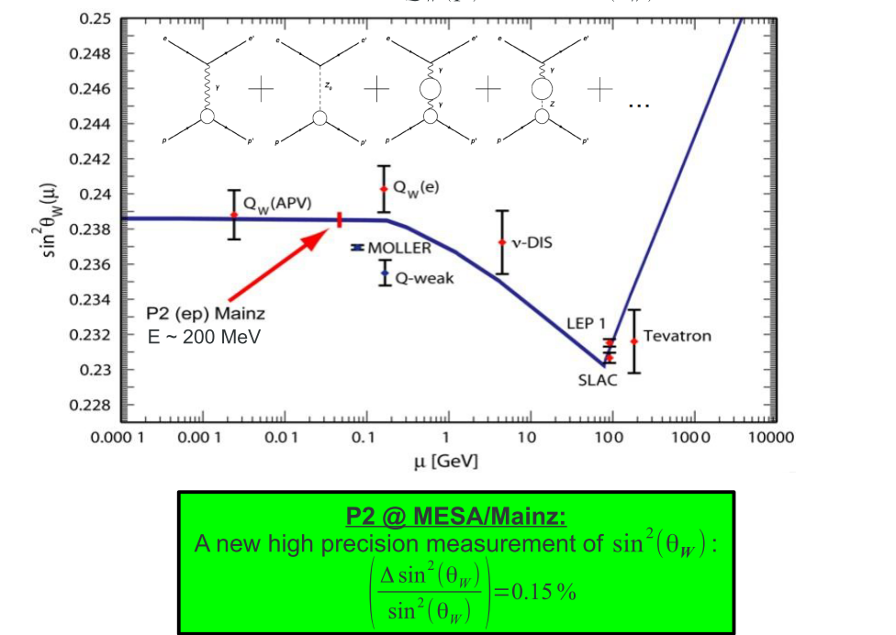
P2-experiment: Accurate measurement of Θ_{W}
Electroweak interference:
Θ_{W} first measured by:
Prescott et al.
Phys. Lett. B. 77 p.347 (1978)
Asymmetry in Prescott et al. :1*10⁻⁴
D. Becker, AIP Proceedings Vol 1563 (2013)
P2 is (almost) Prescott²
Unfortunately: A~Q² (for Q² <<Mz)→
This experiment is simple, but not easy: Scattering Asymmetry is ~2*10⁻⁸

Slide 4
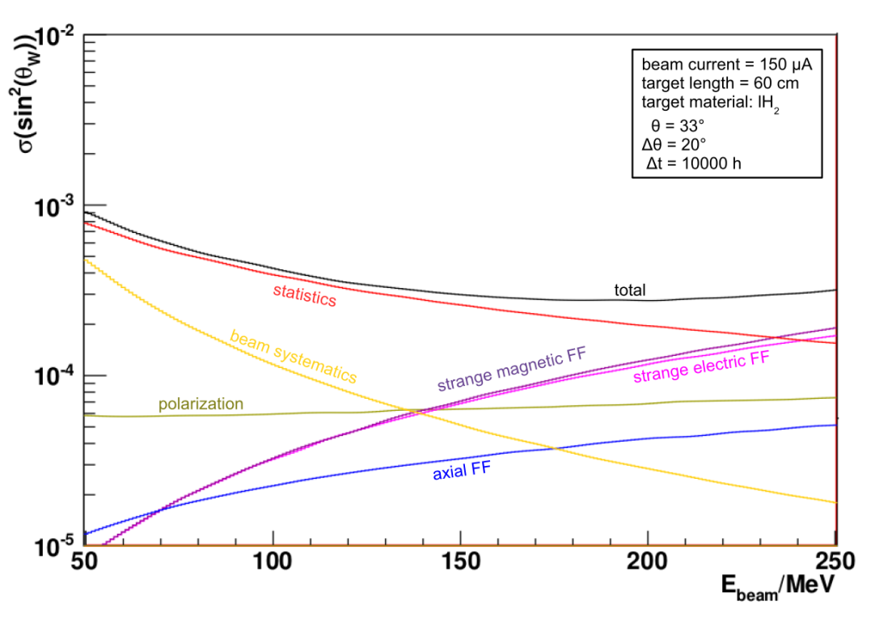
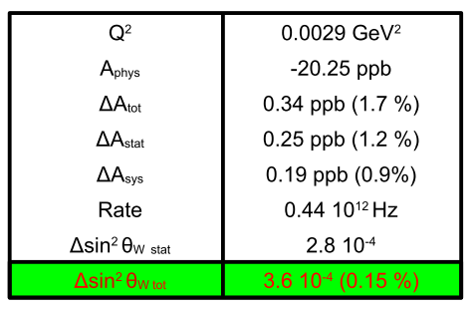
P2-experiment
150 μA Beamcurrent , 60cm lq. H2, Beampol: 85%.→10000 h Data-taking
Extremely high demands on control of HC-fluctuations! &
High accuracy polarization measurement (ΔP/P=0.5% !!)
Precision determination of electroweak mixing angle
co-motivates funding of a new Accelerator:
The MESA project

Slide 5
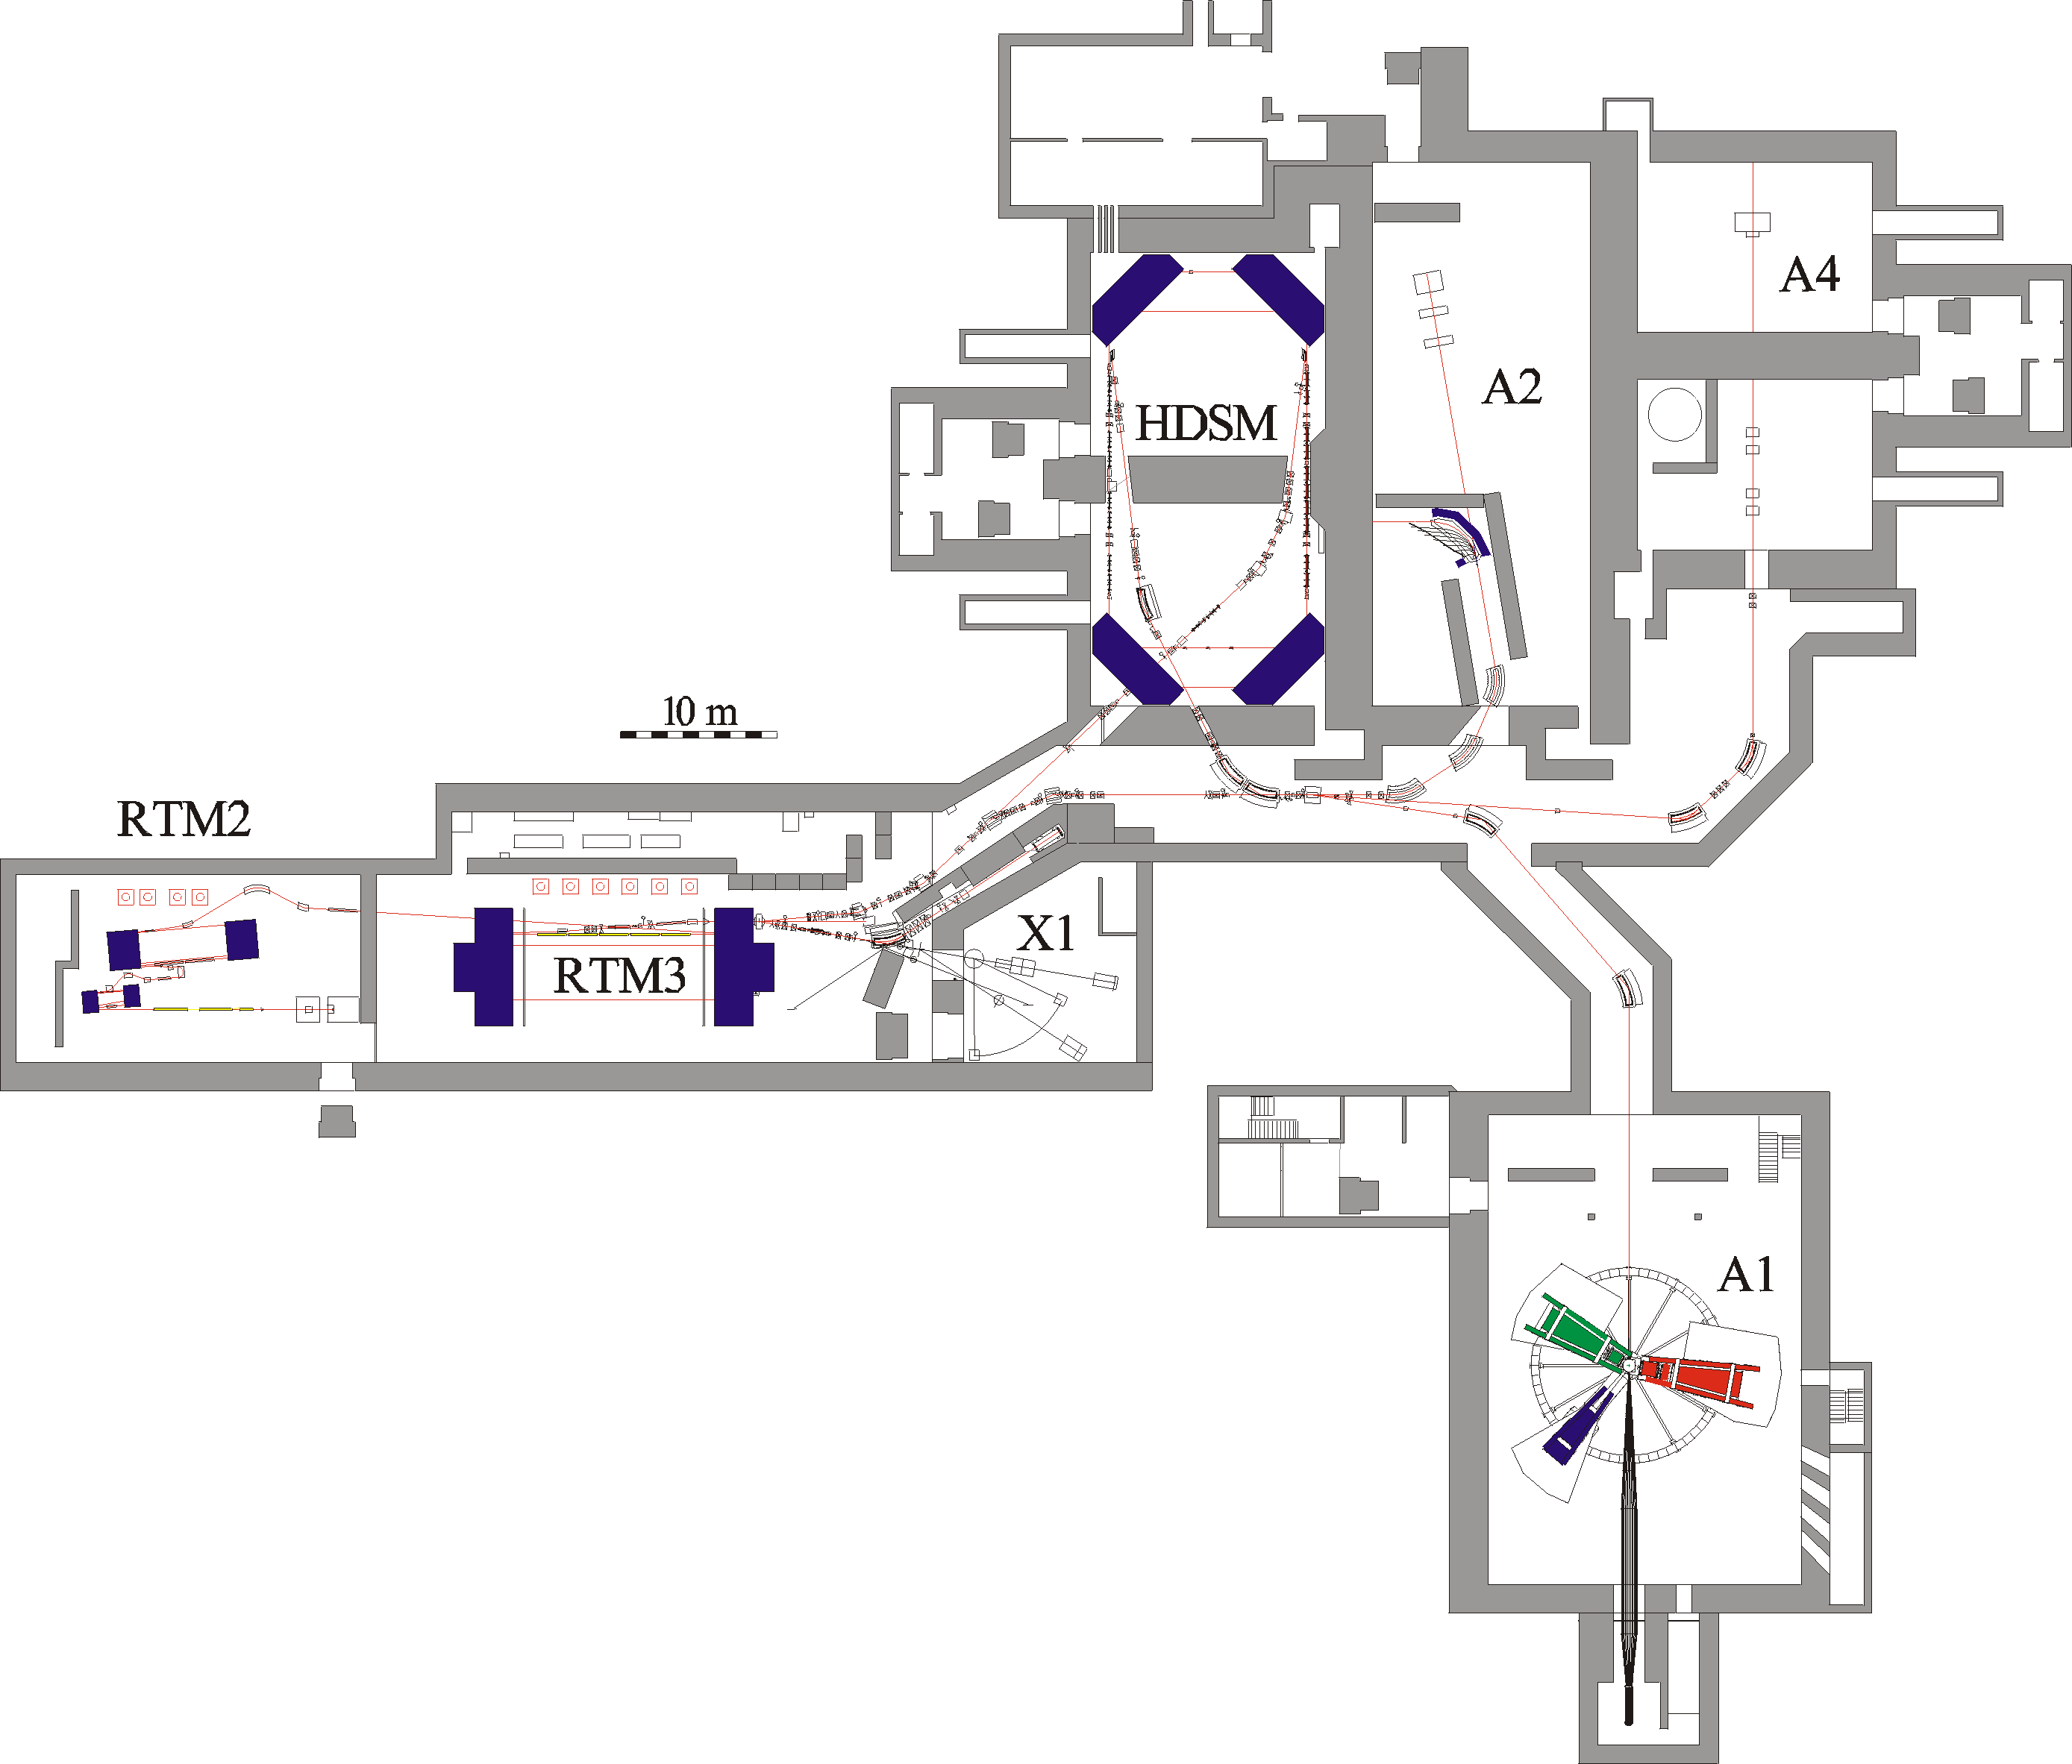
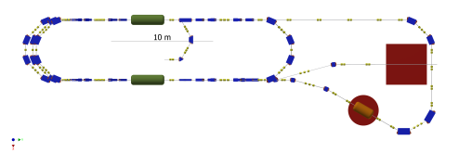
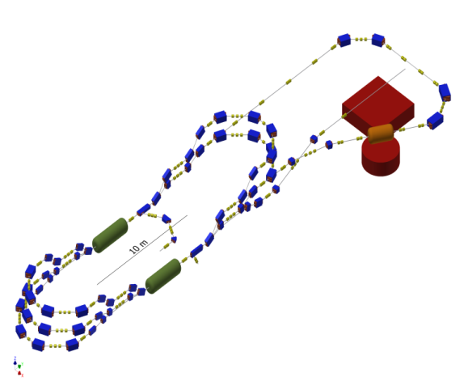
MESA: A new accelerator at KPH-Mainz
High power beam dump
No new buildings necessary
MAMI continues separately for
hadron structure exp. ~1GeV scale
MESA takes over “low energy”
experiments ~100MeV scale
Experimental Hall
Shaft building
MESA-Hall-1
MESA-Hall-2
Shielding
Design of MESA machine ongoing
Commisioning foreseen 2017
MESA

Slide 6
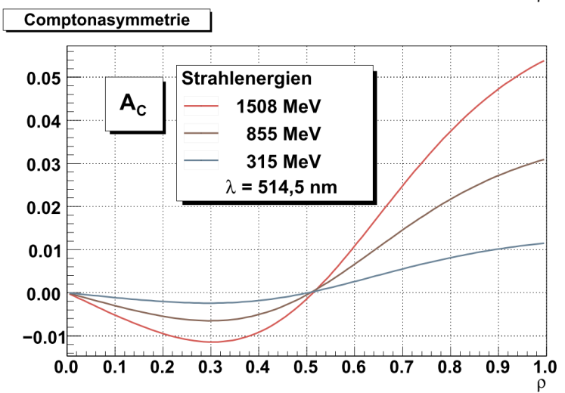
MESA& MAMI: existing Polarimeters
A4 Laser-Compton:
Very low asymmetry at MESA
Energies!
A2 Möller
Mott-Polarimeter
3.5 MeV
A1 Möller

Slide 7
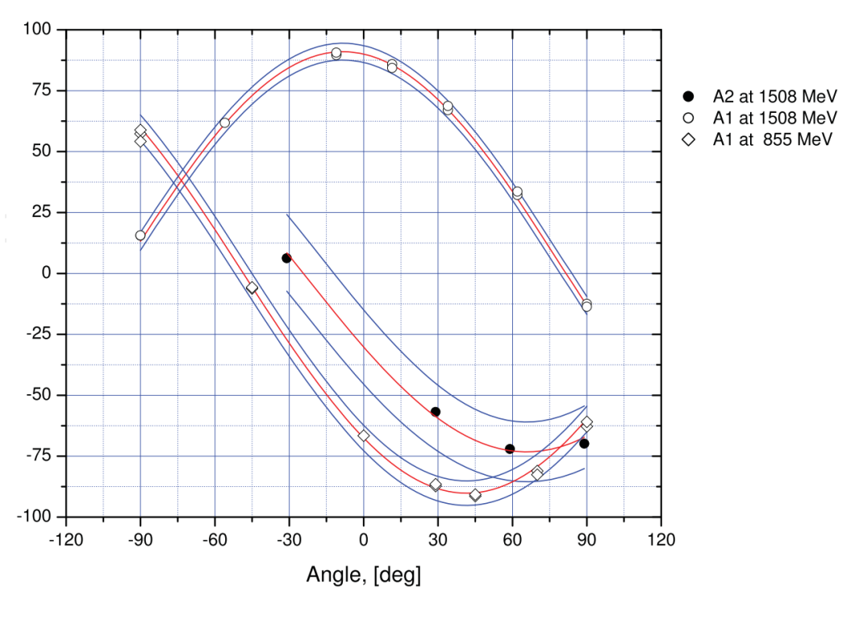
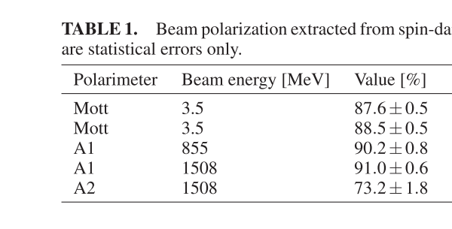
Existing Electron-Polarimeter chain at MAMI
Polarimeter | Energy [MeV] | Pol. [%] ± (stat. only)
Mott | 3.5 | 87,6±0.5
A1-Möller | 855 | 90.2±0.8
A1-Möller | 1508 | 91.0±0.6
A2-Möller | 1508 | 73,2±1.8
V. Tioukine, K. Aulenbacher, (BMBF-Spin-Management)
AIP Conference Proceedings 1563, 276 (2013); doi: 10.1063/1.4829428
What about Mott/Möller systematics?
A2-Möller-target: in plane magnetization: Target Polarization may cause problem
A1- Möller-target: perpendicular magnetization, saturated in 4T B-field
Möller-error sources: PTarget, acceptance corr, Levchuk effect,…→ 2-5 % relative error
Mott error sources: radiative corrections to analyzing power, analyzing power dilution, background,….→ 2-5% relative error.
Due to high multiplicity of error sources it will be hard to improve
existing polarimeters to < 1% accuracy, 0.5% presently not realistically achievable.

Slide 8
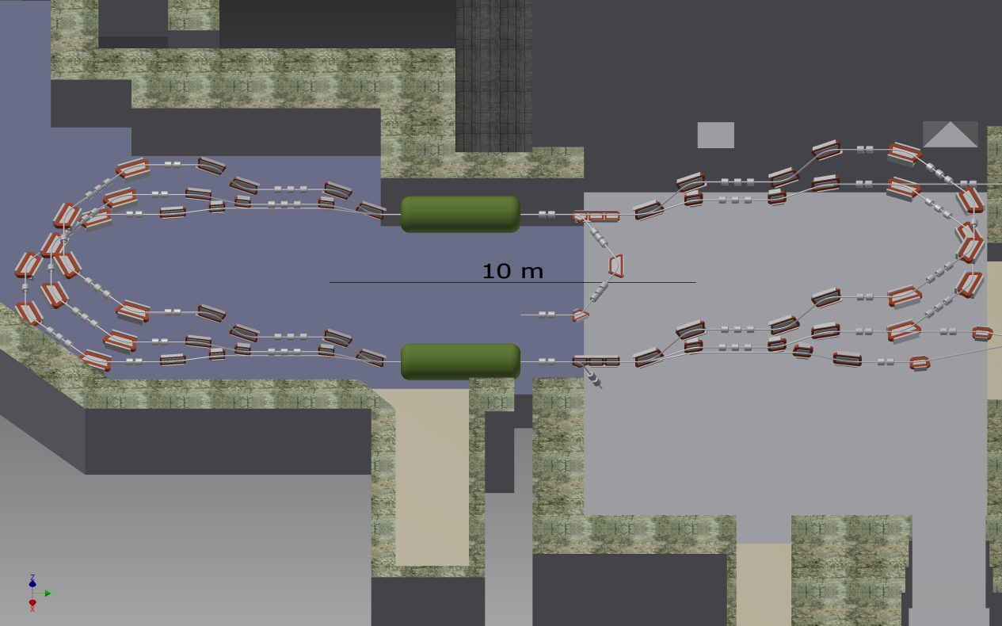
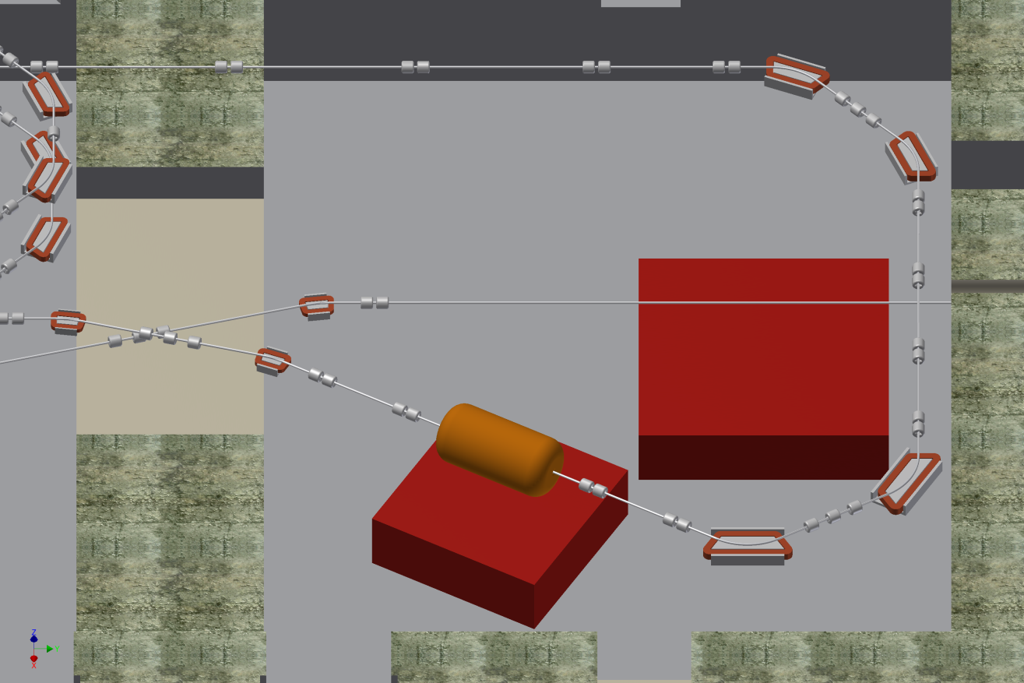
MESA& experiments
PV
PIT
NEW POLARIMETERS ARE REQUIRED!

Slide 9
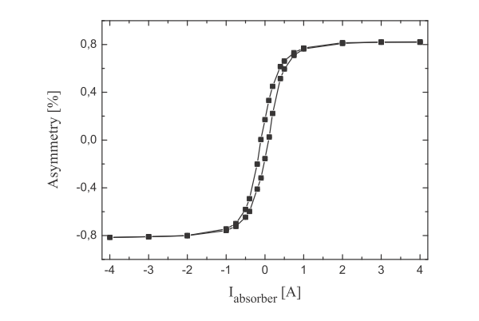
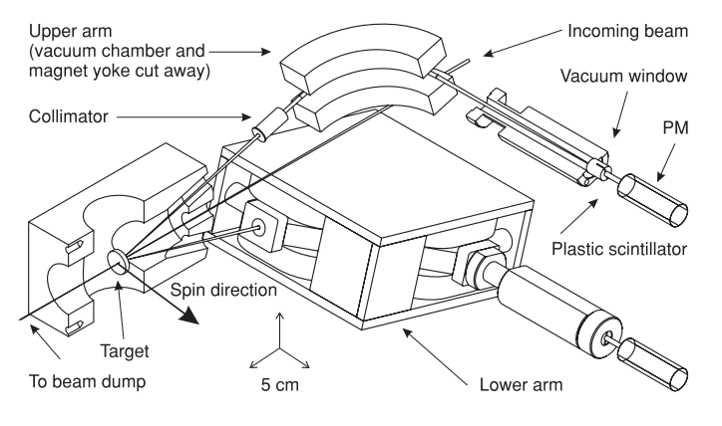
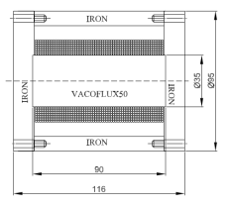
MESA& planned Polarimeter chain
3
2
1
2
3
PV
Polarimeter 1: „Conventional“ Vector-Polarization-Monitor (5 MeV)
Circular polarized γ‘s: P_{σ}~P_{long}
(to absorber)
P-Vector
Mott scattered e‘s:
A ~P_{trans}
Photon-Transmission Asymmetry through
magnetized „Compton-Absorber“
Measures: longitudinal Spin component
Sketch of Mott-Polarimter
with double focusing magnet spectrometers
Measures: transverse Spin component
Primary beam
Polarization Drift consistently observed
in transverse AND longitudinal observable
at the <0.5% level

Slide 10
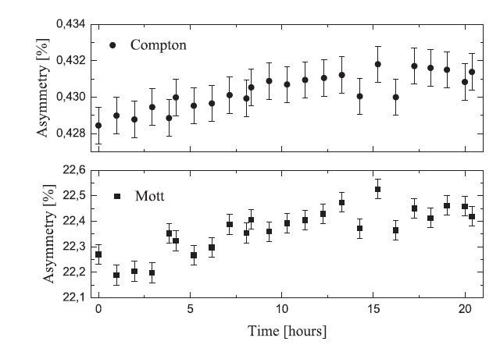
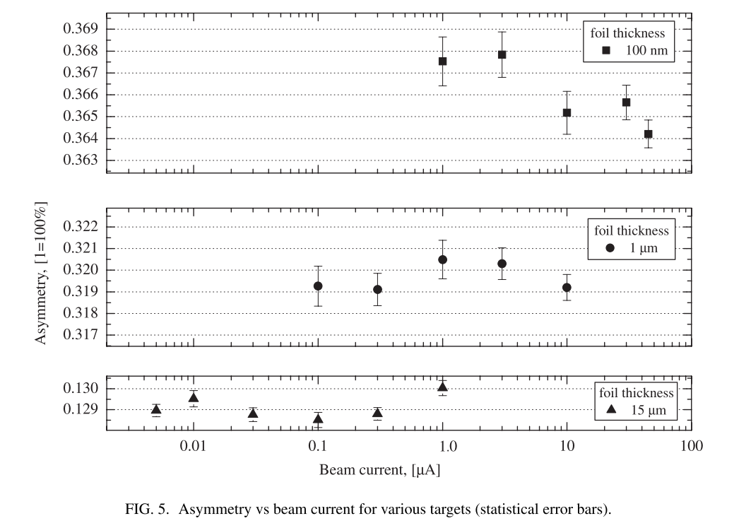
Vector Monitor capabilities
Circular polarized γ‘s: P_{σ}~P_{long}
(to absorber)
P-Vector
Mott scattered e‘s:
A ~P_{trans}
Dynamic Range:
Stability:
Primary beam
V. Tioukine et al. Rev. Sc. Instrum. 82 033303 (2011)
R. Barday et al. 2011 J. Phys. Conf. Ser. 298 012022
Simultaneous measurement:
Polarization Drift consistently observed
in transverse AND longitudinal observable
at the <0.5% level
Demonstration of constant polarization
over large interval in intensities

Slide 11
MESA polarimeter chain
3
2
2
1
3
PV
Polarimeter 1 will monitor the polarization and LINK the two other polarimeters
which operate at different intensity levels
2 Minimal-invasive online polarimeter (ΔP/P ≤ 0.5%) „Hydro-Möller“
Invasive „Double-scattering-Polarimeter“ (DSP) (ΔP/P ≤ 0.5%)
(operates at source energy)

Slide 12
Why is it so difficult to obtain high accuracy ?
Conventional Polarimeter:
Two cases: Single spin asymmetry /double spin asymmetry

Slide 13
“Unconventional” Polarimeters at MESA
3
2
2
1
3
PV
2 Minimal-invasive online polarimeter (ΔP/P ≤ 0.5%) „Hydro-Möller“
3 Invasive „Double-scattering-Polarimeter“ (DSP) (ΔP/P ≤ 0.5%)
The Promise(s):
I „Hydro Möller“ will eliminate Problem of Target Polarization measurement and give
remedy for (almost) all other systematics in Möller polarimetry
II „DSP“ will eliminate the problems of determining S_{eff} altogether
III Both will be checked against each other

Slide 14
What is Polarimeter 2: „Hydro Möller“ ?

Slide 15
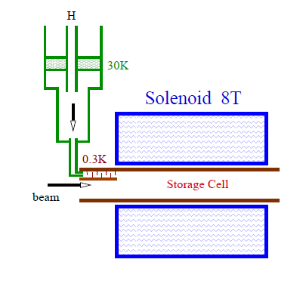

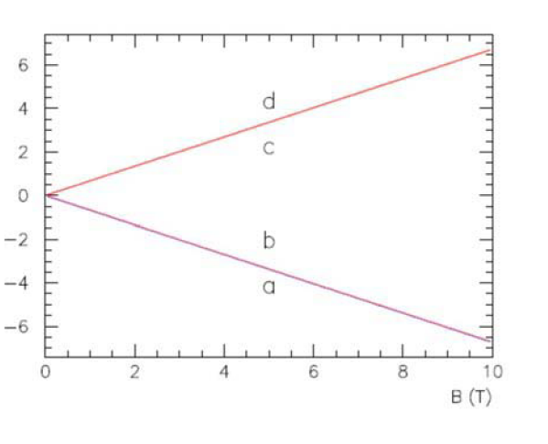

Hydro-Möller
- Utilizing a Polarized Atomic Hydrogen Target
Storage Cell
In a field gradient a force
Pulls into the strong field
Repels out of the field
High rate recombination
(releasing ~ 4.5 eV) at low T ?
Gas: 2-body kinematic suppression
Gas: 3-body density suppression
Surface cell walls coated with
approx 50 nm of superfluid
Density
1-ε % polarization of the electrons
ε ~10⁻⁴

Slide 16
Hydro-Möller
Chudakov&Luppov, Proceedings IEEE Trans. Nucl. Sc. 51, 1533 (2004)
+ measurement is
non-invasive and
+ provides sufficient
statistical accuracy
at the beam current level
of the PV experiment
+ Complete Target polarization
(similar to Laser-Compton)
+ no Levchuk effect
: immense technical effort
: atomic trap has never seen beam
~1m
„Prototype“ of atomic trap was donated to us by UVA/Don Crabb
Template for cryostate development

Slide 17
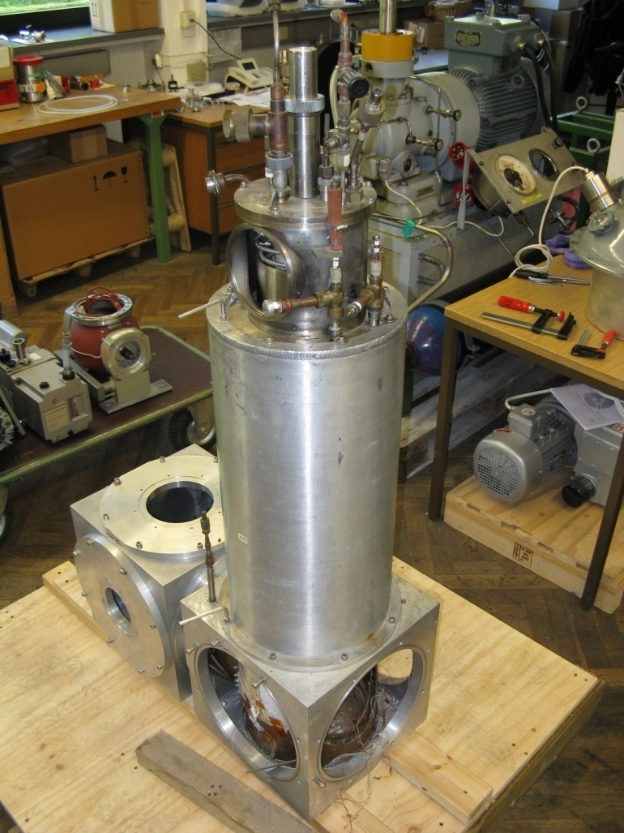
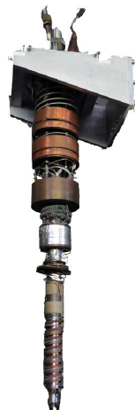
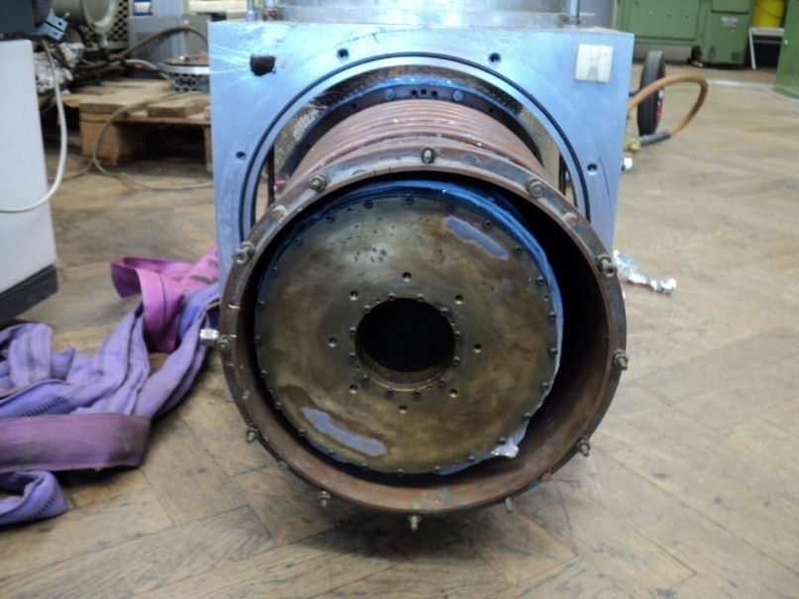
The PROTOTYPE TRAP
T = 300 mK of the atomic trap achieved by using a 3He/4He Dilution Refrigerator
-Dilution refrigerator and magnet
where used at BNL for Prototyping
of polarized proton beam source
in 1990’s
- Shipped from UVA to Mainz (2011)
Refrigerator unfortunately
“not refurbishable”

Slide 18
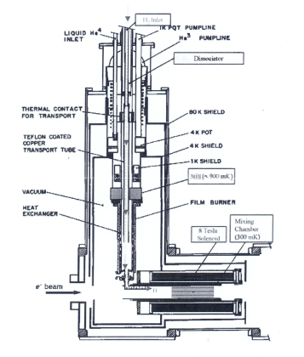
Roadmap of the Hydro Möller at MAINZ
After long and thourough reverse engineering
&discussions with collegues from Dubna, UVA and JLAB
we arrive at the following conclusions:
KPH can & will build a “copy” of BNL cryostat
-1K tests in 2015
-300 mK ~30mW in 2017
- Trap operational and in beam 2018
Open questions:
1.) Beam dynamics
2.) Detection System & 300mK-power req.
3.) Sustain Helium Film?
4.) Beam induced de-polarization?
5.)...
Correlated Möller pair, 75MeV with
up ~1 Cyclotron rotation in 8T field
Steerers
150 MeV beam to PV-Exp also
1 cyclotron rot.
Feedback
BPM‘s

Slide 19
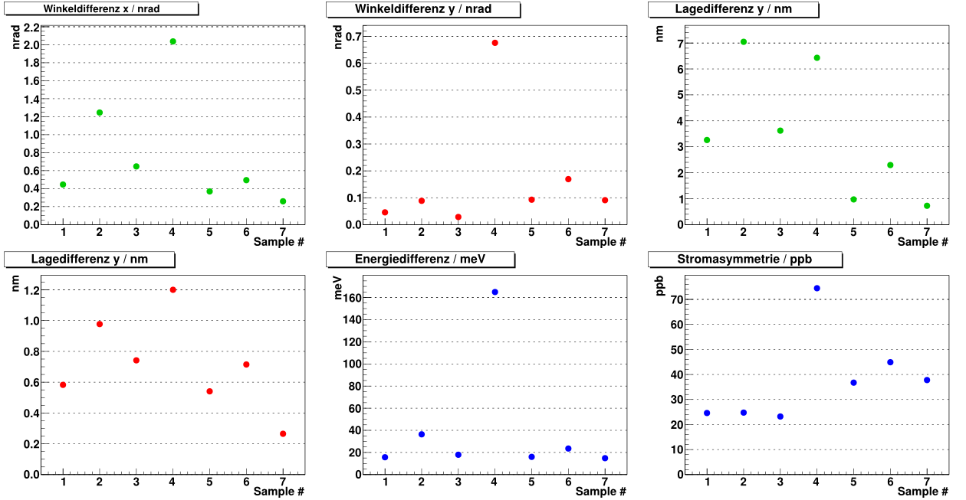
Systematics of A4 @210MeV, extrapolated to 10000h of data taking:
~0.4ppb/10000h
beam angle x
beam angle y
beam position y
~0.05ppb/10000h
beam energy
beam position x
beam current
~2.5ppb/10000h
Required uncertainty 0.1ppb: Really possible to improve position fluctuations in presence
of strong field and short lever arms? → TEST IT

Slide 20
Problems of the Hydro Möller
3
2
2
1
3
PV
2 Minimal-invasive online polarimeter (ΔP/P ≤ 0.5%) „Hydro-Möller“
Is stable „Parity Quality“ operation really achievable with 8T magnet in beamline
and a low energy of 150 MeV?
Longer lever arms for stabilization systems required?
→ Get answer now! Use 180 MeV beam from MAMI-A!

Slide 21
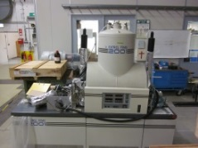
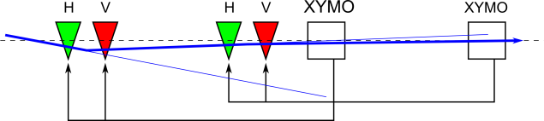
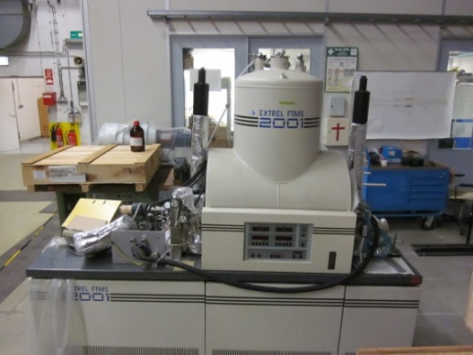
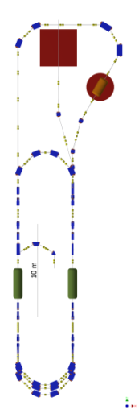
Three topics:
Hydro-Möller-Mock-up-magnet
(3T, available).
Objective: Demonstrate
Parity quality while transmitting
through strong field in front of P2
!
two additional fast WEDL pairs
one additional slow WEDL pair
four additional XYMOs
Objective: Demonstrate
P2-Parity quality beam
Long and short lever arms!

Slide 22
What about Polarimeter 3 ?
3
2
2
1
3
PV
3 Invasive „Double scattering“ polarimeter (ΔP/P ≤ 0.5%)
In contrast to Polarimeter 2, this one already exists
- Small device, testing possible at existing MESA-source
Double scattering Polarimeter makes S_{eff} measurable
What is the working principle?

Slide 23
Polarimeter 3
Gellrich and J.Kessler
PRA 43 204 (1991)
The apparatus of Gellrich & Kessler is in our possesion
Goal:-1 Reproduction of Kesslers claims using test source
Measurements have started in summer 2013, see talk by M. Molitor

Slide 24
Conclusions
3
2
2
1
3
PV
1 Vector-Monitor-Polarimeter
Minimal-invasive online polarimeter (ΔP/P ≤ 0.5%) „Hydro-Möller“
Double scattering polarimter (ΔP/P ≤ 0.5%)
Ambitious polarimetry concept with probably several not yet discovered pitfalls
Ambitioned MESA-Polarimetry team is at work:
Thanks to: P. Aguar, M. Bruker, J. Diefenbach, T. Stengler, M. Molitor, V. Tioukine,
Fruitful and continuing discussions with many people and institutions! Thanks to:
V. Borisov, V. Usov (DUBNA), D. Crabb (UVA) D. Keith (JLAB),
W. DeKoninck (William and Mary) and many more

Slide 25
More remarks
DSP works at ~100keV; ideal for ‚1mA-MESA-stage-1
Targets not extremely thin (~100nm)
Elimination of apparatus asymmetry depends critically on geometrical arrangement of normalization counters
Apparatus calibrates S_{eff}, but does not allow to measure S₀
Claim: Inelastic contributions do not jeopardize the accuracy!
potential issues
→ how to use with polarized beam?
→ What if the two targets are NOT identical?
Hopster&Abraham (1989):
No problem, If a switchable polarized beam is available (|P+|=|P-|),
the first target may then be treated as an auxiliary target
which may be exploited for systematic cross checks

Slide 26
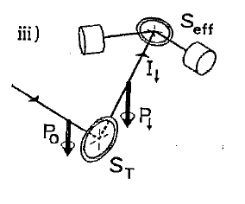
HopsterAbraham/Kessler Method
5 equations with four unknowns→
consistency check for apparative asymmetries!
→ Results achieved by Kessler were consistent <0.3%
S. Mayer et al
Rev. Sci. Instrum. 64 952 (1993)

Slide 27
Conclusion:
low and a high energy polarimeter cross-check:
negl. depolarization due to low energy gain of MESA
Monitoring, stability and cross calibration can be supported by
extremely precise Mott/Compton combination.
Hydro Möller + DSP may obtain ΔP/P <0.5 % each,

