Slide 1
Heat load and stress studies of the ILC collimator
G. Moortgat-Pick^{1;2} S. Riemann², F. Staufenbiel², A. Ushakov¹
¹University of Hamburg
²DESY
International Linear Collider
ILC positron production source (polarization depends on beam collimation)
Collimator designs and its dynamical heat and stress loads
Collimator cooling and average temperatures
Collimator activation and radiation damage
Conclusion

Slide 2
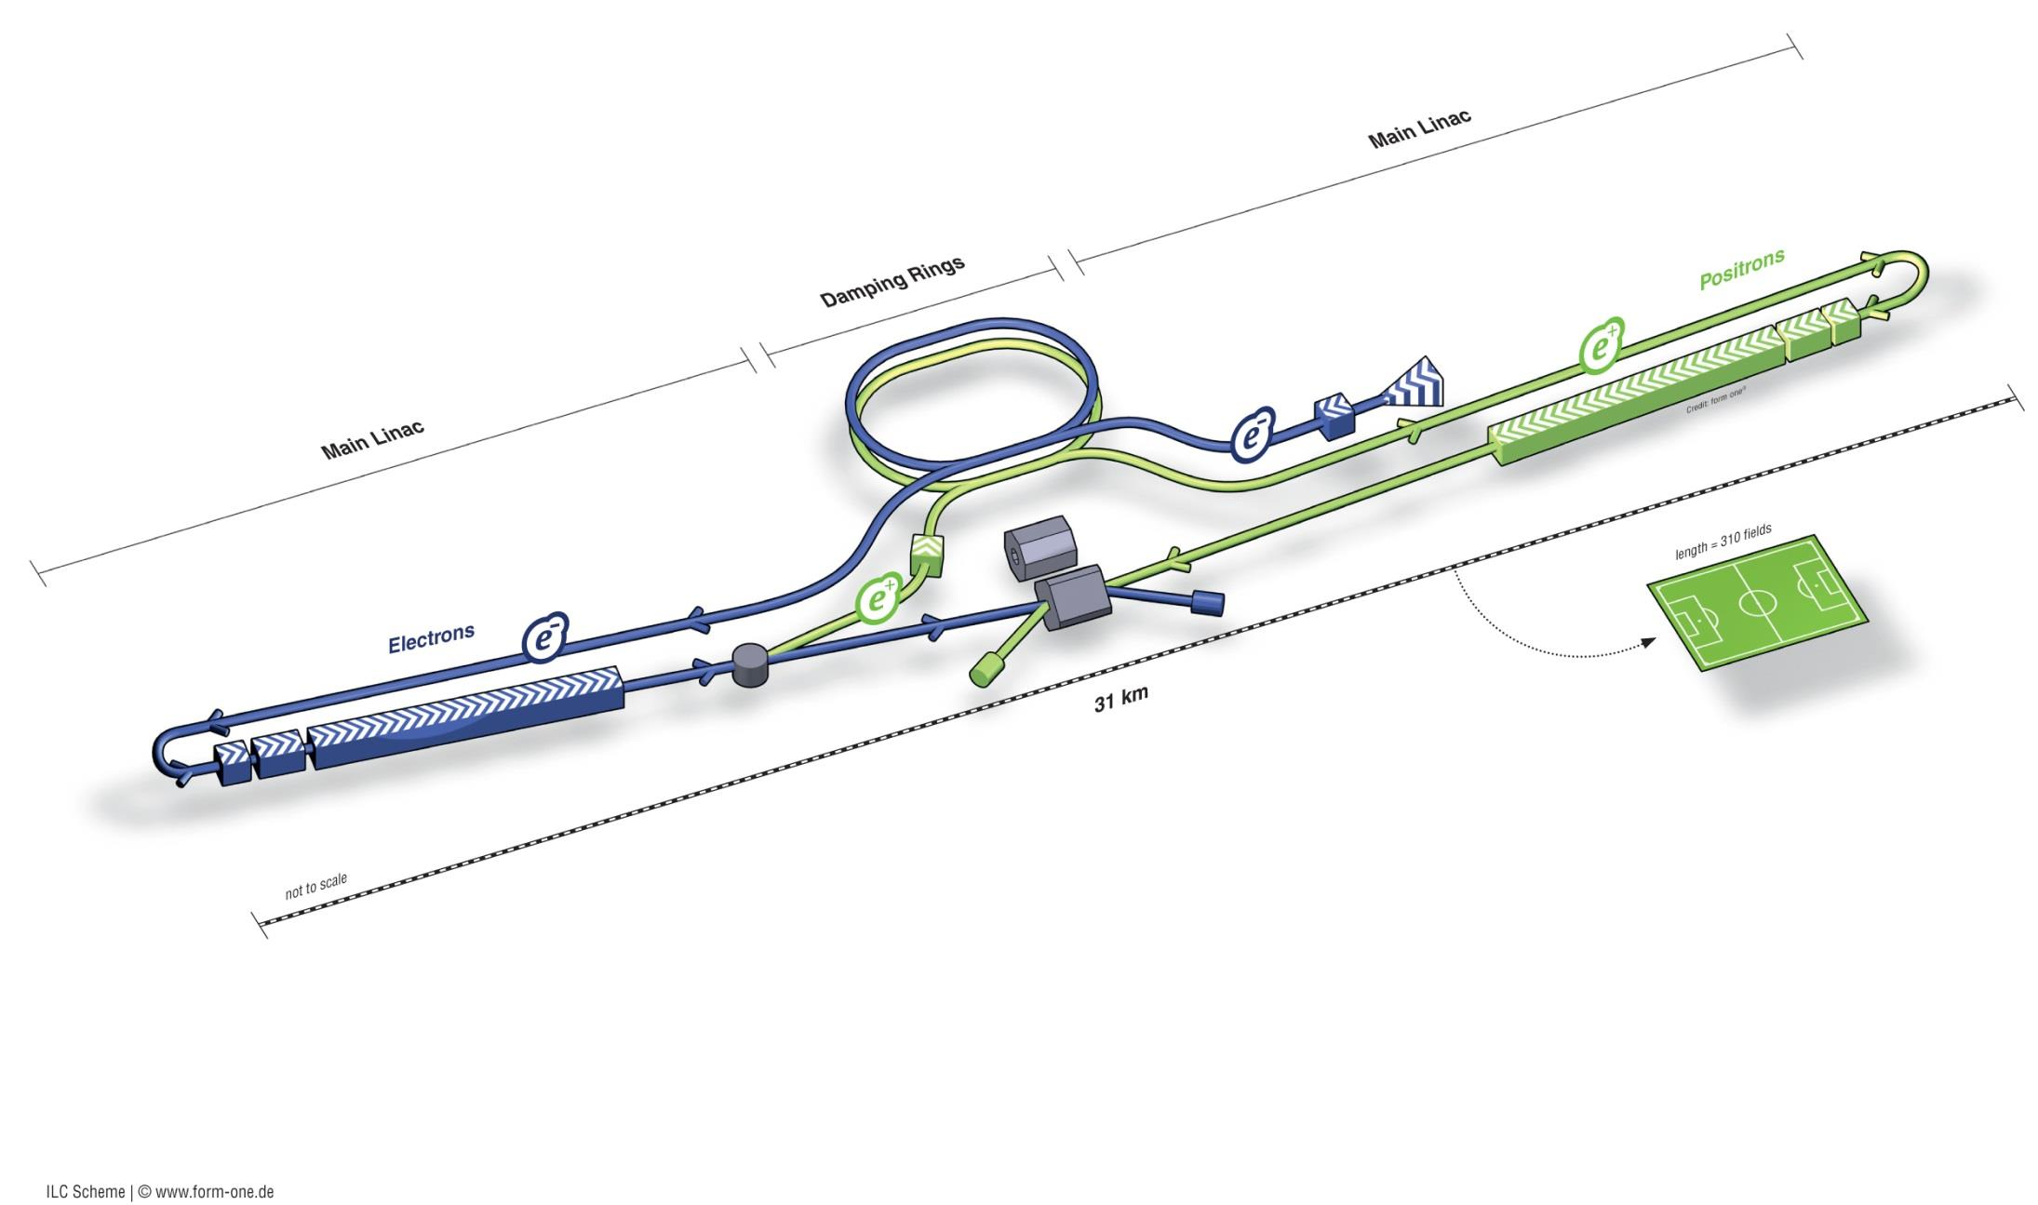
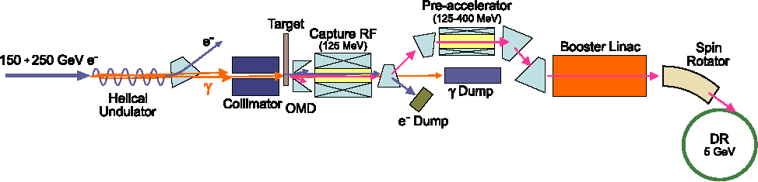
International Linear Collider
Undulator based polarized positron source

Slide 3
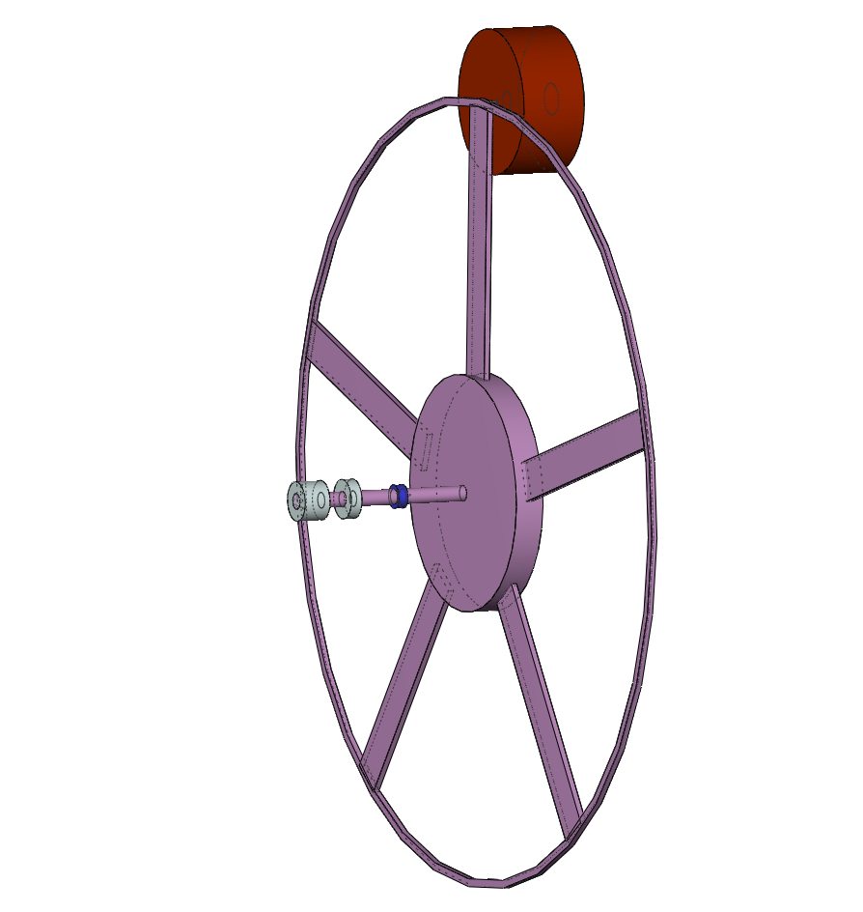
ILC target unit (Ti wheel and collimator stages)
Ti6Al4V target for polarised
positron production
e⁺
150-250 GeV e⁻
photon beam
collimator stages
helical undulator
distribution of
heat load !!
v_{rim} ≈ 50-100 m/s
(1000- 2000 rpm )
r
r = 0.5 m

Slide 4
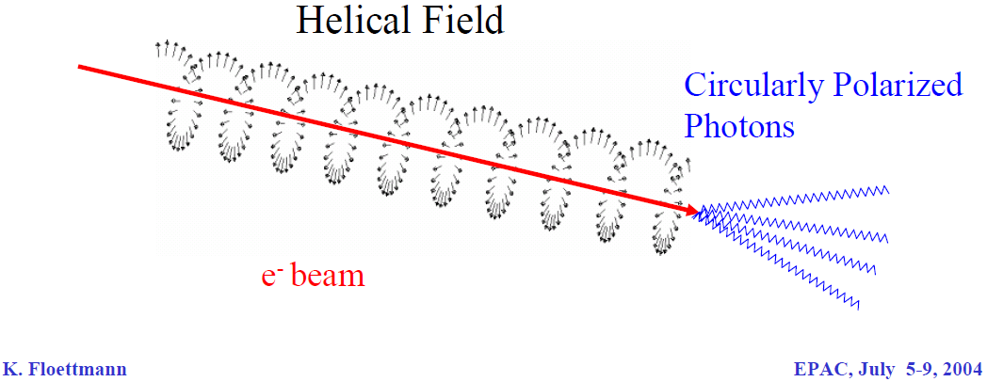
collimator
Collimator aperture [mm] | CMS energy [GeV] | Drive beam energy [GeV] | Polarization e+ | Absorbed power [kW]
2 mm | 250/240 | 150/125 | 55% | 49/42 (50/62%)
1.4 mm | 350 | 175 | 59% | 69 (61%)
1.0 mm | 500 | 250 | 50% | 87 (52%)
0.7 mm | 500 | 250 | 59% | 255 (75%)

Slide 5
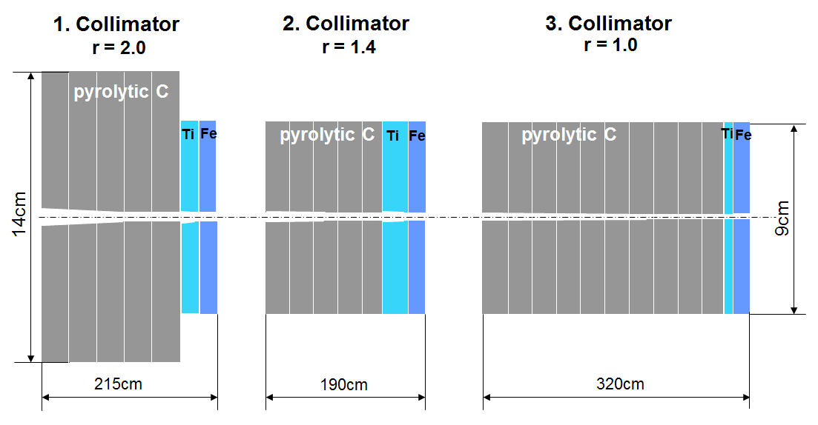
ILC positron source unit
10 Hz 125/150GeV e⁻ , P_{e+}= 55%
5 Hz 175GeV e⁻ , P_{e+}= 59%
5 Hz 250GeV e⁻ , P_{e+}= 50%

Slide 6
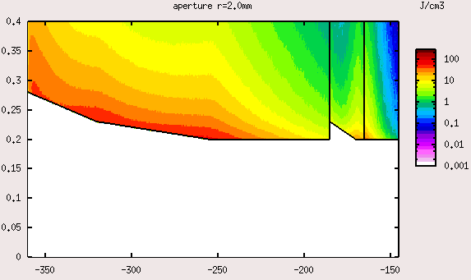
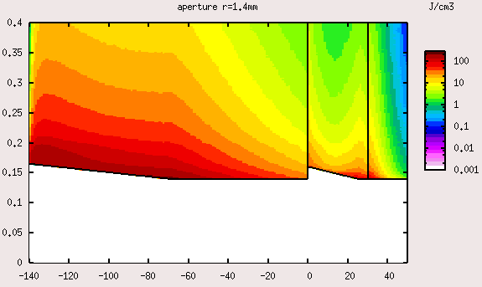
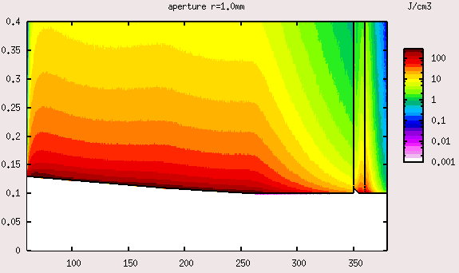
Energy distribution of a multistage photon collimator / 250 GeV (high lumi)
E_{max} = 27 J/g
1.Collimator
E_{max} = 93 J/g
2.Collimator
E_{max} = 120 J/g
3.Collimator
C Ti Fe C Ti Fe C TiFe
10 % 18% 24%
17.2 kW 29.7 kW 40.1 kW
166.2 kW
photon beam
(beam jitter !)
87.0 kW (52%)
collimator absorption
Z_{coll total} = 215 cm + 190 cm + 320 cm = 725 cm

Slide 7
Energy distribution of a multistage photon collimator / 250 GeV (high lumi)
100 μm mismatch of the beam
E_{max} = 27 J/g 37J/g
1.Collimator
E_{max} = 93 J/g 115J/g
2.Collimator
E_{max} = 120 J/g 151 J/g
3.Collimator
C Ti Fe C Ti Fe C TiFe
10 % 18% 24%
17.2 kW 29.7 kW 40.1 kW
166.2 kW
photon beam
(beam jitter !)
87.0 kW 87.3 kW (52%)
collimator absorption
Z_{coll total} = 215 cm + 190 cm + 320 cm = 725 cm

Slide 8
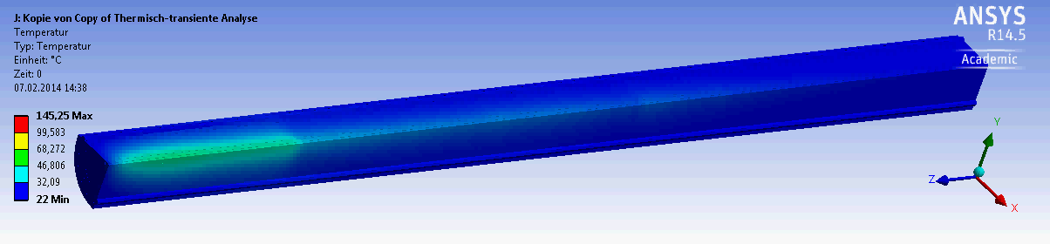
Average temperature with collimator cooling / 175 GeV 5Hz

Slide 9
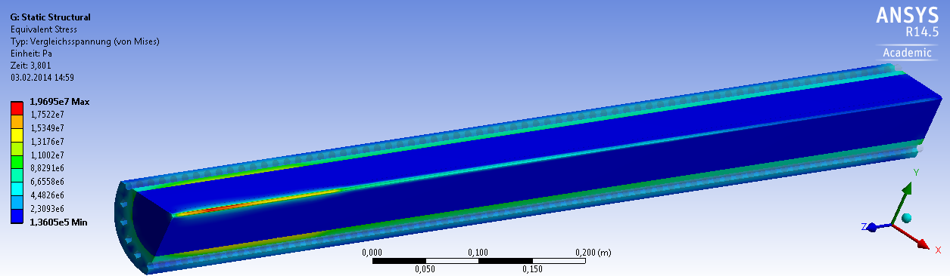
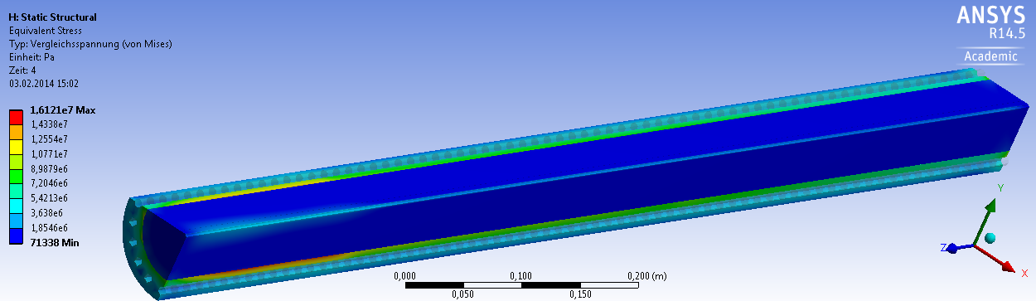
Induced stress by temperature / 175 GeV 5Hz
pyr. carbon
water
copper
ultimate tensile strength : 90MPa

Slide 10
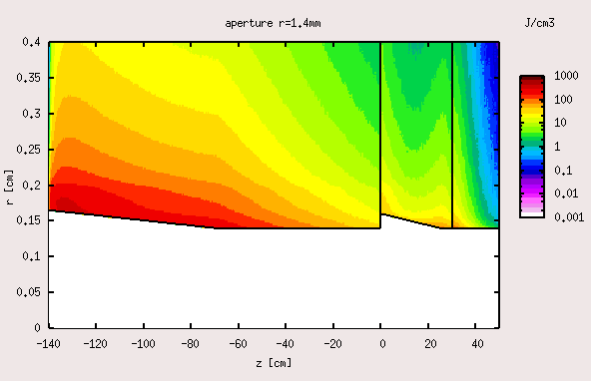
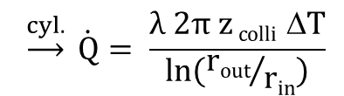


Average temperature with collimator cooling / 175 GeV 5 Hz
$$\underset{→}{cyl.} \dot{Q}= \frac{λ 2π z colli ΔT}{ln\left({rout}/{rin}\right)}$$
2.Collimator (single bunch train)
radial heat flow
25.9 kW
C Ti Fe
z_{colli}
0.05 l/s
Cu
+
$$Tout$$
cooling channels
∅ 8mm = d_{ch}
7.71mm
spacing
r_{in}
$$Tin$$
C / Ti / Fe
average T_{in} = 74 °C
2cm
∅ 2 r_{out}

Slide 11
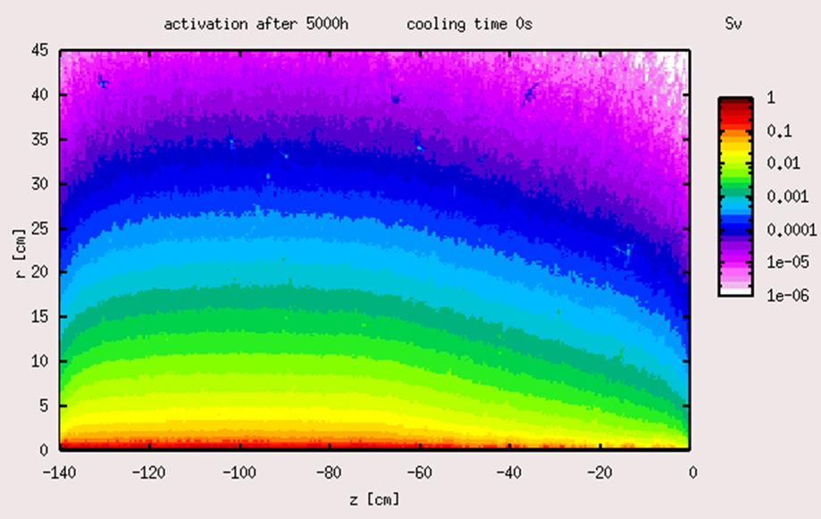
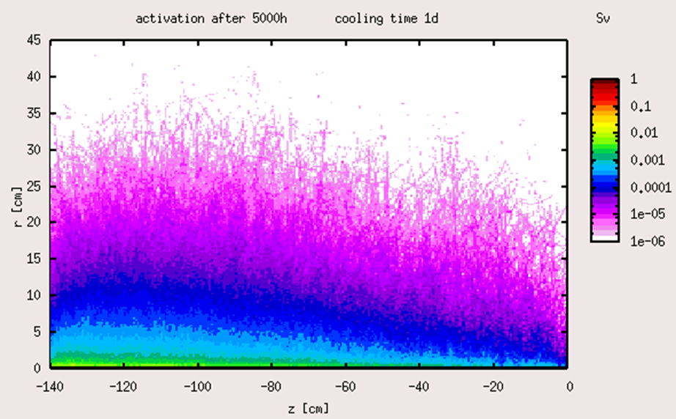
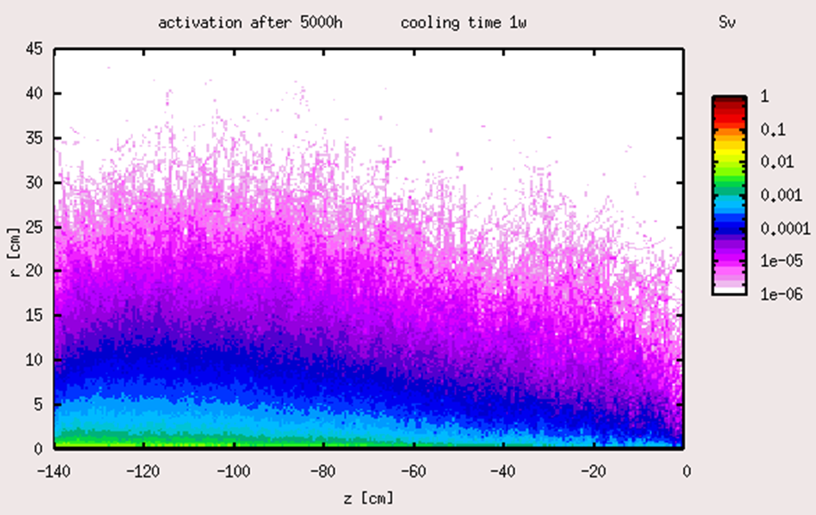
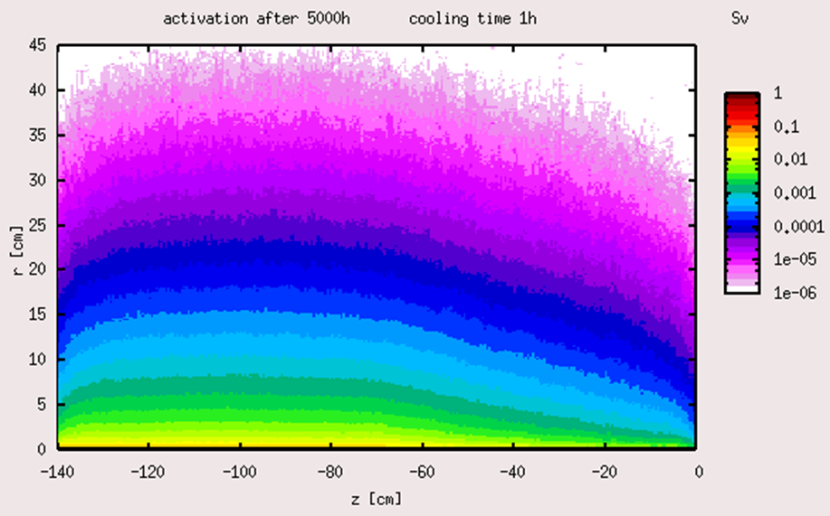
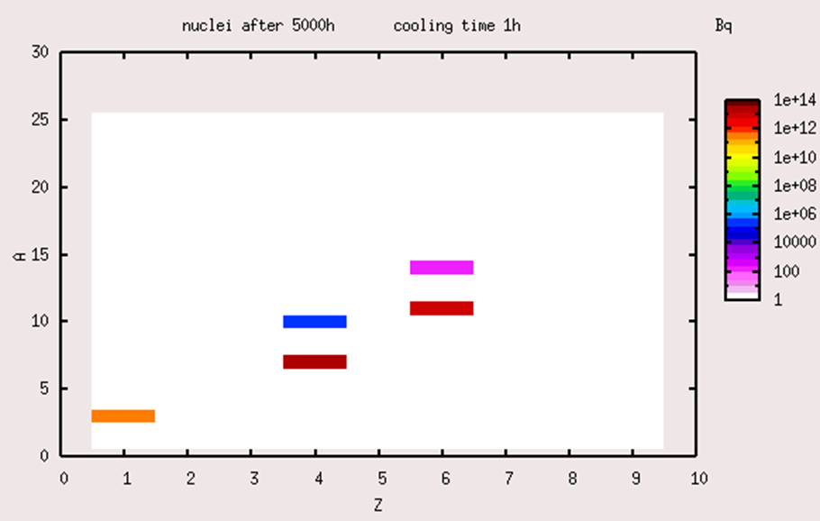
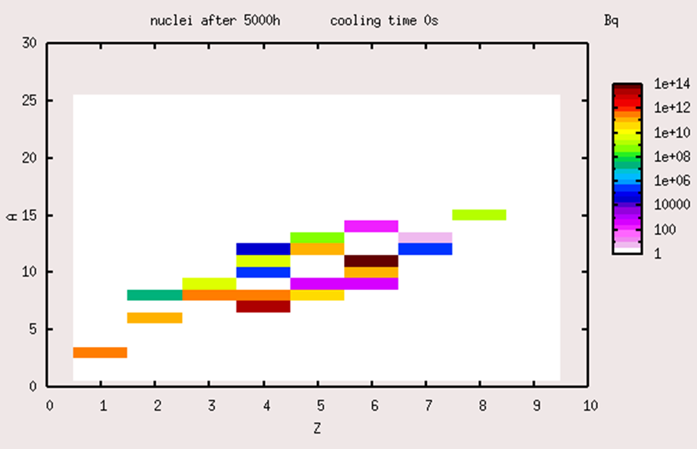
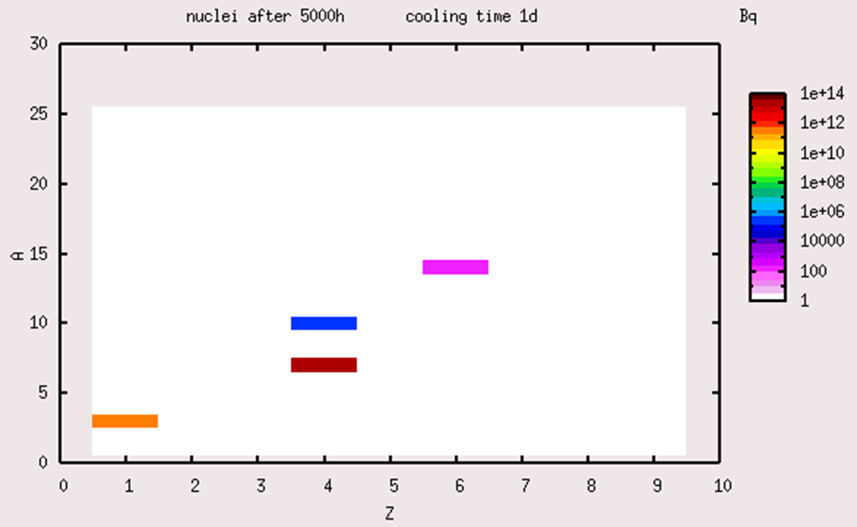
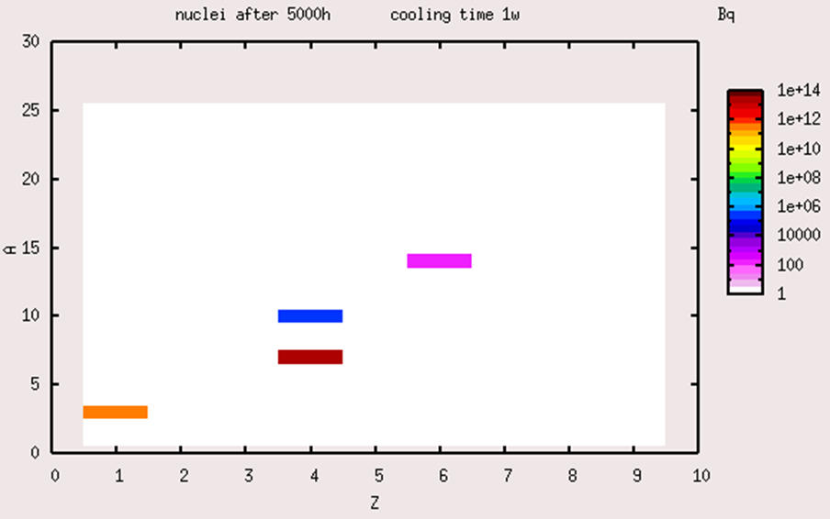




Activation and radiation damage / 175 GeV 5 Hz
2.Collimator / pyr. graphite
First results !
Have to be checked !
$${}_{6}^{14}C (5730 y)$$
$${}_{4}^{10}{Be} (1.5e6 y)$$
$${}_{4}^{7}{Be} (53.3 d)$$
$${}_{1}^{3}H (12.3 y)$$

Slide 12
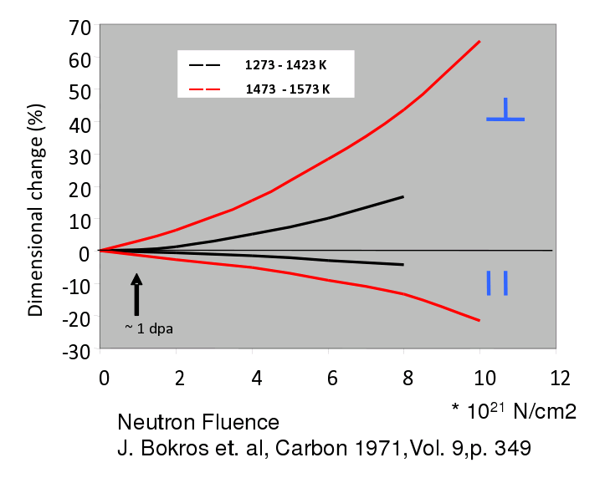
Displacement per atom / 175 GeV 5 Hz
2.Collimator / pyr. Graphite
First results !
Have to be checked !
5000h ≈ 1-2 dpa
T ≈ 400K
talk from Mike Seidel, PSI, 2013 at BNL, US

Slide 13
Conclusion
Positron polarization should be possible between 50% and 60% for the introduced
ILC drive beam parameter sets
The collimator design achieved the stress limits of the materials for the proposed
parameter sets for a long runtime (including safety factors)
The dynamical calculations for the collimator with ANSYS are done and shows no
critical results
The absorbed average power and the collimator cooling should be not difficult
for this introduced design
The radiation damage (dpa) and the swelling/deformation of the collimator
should be not critical
Produced isotopes with a long decay time must be handled after use

